Slide 1
Read me
Start by understanding the value proposition for Microsoft Devices
as a catalyst for Digital Transformation (pitch deck).
Use this industry deck to convey the value of the portfolio to this specific audience. Key scenarios and customer stories are included.
For product deep dive decks, use the Microsoft Book, Microsoft Studio, Microsoft Surface Pro, Microsoft Lumia, or Microsoft HoloLens decks.
For Microsoft sellers
Windows FSI Deck
Windows Security FSI Deck
MSFT Devices Pitch Deck: visit Infopedia/Sales & Marketing/Devices (1st party) then click Portfolio.
Product decks: visit Infopedia/Sales & Marketing/Devices (1st party), then select the product of interest.
Industry apps & demos: Click here for the latest Surface apps and demos deck for Financial Services.
For Partner sellers
Talk to your Microsoft PCMM or PSE for the latest readiness and marketing content. It lives on Drumbeat.

Slide 2
Let’s discuss your current business challenges
Notes:
Jot these down with Surface Pen on the screen…
Pressures on your industry
Challenges your business is facing. Do they fall into these catagories:
1. empowering employees
2. engaging with customers
3. finding operational efficiencies
4. transforming your products or services
How does technology currently play a role?
How is technology holding you back?
What are the main user types/scenarios in your business?
What technology do they currently use?
What sort of improvements would you like to see? Are there metrics you’re trying to meet? (increased productivity, improved operations, improved sales close rates?)

Slide 3
Microsoft Devices for Financial Services
Name
Title
*Software shown is sold separately.

Slide 4

There are huge pressures facing the financial services sector
Unforeseen risks from unknown quarters
High regulatory scrutiny and oversight
Lost customer loyalty
Cost and margin pressures
Historically low interest rates
High catastrophe losses and challenging underwriting environments
Increasing customer demands for technological solutions
Notes:
Performance insight
Bullet 1: Firms have pushed the envelope with asset classes and derivatives that make it very difficult to assess all levels of risk accurately and in a timely manner. Every additional tick of the clock required to calculate credit, together with market risks, limits the business considerably.
Bullet 2:New regulations are on the increase but many still remain ambiguous that firms have to navigate unchartered business issues, while at the same time trying to decipher what the regulatory implications mean for their business.
Lost loyalty
Bullet 3: The financial crisis and often scathing news headlines about disreputable lending and government bailouts has led to a lack of consumer confidence. Financial institutions, more than ever, need to service their existing customers to avoid attrition.
Margin pressures
Bullet 4: It is becoming more expensive to conduct business. We are also seeing eroding margins from price pressures, but also an increasing burden of complex legacy technology that is becoming inefficient to operate and expensive to modernize.
Bullet 5:Due to the economic crisis and historically low interest rates, insurance carriers cannot offset catastrophe losses and underwriting performance with their portfolio returns as they had done before.
Bullet 6: Many carriers are facing challenges in pricing policies at the desired level due to competitive pressures, the economic crisis and the fact that customers no longer have funds readily available to buy as many insurance products as in previous years.
Technology demand
Bullet 7: Technology is an intrinsic part of the business of banking – and the gap between technology capabilities and consumer adoption vs bank system capability is widening. Customers are demanding high social connectivity, they’re using more mobile devices and they’re moving towards cloud services for cost and agility .
These global trends are expected to continue for the foreseeable future, significantly changing the shape of the total financial services landscape.

Slide 5
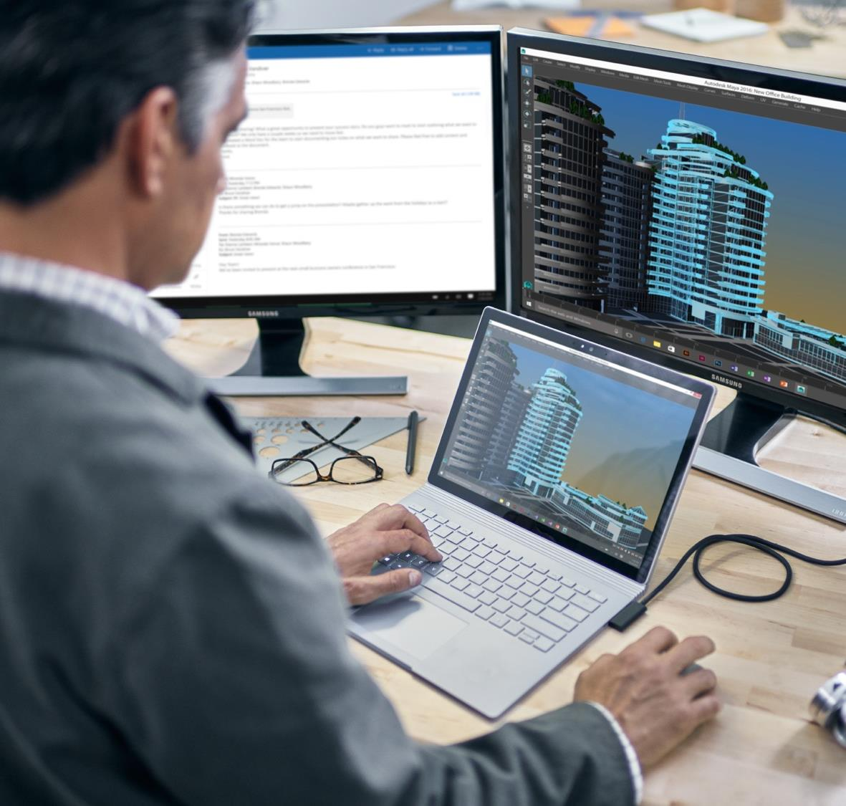
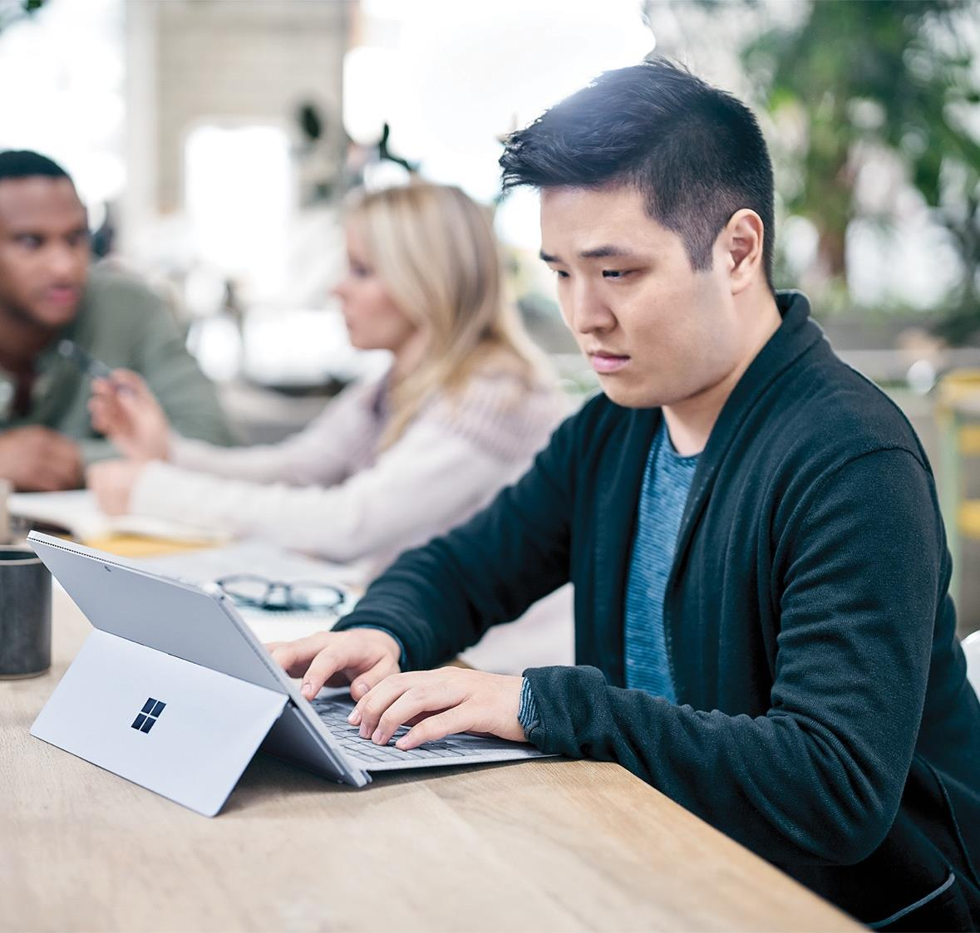
And new demands from customers
Digitization continues to drive huge change
in customer expectations and the ability of financial organizations to adapt.
The rise of Fintech has raised the bar for customer experience and service delivery.
Customers want flexibility. They want to be able to self-service, as well as receive high-quality service face-to-face when they need it.
The financial services sector needs to
expand digital capabilities, to meet customer expectations, whilst continuing to deliver excellent customer service by embracing
the role of technology in doing that.
Notes:
Most CEOs recognise the need to evolve, but research shows that 84%* of digital initiatives are failing, and companies often lack a coherent strategy to deliver successful digital transformation.
Bullet 1: The financial services sector is under more pressure from digital disruption than any other industry.
Bullet 2: Young, rapid-growth financial services companies are taking advantage of Fintech to create new competition for traditional providers.
Bullet 3: Financial services organizations know that there’s still value in the human touch

Slide 6





Windows 10 security for modern devices
Device protection
Threat resistance
Identity protection
Information protection
Breach detection, investigation, and response
Virtualization-based security
UEFI Secure Boot
Windows Trusted Boot
Windows Update
Trusted Platform Module
Device Guard
Microsoft Edge
Windows Defender
Windows Firewall
SmartScreen
Credential Guard
Windows Hello Companion Devices
Windows Hello
Device Encryption
Windows Information Protection
BitLocker Admin and Monitoring
BitLocker
BitLocker To Go
Accessories
AES keyboard
Security Management
Conditional access
Windows Defender Advanced Threat Protection
Pre-breach
Post-breach
Notes:
Device protection
Virtualization Based Security. If a process, or data, is virtualized, then it is isolated from the rest of the operating system, and therefore it is more difficult to tamper with.
UEFI Secure Boot. UEFI will check the boot loader before launching it and ensure it’s signed by Microsoft. If a rootkit or another piece of malware does replace your boot loader or tamper with it, UEFI won’t allow it to boot.
Windows Trusted Boot, used in combination with UEFI Secure Boot, helpsmake sure that your PC boots more securely and that only trusted software can run during start-up.
Windows Update. Windows Update is used to keep Microsoft Windows and several other Microsoft programs updated. Updates often include feature enhancements and security updates to protect Windows from malware and malicious attacks.
Trusted Platform Module: A TPM chip is a secure crypto-processor that is designed to carry out cryptographic operations. The chip includes multiple physical security mechanisms to make it tamper resistant, and malicious software is unable to tamper with the security functions of the TPM.
Threat resistance:
Windows Device Guard helps enhance your threat resistance against malicious apps and firewall attacks.
Microsoft Edge is a web browser developed by Microsoft and included in Windows 10, Windows 10 Mobile, Xbox One, and Windows Holographic, replacing Internet Explorer as the default web browser on all device classes.
Windows Defender Application Guard is similar to Device Guard, but is specific for Internet browsing via Microsoft Edge. You create a company-approved whitelist of approved websites and URLs that can be run. Then, when someone attempts to run a URL not on that list, it opens in a virtualized container.
Windows Firewall is a software component of Microsoft Windows that provides firewalling and packet filtering functions.
Microsoft SmartScreen is a phishing and malware filter implemented in several Microsoft products including Internet Explorer, Microsoft Edge and Outlook.com,
Identity protection:
Windows Credential Guard helps protect user access tokens so you know that the people logging on to your network are authorized to do so.
A Windows Hello companion device is a device that can act in conjunction with your Windows 10 desktop to enhance the user authentication experience.
Windows Hello* enables native, multi-factor authentication. Bear in mind that Windows Hello requires specialized hardware such as fingerprint reader, illuminated IR sensor, or other biometric sensors depending on the authentication enabled.
Information protection:
Device encryption helps protect your data by encrypting ("scrambling") it. Only someone with the right encryption key (like a password) can decrypt ("unscramble") it.
Windows Information Protection. Microsoft Azure is a cloud-based solution that helps an organization to classify, label, and protect its documents and emails
BitLocker Admin and Monitoring MBAM simplifies deployment and key recovery, provides centralized compliance monitoring and reporting, and minimizes the costs associated with provisioning and supporting encrypted drives.
BitLocker. BitLocker Drive Encryption is a data protection feature that integrates with the operating system and addresses the threats of data theft or exposure from lost, stolen, or inappropriately decommissioned computers.
BitLocker to Go. You can use BitLocker Drive Encryption to encrypt your sensitive data on the main hard drive of your PC, and then you can use BitLocker To Go. This last feature will help you to use encryption on remove drives and secondary hard drives connected to your computer.
Accessories:
AES keyboard. All Microsoft USB keyboards have Advanced Encryption Standard AES built-in. This encrypts your keystrokes. The keyboard is permanently paired with its receiver at the factory—no key information is ever shared over the air.
Breach detection investigation and response
Security Management – I’m not sure what this is referring to
Conditional Access. Allows you to prevent access for BYODs that do not meet security standards.
Windows Defender Advanced Threat Protection (ATP) enables you to detect, investigate, and respond to advanced threats and data breaches on your network. It’s a powerful tool that is designed to run alongside any anti-virus solution.

Slide 7

Secure your identities
A financial advisor is working remotely in the lobby before a client appointment. She turns on her Windows 10 device and logs in to do some work.
FINANCIAL ADVISOR
Helps customers plan for retirement
Meets with clients in a variety of locations
Accesses sensitive data on desktop and mobile devices
Windows Hello*
Enables native support of multi-factor authentication—such as biometrics or companion device —to validate users.
Helps ensure that she’s the only person who can sign-in to the device and gain access.
* Windows Hello requires specialized hardware such as fingerprint reader, illuminated IR sensor, or other biometric sensors depending on the authentication enabled.
Notes:
Suggested slide time: 5 minutes
Key points to cover
Transition to scenario stories to talk about Windows 10 features in the day of a financial services organization.
Here, focus on Windows Hello functions and benefits.
Speaker notes
Use case
I’d like to step back now to the roles within your organization—to try to put their challenges in context.
Let’s look at a typical day in the life of a financial institution, possibly similar to yours. As you know, there are numerous roles that come together to keep the organization running. Some of your team work in-office each day, while others are almost always out in the field.
We’ll start by examining mobile roles—people like financial advisors or relationship managers. These folks frequently travel to client meetings that take place in offices, coffee shops, etc.
In this scenario, a financial advisor is out on the job with her device, which she uses to prepare for meetings and present portfolios to her customers. This is very efficient for the advisor—she no longer has to carry paperwork and folders to each meeting, but rather can access account information with her device. But, it means her device must be highly guarded. She and only she should be able to access the info on that device, due to the sensitive nature of the data it contains.
That’s where Windows 10 features come in. As a financial advisor or insurance agent boots up her Windows 10 device, she must login using Windows Hello¹. This uses multi-factor authentication such as Next Gen Credentials (NGC). NGC goes beyond passwords to use things like biometrics or PIN validate by one-time password (OTP), code, or phone factor. This measure provides an extra layer of security against hackers and helps prevent the wrong person from logging and accessing the data on her device.
Real data
To bring this situation home, consider this statistic: Among the top 10 most popular hacking methods are unmanaged personal devices and compromised accounts. ² <Note to presenter: this is a general statistic, not financial services specific>
Features
Windows Hello¹ requires two or more factors of user validation, such as biometrics (fingerprints) and your device, to set up the credentials you will use for authentication. This makes it harder for an attacker to actually compromise the devices your team uses. With Windows 10, you can protect devices so that only the right person signs in to a device and gains access to data, such as personal customer data and account numbers.
Benefits
The takeaway here is that no matter where they are—in the office or in the field—only the right people can log in to their device. No one else.
For the presenter
To learn more about Windows Hello and multi-factor authentication for yourself, reference the Windows 10 Commercial Storybook https://microsoft.sharepoint.com/sites/Infopedia_G02KC/Pages/Custom/Windows10Storybooks.aspx
[Advance slide]
Notes:
¹ Windows Hello requires specialized hardware such as fingerprint reader, illuminated IR sensor, or other biometric sensors depending on the authentication enabled.
² https://www.balabit.com/news/press/social-engineering-leads-the-top-10-list-of-most-popular-hacking-methods-balabit-survey-results-from-black-hat-usa

Slide 8

Secure your identities
A VP of marketing is starting his day and opens a genuine-looking email, appearing to come from a trusted source. He sees a URL included in the mail and clicks it.
CORPORATE EXECUTIVE
Manages company projects
Receives lots of high-priority email
Engages with many different business partners
Credential Guard
Stores his user access token credentials away from the operating system in a virtualized environment.
Protects credentials—even if something happens to his device, his tokens aren’t exposed and he is better protected.
Notes:
Suggested slide time: 5 minutes
Key points to cover
Focus on Credential Guard functions and benefits.
Speaker notes
Use case
Now let’s move to the headquarters, where an executive is reading email. This VP of marketing clicks on a genuine looking email that appears to come from one of his business partners. He sees a link in the email and clicks it—but unbeknownst to him, it contains malware. The link activates the code and ultimately gives the hackers a way insider his machine to see his activity. Now, consider that this executive is often handling sensitive data—which, if in the wrong hands, could be compromised.
Feature
Behind the scenes, Credential Guard protects the user access tokens that are generated once your users have been authenticated. So even if a device is compromised, the credentials are not available to the attacker. With user access tokens, an attacker could access your resources by effectively impersonating a user’s identity. Credential Guard stores user access tokens within a virtualization-based security environment running on Hyper-V, away from the Windows 10 kernel. This helps safeguard you from Pass-the-Hash and other advanced persistent attacks. And Credential Guard can be enabled using Group Policy, making it easy and familiar for your IT staff to administer using the existing management tools they have in place.
There is one more feature that has been around for a while—BitLocker—that we should also briefly cover here. In the event that a device is stolen (for example, if the VP leaves her office door unlocked and the device is taken), the content within it is better protected and encrypted with BitLocker.
Real example
Let’s consider a real scenario for a moment to bring this home. In Singapore, a malware file attached to a spear-phishing email was received by a bank employee. The malware went undetected and ran on multiple platforms. Similarly, a malware called DireWolf targeted corporate banking accounts and hackers stole more than $1M from banking companies.¹
Benefits
With Credential Guard, the user credentials are better protected against theft, breach, and phishing—all with no additional hardware required. So even if an employee takes an action that would otherwise lead to exposure, it can be halted.
For the presenter
To learn more about Credential Guard, reference the Windows 10 Commercial Storybook https://microsoft.sharepoint.com/sites/Infopedia_G02KC/Pages/Custom/Windows10Storybooks.aspx
[Advance slide]
Sources:
¹http://www.computerweekly.com/news/450280227/Adwind-at-centre-of-cyber-attack-on-Singapore-bank

Slide 9

Protect enterprise data
A product manager is preparing a proposal for a new product, incorporating sensitive internal and external data. She accidentally copies and pastes this research to a public social app.
PRODUCT MANAGER
Creates and approves product roadmaps
Works with internal and external data
Prepares reports to share recommendations with her team
Windows Information Protection
Separates her personal and business data and encrypts data per policy.
Notifies when she takes an unauthorized action—but otherwise works seamlessly in the background so she’s not distracted.
Notes:
Suggested slide time: 5 minutes
Key points to cover
Windows Information Protection (WIP) feature function and benefits.
Speaker notes
Use case
Throughout their day, product managers deal with a lot of secure information. They may dive into data and results from your own business, such as financials, and also research competitors.
In this scenario, a product manager is working on a presentation for her team, including a recap of the year to-date, as well as ideas for the next two quarters. She is copying and pasting sensitive corporate data into a different document for her team.
To take a small break, she goes to Facebook to post a status update. Her post is unrelated to work—but she accidentally pastes in some of the corporate data that she’d just been looking at. Windows Information Protection (WIP) stops her before she makes the post, warning her before content is copied to an unauthorized website.
Real example
In the example scenario, we’re putting the trust on the product manager that she did not intentionally wish to leak data. Hers was an error.
But in some cases, there’s malicious intent. Take the example from 2015 of a Morgan Stanley employee who intentionally captured customer data—900 clients’ worth—and posted it on a known site called Pastebin, with potential to sell this client data to identity thieves. ¹
Features
So you see, Windows Information Protection (WIP) distinguishes between corporate and personal information and encrypts the data per policy. All seamlessly for your users.
With WIP, this happens under the hood, unseen by the user. It’s only when a policy kicks in that they see the info. This is great news for employees who may otherwise be distracted by policy configurations—and for you, to ensure that data is secured.
Here’s a bit more about what WIP can do:
Separate personal and professional data.
Windows Information Protection (WIP) helps IT and users prevent accidental leaks by separating personal and business data. WIP allows IT administrators to apply rules to control how business data can be used. WIP recognizes business data as it arrives on devices, is generated by business applications, or when it is designated as business data by the user. What this means is your security team can set policies for corporate data. Even if a user stores corporate data on a personal device, the encryption policies will stay with the files.
User and app access control.
WIP enables IT to set policies that define which applications and users are authorized to access business data. WIP also enables IT to define which rights a user has, allowing IT to either help block leaks or, optionally, help warn the user before content is copied to unauthorized websites and personal documents (as in our scenario story, above).
WIP also helps protect business data that is placed on removable storage by ensuring all business data is encrypted and accessible only by authorized users. So if your users store corporate data on a personal USB device, for example, the files are encrypted.
Provides greater IT control with a seamless experience for users.
Business data protection takes place completely behind the scenes. Users only get notifications when they’re attempting to take an unauthorized action. So they aren’t distracted or interrupted by policies.
And, your IT team has full control of keys and protected data, making it easy to perform a remote wipe of business data on demand while leaving personal data untouched.
Benefits
WIP gives you enterprise-ready security that is easy to manage and use—for mobile and desktop platforms.
WIP allows you to encrypt files at the file level to help ensure only the right user can access the file. It also helps prevents copy and paste, as we saw in the example.
Your big takeaway is that your users remain focused on getting work done, and you get the corporate data protection you need with straightforward manageability.
For the presenter
To learn more about WIP for yourself, reference the Windows 10 Commercial Storybook https://microsoft.sharepoint.com/sites/Infopedia_G02KC/Pages/Custom/Windows10Storybooks.aspx
To share more information about WIP with your customer, you can visit this TechNet page: https://technet.microsoft.com/en-us/itpro/windows/keep-secure/protect-enterprise-data-using-wip
[Advance slide]
Source:
¹ http://www.forbes.com/sites/antoinegara/2015/01/05/morgan-stanley-fires-rogue-employee-after-customer-data-leak/#943e4e105d9b

Slide 10

Enhance threat resistance
A teller working in a bank receives a genuine-looking email that he thinks came from his company’s IT department. He tries to install an app update to a company-used program.
BANK TELLER
Engages with and assists customers
Accesses customer accounts and dispenses money
Uses desktop and mobile devices for transactions
Device Guard
Restricts what can be installed on the device and allows the teller to only install apps that are trusted and approved by IT.
Works behind the scenes to help prevent unauthorized apps from gaining access to the agency’s network.
Notes:
Suggested slide time: 4 minutes
Key points to cover
Device Guard feature function and benefits.
Speaker notes
Use case
A teller engages with clients wherever they are. He may be behind the counter or in the lobby. He uses a company-issued device to assist with transactions. Today he receives an email that looks like it came from his company’s IT department. It instructions him to update a teller application on his device. So, he clicks.
When he attempts to install the app, Windows Device Guard makes a determination on whether that app is trustworthy. He is blocked from the action.
As well, consider automatic teller machines (ATMs). With Windows 10 and Device Guard on these machines, you can rest easier knowing that hackers will be prevented from installing malware that could otherwise infiltrate the ATM and dispense money.
Real example
As mentioned a few moments ago, once hackers gain access to a computer they may be able to then access a network and even take control of peripherals such as ATMs or otherwise. In the case in Singapore, the malware was a backdoor, a tactic that gives hackers access inside an employee’s machine or network. ¹
Features
Device Guard can help protect the Windows system core and helps prevent untrusted apps and executables from starting.
With Device Guard you can lock down devices, granting access only to apps from trusted sources. Device Guard uses hardware-based isolation and virtualization to help protect itself and the Windows system core from vulnerability and zero-day exploits.
Its Hyper-V Code Integrity Service feature enforces best practices for running drivers and other software at the highest level of privilege.
Here’s more about what Device Guard can do:
Protect against malware.
Help secure your environment and prevent untrusted apps and code from running by using the ultimate form of app control. Using virtualization-based security, the Device Guard feature in Windows 10 offers a solution more powerful than traditional app control products, providing rigorous protection from tampering and bypass.
Hardware rooted app control.
Device Guard uses virtualization-based security to isolate and help protect Device Guard features, such as the Hyper-V Code Integrity Service (HVCI), from malware and attacks, even if Windows itself has been compromised. HVCI enables Device Guard to help protect kernel mode processes from in-memory attacks, giving you a strong defense against zero-day exploits.
Only run trusted apps.
Device Guard helps enable your IT department to decide which software vendors and apps can be trusted within your environment. IT can designate as trustworthy the right combination of apps for your organization, from internal line-of-business apps to everything from the Windows Store to apps from specific software vendors. Device Guard works with Windows Classic apps and Universal Windows Platform apps, and it includes tools that make it easy to sign your existing apps.
Device Guard completely restricts what you can run on the device.
Benefits
In our scenario story, when the teller attempted to install the app, it could have installed something with malware on the machine without him even knowing it—potentially stopping his firewall software from running and affecting the whole network. But with Device Guard installed, apps have to first earn their trust—before a breach can happen.
With Device Guard on Windows 10, you are in control of your environment and a step ahead of malware. You can help safeguard against threats—current and future—all built in, at no extra cost.
For the presenter
To learn more about Device Guard for yourself, reference the Windows 10 Commercial Storybook https://microsoft.sharepoint.com/sites/Infopedia_G02KC/Pages/Custom/Windows10Storybooks.aspx
[Advance slide]
Sources:
¹http://www.computerweekly.com/news/450280227/Adwind-at-centre-of-cyber-attack-on-Singapore-bank

Slide 11

Enhance threat resistance
The managing director is performing research online to learn more about potential business partners. He does an Internet search and pulls up an unfamiliar website.
MANAGING DIRECTOR
Manages the branch staff and bottom line
Uses Internet for frequent research
Doesn’t have time to worry about device security
Windows Defender Application Guard
Isolates his Microsoft Edge browsing activity from the rest of the system by automatically running a virtualized instance of the browser.
Allows him to get the information he needs, while better protecting the operating system from potential malware.
Notes:
Suggested slide time: 4 minutes
Key points to cover
Windows Defender Application Guard feature function and benefits.
Speaker notes
Use case
The managing director has a busy day—every day. He takes care of the bank and his staff and performs research via the Internet—to learn about new potential business partners, for example. Here he has performed an Internet search via Microsoft Edge and visits an unfamiliar website. His company has already set up an approved whitelist of URLs that can be run, and this website is not on that list.
Microsoft Edge when in Windows Defender Application Guard mode does not recognize this as a trusted website. It is not on the corporate-approved list of accessible URLs. It’s important to note that Microsoft Edge does allow him to visit the website—after all, the managing director needs to be able to do his job and visit many different websites each day. But, it opens the site in a secure container powered by Windows Defender Application Guard, allowing him to get the information he needs, while better protecting the devices, apps, and data from potential malware, vulnerability exploits, and even zero days.
Features
Microsoft Edge when in Windows Defender Application Guard mode isolates untrusted user activity such as browsing the Internet with Microsoft Edge, using light-weight, hardware-based virtual machines (containers).
It automatically runs a virtualized instance of the browser and contains the browsing activity away from the rest of the system.
When the new browser window appears, it features a window decoration indicating the session is running a container as the user lands on an untrusted website. A user can then make a determination to close the Microsoft Edge window and the entire session is discarded, including any malware.
The host network is left untouched, as any malware is not able to jump out of the container.
Documents downloaded in the container are not persisted between container sessions; documents downloaded in the container are blocked from being downloaded or saved to the host.
As well, the state of the container is not persisted between sessions. I.e. cookies, remembered passwords, favorites, and temporary files will not be persisted from session to session in a container.
Benefits
In our scenario story, when the managing director visited the website, it could have contained something harmful that would have infiltrated his PC and network. But with Microsoft Edge when in Windows Defender Application Guard mode, the director can visit the website that he needs while the operating system is better protected from malware.
[Advance slide]

Slide 12

Secure your devices
A security officer and her team are setting up corporate devices and digital signage for the branch. They need to make sure the network is more secure.
SECURITY OFFICER
Manages team setting up devices and networks
Ensures data and devices are secure
Reviews infrastructure and policy requirements for organization
Windows 10 modern hardware provides:
UEFI Secure Boot
Biometric Sensors
Cryptographic Processing
Virtualization
Notes:
Suggested slide time: 3 minutes
Key points to cover
Windows 10 modern hardware features and functions
Speaker notes
Use case
In the back office, the security officer and IT team must maintain control over a plethora of devices in the environment…from employees bringing personal phones and devices into work, to corporate PCs to digital signs and kiosk in branch offices. As well, they must set up new devices for the distributed field teams to use. These roles need to better secure all of the devices and connections, which is possible using a variety of tools already built in to Windows 10.
Features
Here are some of the features built in to Windows 10 Enterprise Edition that enable your organization to better protect devices, leverage modern access controls, help ensure trusted boots, and help ensure that only certified apps are running.
App-specific VPN access helps you maintain the integrity of your devices and your organization’s platform by determining trustworthiness using Unified Extensible Firmware Interface (UEFI) and Trusted Platform Module (TPM). This helps ensure that only authorized apps can communicate across the VPN—and that malware on the client won’t propagate to your organization’s network.
Ensure trusted boot by closing off the pathways that allow malware to hide. With Windows trusted boot, used in combination with UEFI Secure Boot, you help make sure that your PC boots more securely and that only trusted software can run during start-up.
Device Integrity helps you maintain the integrity of the device itself (i.e., firmware) and start a tamper-free version of the desired operating system.
Hardware-based cryptographic processing (i.e., TPM) helps create keys, sign sensitive data, and assist in integrity validation (example: remote attestation).
Use Virtualization to make use of hardware-based technologies so that they can move some of the most sensitive Windows processes into containers that can prevent tampering—even if the Windows kernel has been fully compromised.
Finally, while not necessarily required, you need to move to stronger forms of identity. Biometric sensors offer a means to eliminate the use of passwords and other sharable secrets to access resources.
Benefits
In today’s modern bring-your-own-device (BYOD) workplace, numerous devices connect to your networks every day. From employees to visitors to cybercriminals, you can’t know everyone who is trying to connect.
Windows 10 security feature's help you and your security team to protect devices wherever they are, to help maintain the integrity of devices and organization platform, determine trustworthiness, and block unhealthy devices. Your security team sets up a more secure desktop, meaning employees can work versus wait for software to run authentication. And you can be confident knowing that pathways that might allow malware to hide are closed.
For the presenter
To learn more about modern hardware including UEFI Secure Boot for yourself, reference the Windows 10 Commercial Storybook https://microsoft.sharepoint.com/sites/Infopedia_G02KC/Pages/Custom/Windows10Storybooks.aspx.
[Advance slide]

Slide 13
Windows 10 Security on Surface Devices
Virtualization Based Security
UEFI Secure Boot
Surface Enterprise Management Mode (SEMM)
Device Encryption
Windows Trusted Boot
Device Guard
Credential Guard
Windows Information Protection
Security Management²
Windows Update
Microsoft Edge
Windows Hello Companion Devices
BitLocker Admin and Monitoring
Conditional Access
Windows Defender
Trusted Platform Module
Windows Firewall
Windows Hello
BitLocker
Windows Defender Advanced Threat Protection
SmartScreen
BitLocker to Go
Device protection
Threat resistance
Identity protection
Information protection
Breach detection investigation & response
PRE-BREACH
POST-BREACH
Notes:
Key points to cover
Surface stands out as the only PC manufacturer with an additional layer of hardware security at the UEFI level
SEMM or Surface Enterprise Management Mode is only offered with Surface.
SEMM is already deployed on all your Surface device (Pro3, Pro4, Book, and Studio)
Speaker notes
Let’s revisit an earlier slide where we discussed why it is important to upgrade your PC when migrating to Windows 10. As per our earlier discussion, we know that you are going to get the full suite of Windows10 security features when you upgrade to a modern device (Device needs to have 64 bit and have UEFI secure mode enabled). However there is one additional Surface security feature which is unique to Surface and our Windows 10 customers. I want to introduce Surface Enterprise Management Mode, or SEMM. SEMM is already deployed to all of your Surface devices, you probably don’t even realize that you have this valuable enterprise management tool on your devices.

Slide 14
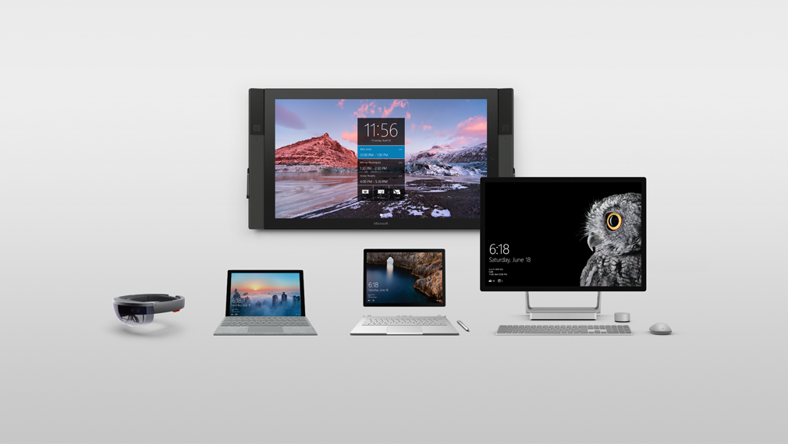
A portfolio designed around people
Natural
interactions
Versatile
form factors
Meticulously
crafted
Connected experiences
Notes:
We’re in the devices business to not just evolve and improve, but to revolutionize the way we work – the way we create, the way we innovate. To re-define and establish new categories of devices. To empower every business on the planet to achieve more.

Slide 15
Demo

Slide 16
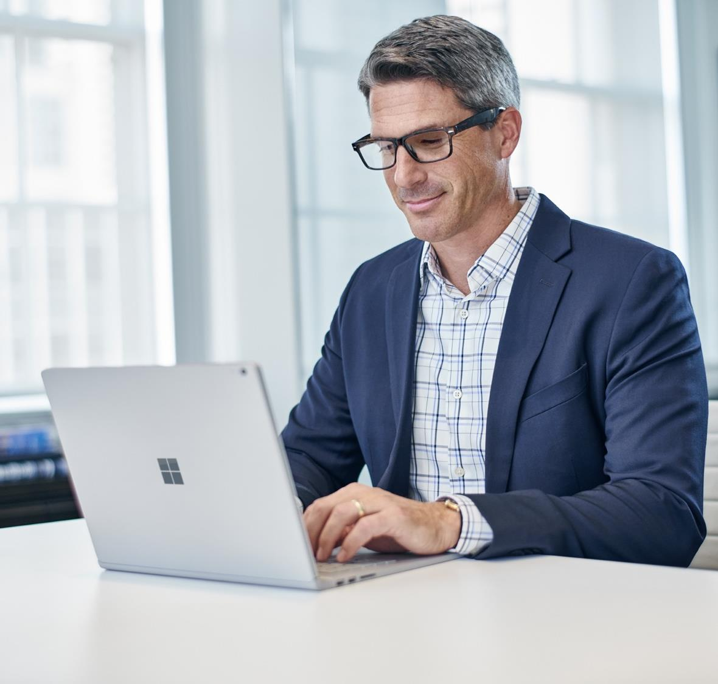
Surface in Financial Services
Financial Advisor
Retail banker
Insurance sales & claims
Notes:
Here are the 3 key scenarios where Surface can make the most impact for your organization:

Slide 17


Financial Advisors
Typical challenges:
Collaborating over complex financial problems with clients and colleagues.
Protecting customer and company finances, from first to last, in a changing landscape where people are increasingly working on the move.
Managing and monetizing data to improve risk management and operational efficiency.
Notes:
Financial advisors are always on the move. And they always need to stay up to date. With Surface they can get secure access to customer and company data and collaborate with clients and colleagues wherever they are.

Slide 18
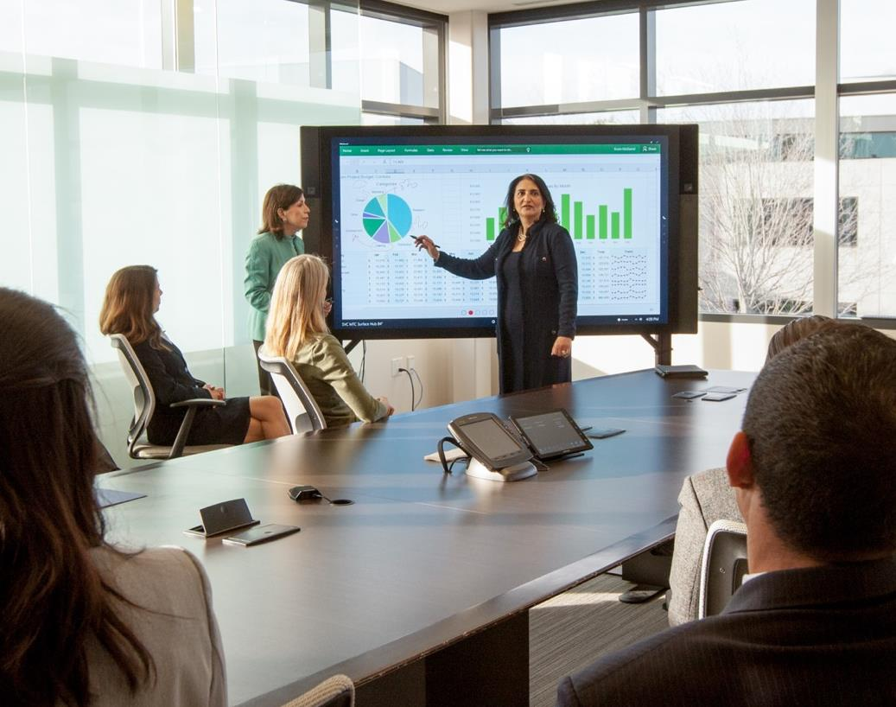

Financial Advisors
How we solve the problem:
Unlock the power of the group with Surface Hub. Enjoy built-in conference cameras, audio and an interactive touchscreen to share and discuss data visualizations with clients or colleagues.
Connect and import financial information securely from additional data sources using OData to access Azure Marketplace, SharePoint, and legacy systems on any Surface device.
Make informed decisions, better anticipate risk and react in real time with OneDrive for Business. Share, edit and access the files you need when you need them, providing a clear record for compliance
teams in the interim.
Software shown is sold separately
Notes:
There are always questions you can’t answer. And, as an advisor, it’s vital to have market insights at your fingertips to create better financial decisions wherever you are. Complex financial questions, or even billing queries.
With Surface, your staff can easily contact your team anywhere in the world and gain a better view of market trends that could impact institutional performance. Whether it be video conferencing and Skype, or by editing live documents together, secure in the Microsoft cloud. Or you can create kiosks to put your experts in front of the customer too.
The point is – Surface makes this whole experience painless, as it’s built to integrate with your existing communications apps, like Skype for Business or Outlook.

Slide 19

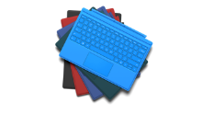
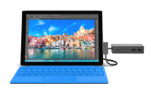




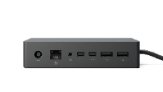
Surface for financial advisors
BENEFITS
Mobility + Power means better use of down time
  Thin, light design for mobility
  Intel Core M/i5/i7 runs touch friendly Windows programs + apps
  Eliminate the delays of logging into multiple devices throughout the day
  Easily move from tablet touch & pen mode to laptop keyboard/mouse mode
  Powerful with long battery life
  USB, SD card and MiniDisplay ports for connecting to peripherals
  Leave a great impression
  Premium devices with high quality screens and materials
  Brilliant Pixelsense® touch screen for engaging with customers
  High def cameras and microphones for quality video conferencing and document scanning
  Streamline customer process by going paperless with touch screen, high quality digital inking and easy cloud access
  Capture electronic signatures or write progress notes with the Surface Pen1
  Benefit of 2-in-1
  Every Surface can move to various modes to accommodate different input needs
  Technology: high savings – one less platform to maintain and secure along with less device procurement
  Cost Savings Estimate: Three-year cost of 2-in-1 = $2719 vs. laptop + iPad = $4189. 2-in-1 device saves about
  35% over three years (including support, replacements, etc…)*
Security & Manageability
  Windows 10 enterprise security
  SEMM for added device security
  Can be simply and easily managed by IT with existing management tools like any other Windows device
KEY ACCESSORIES
Surface Type Cover, Keyboards & Mice
Optimized for fluid typing with well spaced mechanical keys, enlarged glass trackpads and ergonomic sculpting
Surface Dock
From ultraportable to ultraproductive: Connect to dual monitors, speakers, a full-size keyboard and more
Surface Pen
Enables note taking, annotating changes or questions on Edge, PowerPoint, PDF and capturing customer signatures
Microsoft Complete
for Business
Extended service and accident protection for Surface; includes setup and reimagining support for up to three years
*Accessories sold separately.
**Forrester Research, Microsoft Surface Pro 3 Delivers Reduced Device Costs And Improved Revenue, June 2015. Statistics based on using a Surface Pro 3 device.
Notes:
Surface Pro 4
12.3-inch PixelSense touchscreen display
Up to 9 hours of battery life¹
Up to 16GB RAM/256GB SSD³
i5/i7: 0.78 kg m3: 0.76 kg
Surface Pen included
¹Up to 9 hours of video playback. Testing conducted by Microsoft in September 2015 using preproduction Intel Core i5, 256GB, 8GB RAM device. Testing consisted of full battery discharge during video playback. All settings were default except: Wi-Fi was associated with a network. Battery life varies significantly with settings, usage and other factors.
³System software uses significant storage space. Available storage is subject to change based on system software updates and apps usage. 1 GB= 1 billion bytes. See Surface.com/Storage for more details.
Surface Book
13.5-inch PixelSense touchscreen display
Up to 12 hours of battery life*
Up to 16GB RAM/1TB SSD¹
1.51 kg
Surface Pen included
Up to 12 hours of video playback. Testing conducted by Microsoft in September 2015 using preproduction Intel Core i5, 256GB, 8 GB RAM device. Testing consisted of full battery discharge during video playback. All settings were default except: Wi-Fi was associated with a network and Auto-Brightness disabled. Battery life varies significantly with settings, usage and other factors.
¹ System software uses significant storage space. Available storage is subject to change based on system software updates and apps usage. 1 GB= 1 billion bytes. See Surface.com/Storage for more details.

Slide 20
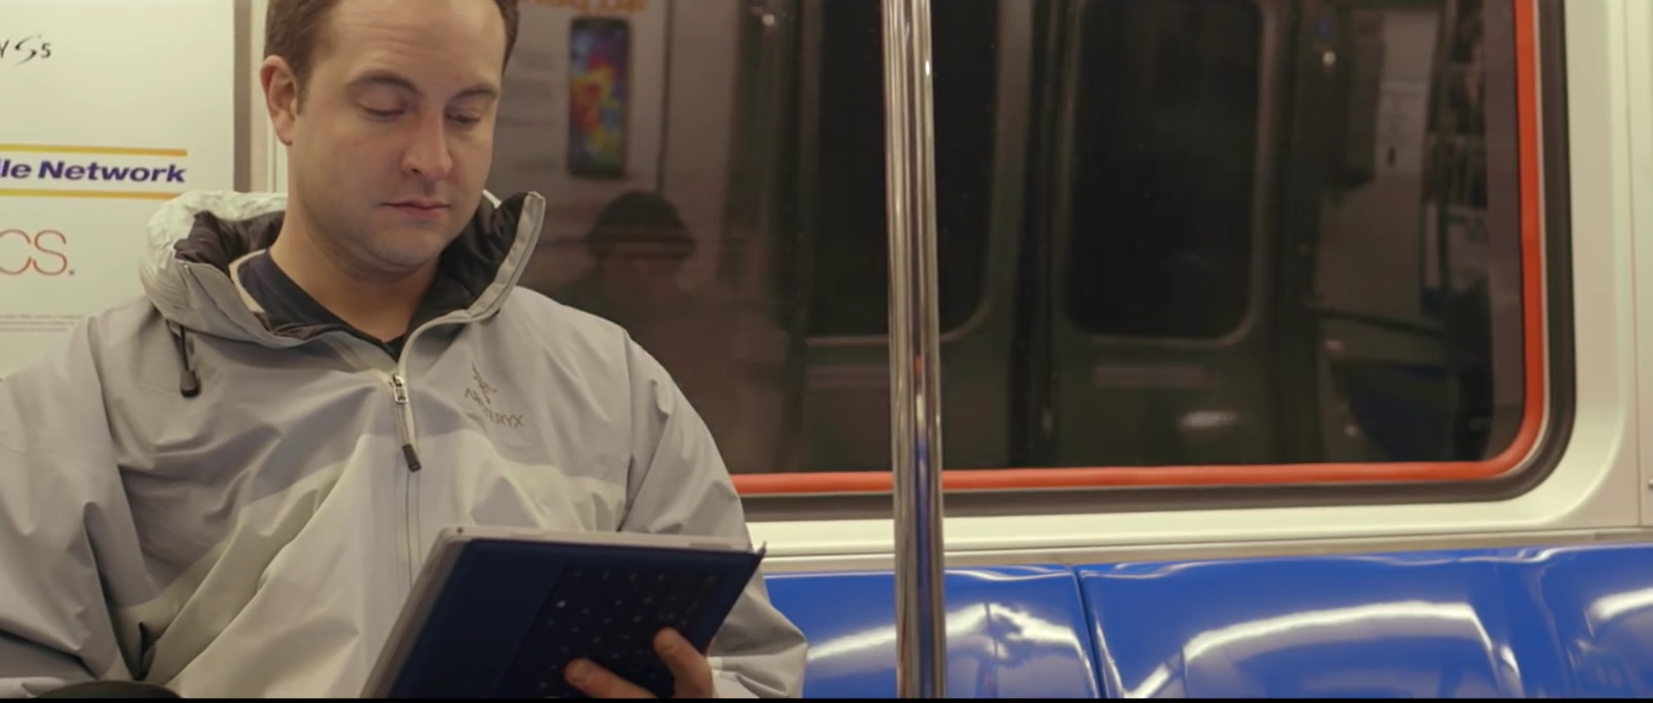

Emancipation Capital has huge technology needs. Network and data security is paramount. But on the road, that poses a huge problem: how can Christian Wallace, a tech analyst, stay productive without the power of his desktop PC?
Faster processing and more
memory than PC
Access to applications on-site
Versatility of switching from PC
to tablet to notepad
The Surface Pro easily transforms into a PC when Christian’s back in the office. Then when he’s out and about, he can take notes with his Surface pen and isn’t reliant on finding typing them
out on the keyboard.
Surface Pro is now giving Christian stronger processing speed than his PC, and more memory. It loads faster, and he has access to all of the applications he needs, wherever he is.
“The Surface has definitely become the most important piece of technology that I own… it really allows me for the first time to be truly mobile.”
Christian Wallace
Tech analyst, Emancipation Capital
PLAY VIDEO

Slide 21

Retail Banker
Typical challenges:
Serving customers faster and more efficiently with real-time, secure access to their finances.
Managing customer relationships and delivering tailored recommendations on the spot whether “in-line” or on the move.
Providing an intuitive, multichannel customer experience across devices so customers can get things done
on their own terms.

Slide 22
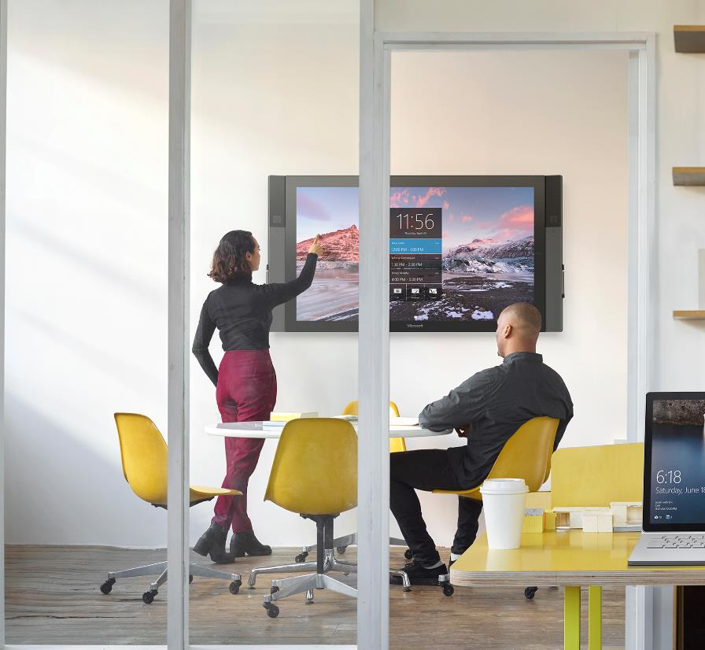
Retail Banker
How we solve the problem:
Securely access statements, contracts, and conversations with a range of Windows security protocols including Smart Screen, Microsoft Passport and Windows Hello.
Provide innovative customer experiences with well-timed, targeted and relevant advice using Microsoft mobility and CRM solutions.
Share and gain visibility into strategic initiatives and understand clients better by accessing every interaction across different channels. Surface devices support a comprehensive suite of integrated social marketing and listening capabilities to allow you to do just that.
Offer specialist advice on the spot with a video kiosk
that utilises Skype for Business on any Surface device. Remote advisors can provide one-on-one tailored recommendations to free up in-store staff.
Notes:
When you consult with customers in a branch or off-site, you can access their data quickly and effortlessly, with seamless integration with your existing Office applications. The same device comes with you – there’s no need to switch to a clunky desktop or laptop just to crunch numbers or access complex systems.
Surface is perfect for finance professionals. The pen is so accurate and intuitive that it can be used to take notes as if on a notepad, and sign documents securely. Plus there is a whole host of applications available through Windows that are specially made for finance. This is all part of the Surface story – showing what’s possible with a single device that acts as desktop, laptop and tablet all in one.

Slide 23
Surface for retail bankers
BENEFITS
Gain effortless mobility within the branch
  Thin, light design for mobility
  Intel Core M/i5/i7 runs touch friendly Windows programs + apps
  Easily move from tablet touch & pen mode to laptop keyboard/mouse mode
  Powerful with long battery life
  No need for multiple devices
  USB, SD card and MiniDisplay ports for connecting to peripherals
  Greet customers with account data in hand for better customer engagement
  Premium devices with high quality screens and materials
  Brilliant Pixelsense® touch screen for engaging with customers
  High def cameras and microphones for quality video conferencing and document scanning
  Streamline customer process by going paperless with touch screen, high quality digital inking and easy cloud access
  Capture electronic signatures or write progress notes with the Surface Pen¹
  Benefit of 2-in-1
  Every Surface can move to various modes to accommodate different input needs
  Technology: high savings – one less platform to maintain and secure along with less device procurement
  Cost savings estimate: Three-year cost of 2-in-1 = $2719 vs. laptop + iPad = $4189. 2-in-1 device saves about 35% over three years (including support, replacements, etc…)*
Security & Manageability
  Windows 10 enterprise security
  SEMM for added device security
  Can be simply and easily managed by IT with existing management tools like any other Windows device
KEY ACCESSORIES
Surface Dock
From ultraportable to ultraproductive: Connect to dual monitors, speakers, a full-size keyboard and more
Surface Pen
Enables note taking, annotating changes or questions on Edge, PowerPoint, PDF and capturing customer signatures
Surface Type Cover, Keyboards & Mice
Optimized for fluid typing with well spaced mechanical keys, enlarged glass trackpads and ergonomic sculpting
Microsoft Complete
for Business
Extended service and accident protection for Surface; includes setup and reimagining support for up to three years
*Accessories sold separately.
**Forrester Research, Microsoft Surface Pro 3 Delivers Reduced Device Costs And Improved Revenue, June 2015. Statistics based on using a Surface Pro 3 device.
Notes:
Surface Type Cover Technical Specifications:
11.60” x 8.50” x 0.19”
(295 mm x 216 mm x 4.65 mm)
0.68 lbs (310 g)
Available in onyx (with Fingerprint ID)
Mechanical keys that are spread out for
precision typing
Layout: QWERTY, full row of function keys (F1–F12)
Dedicated buttons for Windows shortcuts, media controls, and screen brightness
Right-click button
Magnetic attachment
Accelerometer
Surface Dock Technical Specifications:
5.12” x 2.36” x 1.18”
(130 mm x 60 mm x 30 mm)
1.2 1lbs. (550 g)
2 Mini Display Ports
1 Gigabit Ethernet port
4 USB 3.0 ports
1 Audio out port
Surface Connect cable
External power supply
Surface Pen Technical Specifications:
5.67” x 0.37” x 0.40”
(144 mm x 9.5 mm x 1 0.20 mm)
0.04 lbs (20 g)
Available in black, gold, blue, and silver
Compatibility: Surface 3, Surface Pro 3, Surface Pro 4, and Surface Book
Connector Type: Bluetooth 4.0LE
Buttons: Right-click and eraser
Battery: 1 AAAA

Slide 24

Insurance sales & claims
Typical challenges:
Tight regulations
Limited margins
Customer loyalty
High seller turnover

Slide 25

Insurance sales & claims
How we solve the problem:
Devices that allow you to maximize sales efficiencies by making use of down time
Brilliant premium products with touch screen for brand alignment and employee retention
Touch screen, digital inking for paperless scenarios like note taking and signature captures
High quality cameras for capturing data and imagery

Slide 26
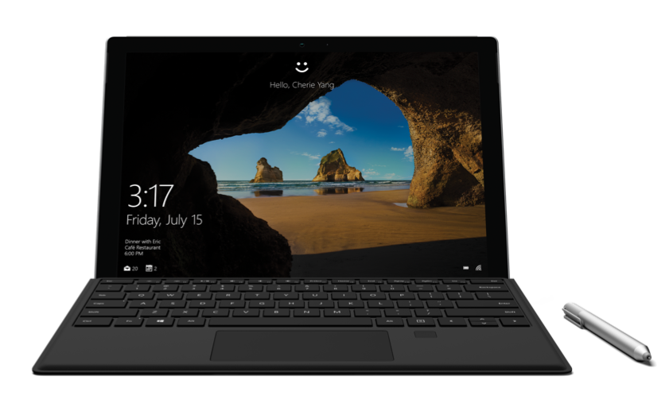
Surface for insurance sales & claims
BENEFITS
Gain effortless mobility within the branch
  Thin, light design for mobility
  Intel Core M/i5/i7 runs touch friendly Windows programs + apps
  Easily move from tablet touch & pen mode to laptop keyboard/mouse mode
  Powerful with long battery life
  No need for multiple devices
  USB, SD card and MiniDisplay ports for connecting to peripherals
Greet customers with account data in hand for better customer engagement
  Premium devices with high quality screens and materials
  Brilliant Pixelsense® touch screen for engaging with customers
  High def cameras and microphones for quality video conferencing and document scanning
  Streamline customer process by going paperless with touch screen, high quality digital inking and easy cloud access
  Capture electronic signatures or write progress notes with the Surface Pen1
Benefit of 2-in-1
  Every Surface can move to various modes to accommodate different input needs
  Technology: high savings – one less platform to maintain and secure along with less device procurement
  Cost savings estimate: Three-year cost of 2-in-1 = $2719 vs. laptop + iPad = $4189. 2-in-1 device saves about 35% over three years (including support, replacements, etc…)*
Security & Manageability
  Windows 10 enterprise security
  SEMM for added device security
  Can be simply and easily managed by IT with existing management tools like any other Windows device
KEY ACCESSORIES
Surface Type Cover, Keyboards & Mice
Optimized for fluid typing with well spaced mechanical keys, enlarged glass trackpads and ergonomic sculpting
Surface Dock
From ultraportable to ultraproductive: Connect to dual monitors, speakers, a full-size keyboard and more
Surface Pen
Enables note taking, annotating changes or questions on Edge, PowerPoint, PDF and capturing customer signatures
Microsoft Complete
for Business
Extended service and accident protection for Surface; includes setup and reimagining support for up to three years
*Accessories sold separately.
**Forrester Research, Microsoft Surface Pro 3 Delivers Reduced Device Costs And Improved Revenue, June 2015. Statistics based on using a Surface Pro 3 device.
Notes:
Surface Type Cover Technical Specifications:
11.60” x 8.50” x 0.19”
(295 mm x 216 mm x 4.65 mm)
0.68 lbs (310 g)
Available in onyx (with Fingerprint ID)
Mechanical keys that are spread out for
precision typing
Layout: QWERTY, full row of function keys (F1–F12)
Dedicated buttons for Windows shortcuts, media controls, and screen brightness
Right-click button
Magnetic attachment
Accelerometer
Surface Dock Technical Specifications:
5.12” x 2.36” x 1.18”
(130 mm x 60 mm x 30 mm)
1.2 1lbs. (550 g)
2 Mini Display Ports
1 Gigabit Ethernet port
4 USB 3.0 ports
1 Audio out port
Surface Connect cable
External power supply
Surface Pen Technical Specifications:
5.67” x 0.37” x 0.40”
(144 mm x 9.5 mm x 1 0.20 mm)
0.04 lbs (20 g)
Available in black, gold, blue, and silver
Compatibility: Surface 3, Surface Pro 3, Surface Pro 4, and Surface Book
Connector Type: Bluetooth 4.0LE
Buttons: Right-click and eraser
Battery: 1 AAAA

Slide 27

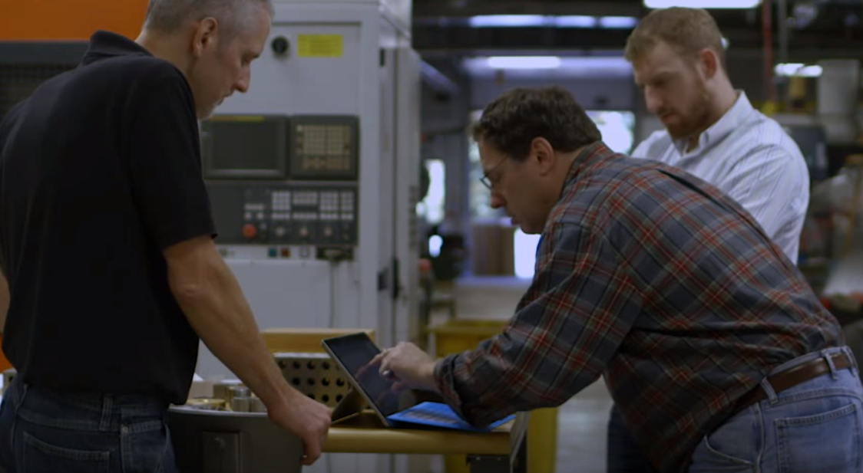
“With the Surface Pro, I’m just blown away at how effective it
is a tool that I can put in my one hand and edit and actually do 3D CAD. This is just a breakthrough product.”
Bob Mileti
Owner, Trlby Innovative
Situation
Trlby Innovative provides product design and development services. Owner Bob Mileti needed a way to use high-powered design tools to achieve his customers’ design needs without being tethered to a workstation.
Solution
The Surface Pro can do everything Mileti’s normal workstation could do and more. For example, when looking at the model of a machine he is building he needs to be able to see over 1,000 parts at incredible detail – down to the threads on screws. With the Surface, he can use his hands to rotate and zoom more effectively than ever.
Benefits
Mileti can run everything on one device from Solid Edge to PDFs to email, and all run smoothly at the same time. And the Surface provides the confidence of having all his data easily accessible no matter where he is – home, the shop floor, or with clients.
PLAY VIDEO
Notes:
https://www.youtube.com/watch?v=tpleeXcyidc

Slide 28
“On average, when we recommend solutions using the USI Omni Knowledge Engine and Surface, it shortens the sales cycle by up to 25 percent.”
John Mann
Senior Vice President,
Business Development, USI Southwest
USI Insurance has 1,500 mobile professionals, many of whom left their heavy laptops at home when making sales calls. This deprived them of access to competitive selling tools.
USI is outfitting all 1,500 mobile employees with Microsoft Surface Pro devices. Salespeople can now run risk analyses with customers, keep up with email, and be more productive on the road.
Now, USI close more deals because employees have access to key applications everywhere. So the sales cycle is now 25% shorter.
1,500 mobile workers using Surface as their only computer
Sales cycle shortened by 25%
Computer-training costs reduced by $33,000 annually

Slide 29
“With the Surface Pro, I can react in real time, which helps us win business and ultimately increase revenues. I’m easily saving two to three hours a week by eliminating prep and follow-up work.”
Ryan Parry
Senior Territory Manager, Safeco,
a division of Liberty Mutual
Liberty Mutual wanted to serve its customers better and improve the productivity of its mobile workforce – especially its sales team that relied heavily on paper.
The Microsoft Surface Pro is now offering Liberty Mutual the benefits of its small size but laptop-caliber performance workers need.
Insurance agents have eliminated hours of prep and follow-up time every week, and can answer customer questions rapidly. Claims processing time is improved, and customer relationships are deeper as a result.
Faster claims processing
Fewer paper-based processes
Hours saved weekly on prep and follow-up work

Slide 30
Everyone loves them
Risk & compliance teams say
“Surface and Windows security protocols mean I don’t have to compromise on the safety of my customer’s contracts.”
HR and training teams say
“Surface easily fits into standard policies and existing processes already in use for our Windows devices.”
Financial advisors say
“Surface is lightweight and has a long battery life, which is great for when I’m traveling to client meetings.”
Senior FS executives say
“With Surface, I’m able to talk
clients through presentations with
ease, encouraging interactivity
and engagement.”
CX bosses say
“Surface Hub allows advisors in
branch to engage with customers freely, in real time.”
Finance say
“One device per employee means
less money spent on hardware.
And there are no increased costs
to support, manage, or deploy
separate OS devices.”

Slide 31
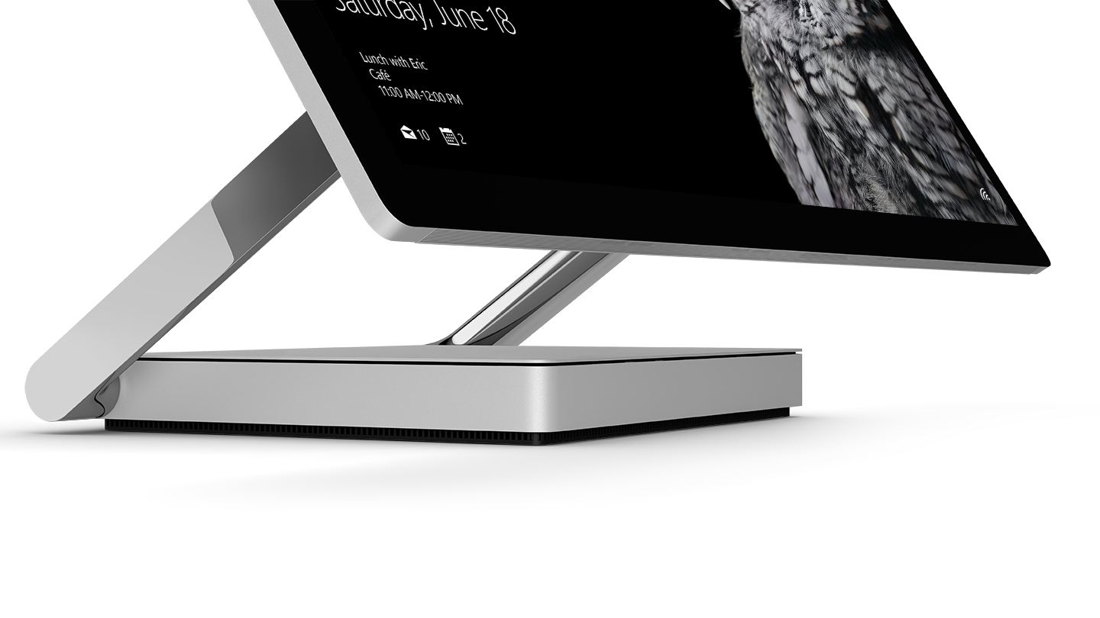
Proof points

Slide 32
Surface delivers proven results
$615 saved in device purchase costs as employees can be provisioned with a single Surface Pro.
15
20
90
60
%
%
%
%
Improvement in close rate
Improvement in deal size leveraging Surface Pro devices to deliver mobile presentations and information from LOB systems.
Agree or strongly agree they get more done away from their desk
Agree or strongly agree they are more satisfied with their ability to get things done
Forrester Research, Microsoft Surface Pro 3 Delivers Reduced Device Costs And Improved Revenue, June 2015. Statistics based on using a Surface Pro 3 device.
Notes:
The results – in terms of efficiency, productivity and cost-savings - speak for themselves.

Slide 33
Surface Hub total economic impact
1: Summary of benefits
Through 5 customer interviews and data aggregation, Forrester concluded that Microsoft Surface Hub has the following financial impact.
2: Breakdown of benefits
The TEI study quantified specific costs, benefits, and metrics that matter to customers.
$1.5
ROI
138
$1
%
9
Months payback
Installation and ongoing costs
Millions 3-year analysis
Device costs
$0.5
Sales improvement enabled by Surface Hub client meetings
Meeting productivity
$0
Meeting productivity
$1.4m
Benefits
$620k
Costs
This document is an abridged version of a case study commissioned by Microsoft titled:
The Total Economic Impact of Microsoft Surface Hub. February, 2016.
Notes:
Don’t just take our word for it.
A Forrester Total Economic Impact study has studied the financial benefits on organizations.

Slide 34
Surface Hub total economic impact
3: Voice of the customer
4: Surface Hub by the numbers
“We had a client meeting to propose a project. Instead of using the whiteboard, we used the Surface Hub, and it was incredibly successful.“
Director of Design and Construction,
Architecture Firm
1,065,697
$
in year 3
Annual benefit after full ramp up of Surface Hub devices
15-23
25
$
Minutes saved on pre and post meeting tasks
In printing costs saved per meeting
“Emailing the OneNote files after a
meeting saved time on every meeting
that uses the Surface Hub.“
COO,
US law firm
20
%
Increase in sales from client meetings leveraging Surface Hub
This document is an abridged version of a case study commissioned by Microsoft titled:
The Total Economic Impact of Microsoft Surface Hub. February, 2016.
Notes:
Don’t just take our word for it.
A Forrester Total Economic Impact study has studied the financial benefits on organizations.

Slide 35
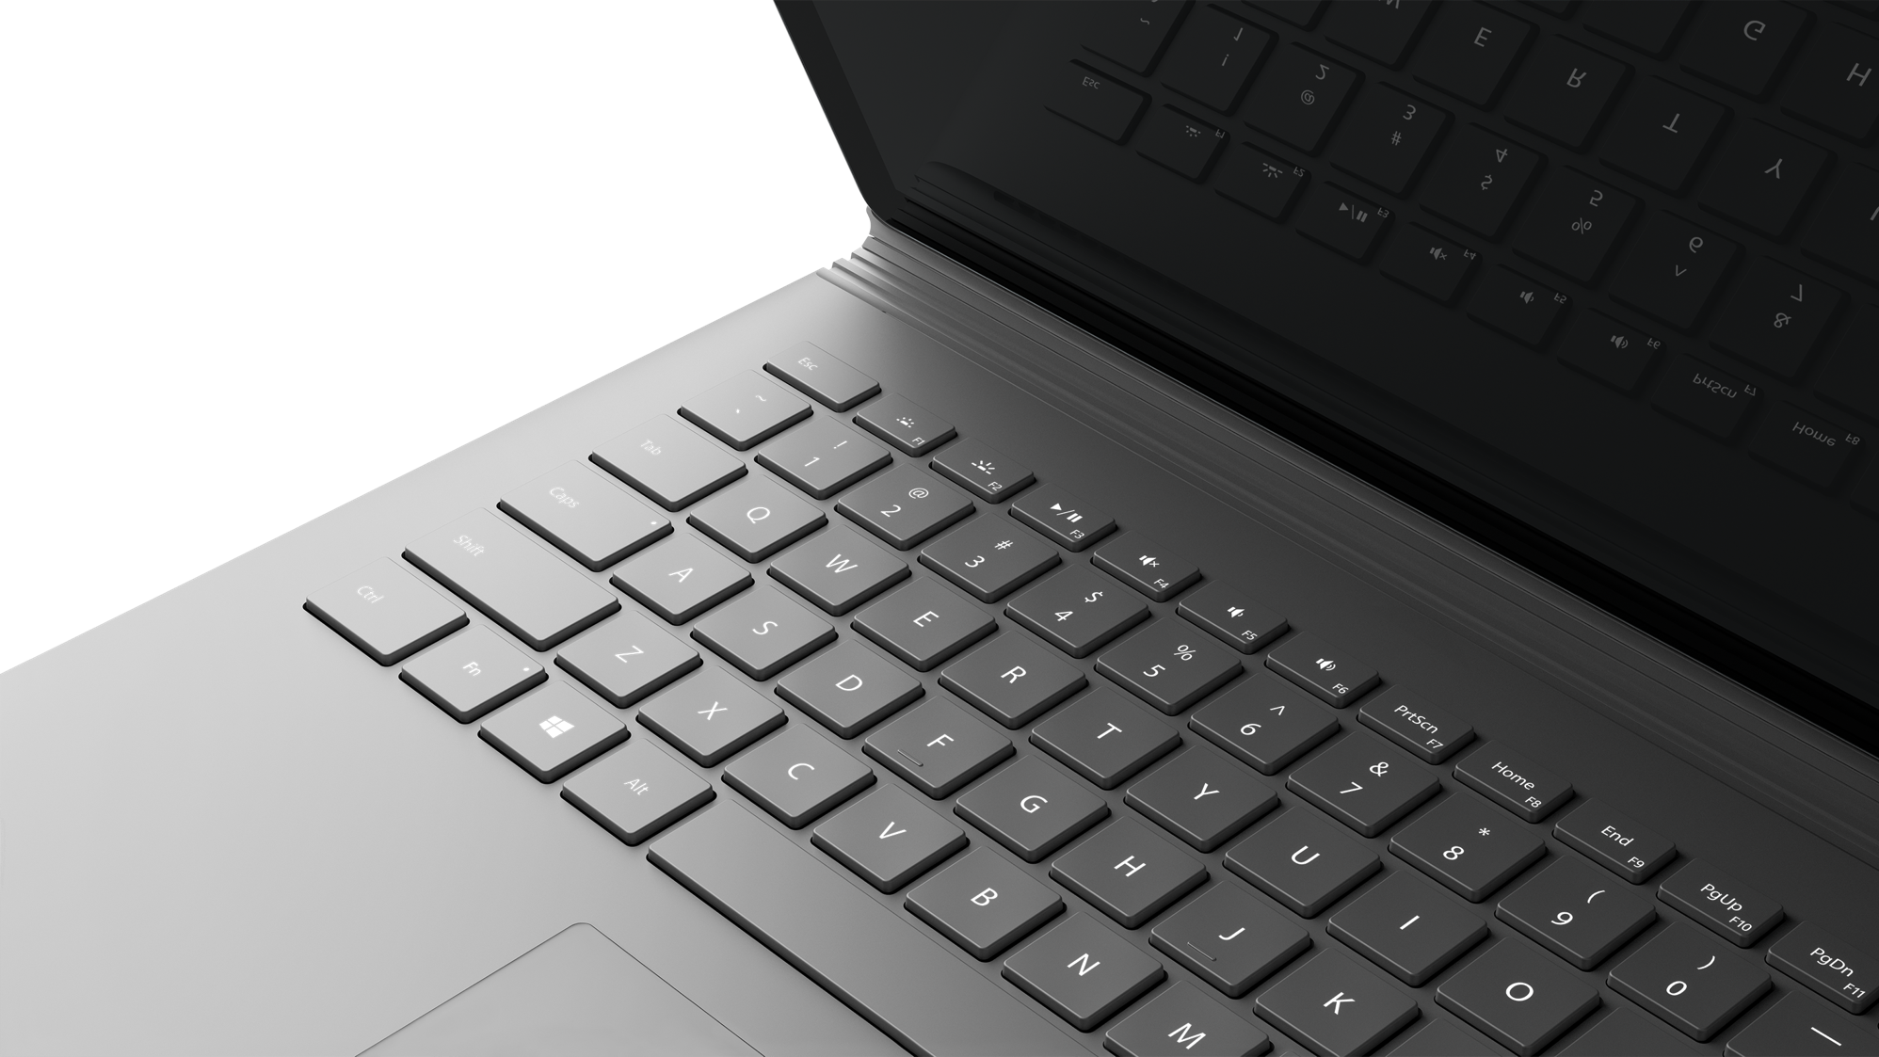
Next Steps

