Slide 1
Read Me
Start by understanding the value proposition for Microsoft Devices
as a catalyst for Digital Transformation (pitch deck).
Use this industry deck to convey the value of the portfolio to this specific audience. Key scenarios and customer stories are included.
For product deep dive decks, use the Microsoft Book, Microsoft Studio, Microsoft Surface Pro, Microsoft Lumia, or Microsoft HoloLens decks.
For Microsoft sellers
Windows 10 Security in Government
MSFT Devices Pitch Deck: visit Infopedia/Sales & Marketing/Devices (1st party) then click Portfolio.
Product decks: visit Infopedia/Sales & Marketing/Devices (1st party), then select the product of interest.
Industry apps & demos: Click here for the latest Surface apps and demos deck for Government.
For Partner sellers
Talk to your Microsoft PCMM or PSE for the latest readiness and marketing content. It lives on Drumbeat.
Notes:
Miami's metro area is the fourth-largest urban area in the United States, with a population of around 5.5 million.
As part of their ‘smart government strategy’ they chose to equip inspectors with Surface Pro as a single 3-in-1 device – a tablet, laptop, & camera. For executives, Surface Pro replaces a laptop.
The inspectors are able to use all of the inputs to increase productivity: pen, voice, touch, keyboard, & mouse.
This means fewer trips to and from the office, enables report writing, and provides permanent access to information systems from any place.
They’ve experienced a performance gain of more than 20% when running multiple apps versus on their previous laptops.

Slide 2
Let’s discuss your current business challenges
Notes:
Jot these down with Surface Pen on the screen…
Pressures on your industry
Challenges your business is facing. Do they fall into these catagories:
1. empowering employees
2. engaging with customers
3. finding operational efficiencies
4. transforming your products or services
How does technology currently play a role?
How is technology holding you back?
What are the main user types/scenarios in your business?
What technology do they currently use?
What sort of improvements would you like to see? Are there metrics you’re trying to meet? (increased productivity, improved operations, improved sales close rates?)

Slide 3
Microsoft Devices for Government
Name
Title

Slide 4

Digital transformation in government
Government understands the need to digitally transform because of the potential to deliver vast benefits to the them in the form of;
Innovation
Collaboration
Cost efficiencies
Communication
Meeting the growing expectation of the public to deliver a better service
Notes:
The bullets below are a prompt for some of these key themes on this slide. Pick and choose, and bring in others, to suit your customer.​
The government landscape is changing. This is not a digital disruption—it is a digital transformation. Globally, government CIOs estimate that 44 percent of business processes are now undergoing digital change, with 62 percent to be impacted within two years and 80 percent within five years. http://www.gartner.com/newsroom/id/3239917
Government leaders look to enhanced technology and its ability to help them get an aggregated perspective of what’s going on in their agency, to enhance their decision making abilities. This can include situational awareness, citizen input, budgets, and data from multiple/diverse information sources.
As well, mobility and collaboration are paramount. Modern governments seek to empower field workers with enriched mobile experiences across devices so they can stay in sync while working in the field and so that remote government workers have the flexibility to work from virtually anywhere, anytime.

Slide 5
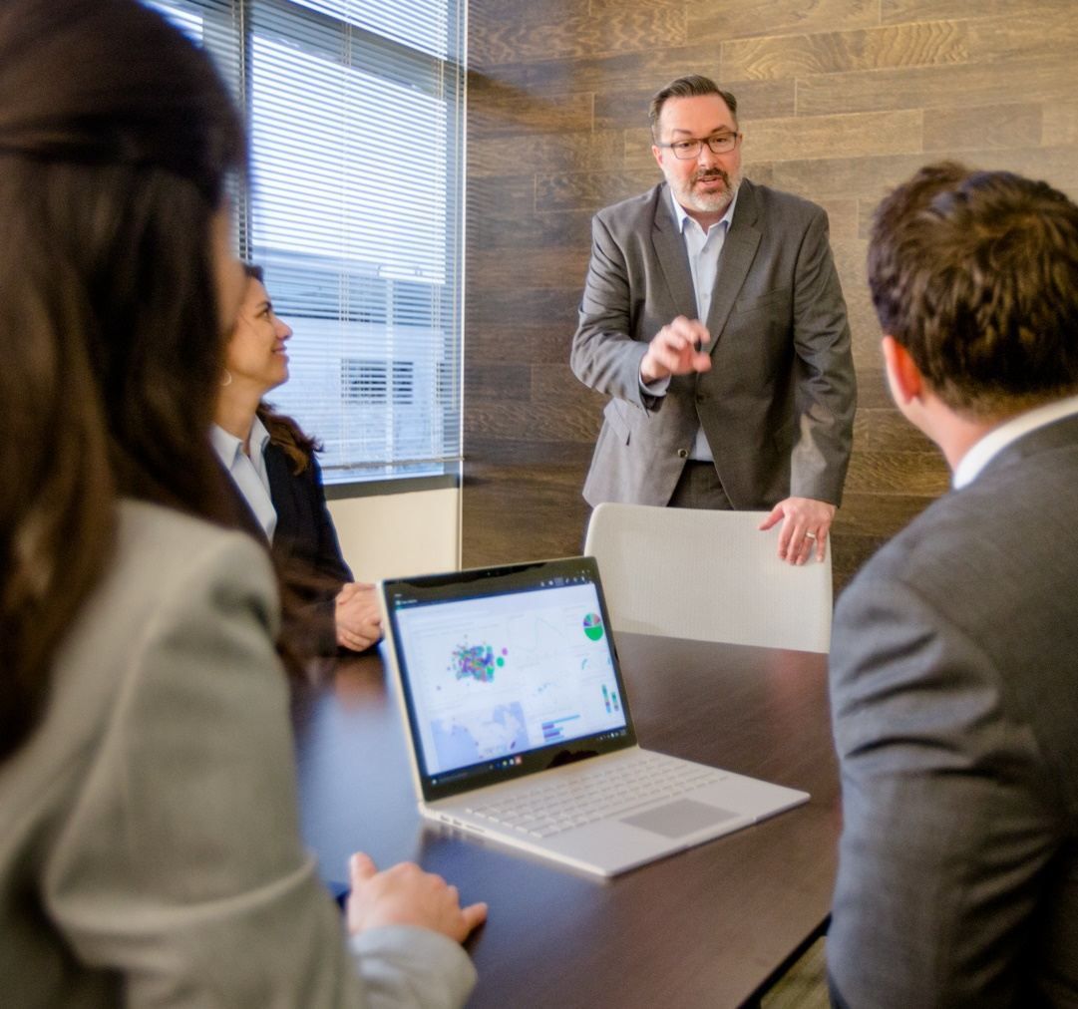
Digital transformation in government
Government are currently unable to reap those rewards because of security concerns – well founded because;
By 2020 there will be 30b devices with unique IP addresses connected to the Internet
and 10b mobile connected devices
The average global cost of a single data breach is $4m
Ransomware is evolving
Compliance complexity is increasing
Notes:
With the transition to a more mobile and collaborative environment comes new vulnerabilities, increased regulation, and increasing security budgets.
Data breaches of government information can be costly and damaging to a government’s trustworthiness and reliability.
Stats and facts for each bullet point:
30 Billion Unique IP Connections to Internet. Source: http://www.gartner.com/newsroom/id/2602817, http://www.statista.com/statistics/219750/global-mobile-internet-device-market-size-forecast/
10 Billion Mobile Devices. Source: http://www.statista.com/statistics/219750/global-mobile-internet-device-market-size-forecast/
The average global cost of a single data breach incident is US$4 million, up from US$3.8 million in 2015. Source: A 2016 study by IBM and Ponemon Institute, <Note to Presenter: This stat is not specific to government.>
Ransomware is evolving, increasingly targeting organizations rather than consumers. Although most ransomware is still spread via phishing, newer ransomware families are much more damaging than earlier versions. All early versions of ransomware (CryptoLocker, CryptoWall, Locky) encrypted files, both local and on network share, and left computers operational. The newer versions, like Petya, encrypt the file system structures and render an entire machine unusable. Source: http://www.bankinfosecurity.com/ransomware-epidemic-prompts-fbi-guidance-a-9008.
Increased compliance complexity. Security and privacy are major concerns in the data-dependent, cloud-based mobile world of modern government. Concerns are driven by data losses, security agency insider revelations and the undercurrent of increasing cyber-attacks. Data security and privacy are critical to successful governance, stability and growth. Governments around the world have responded by developing policy, legislation, and regulation that agencies and vendors must meet and demonstrate compliance with in order to provide services to the public. The digitization of information and processes along with increasing mobile connectivity presents challenges to securing data and information on premises, a scenario for which many security and privacy policies and compliance rule were developed.
With enhanced mobility and collaboration, governments need to defend themselves against cyber attacks. We’re now going to show how the unique combination of Windows 10 and Surface will deliver the results government is looking for.

Slide 6
Windows 10: the most secure Windows ever
PROTECT, DETECT, and RESPOND
Secure your identities
Protect enterprise data
Enhance threat resistance
Secure your devices
and connections
Detect, investigate, and respond to breaches
Pre-breach
Post-breach
Surface management mode
Notes:
Key points to cover
Microsoft’s approach to security is to “protect, detect, and respond.” Windows 10 helps safeguard your government organization before a breach happens and helps you respond to a breach when one occurs.
Windows 10 the most secure Windows Microsoft has ever built. It delivers more protection including anti-virus, firewall, and anti-phishing technologies—for the supported lifetime of your device. This means more security features and ongoing updates to help safeguard you against current and future threats and lower costs.
On our Surface devices (not Hub) you can use Surface Enterprise Management Mode to control which features are disabled on the device, which adds more security. Physical access to the PC is required, and a secondary layer of protection - which cannot be managed remotely (only Admin can manage) - can further restrict access via networks.
Protect, Detect & Repond:
Protect
Windows Credential Guard helps protect user access tokens so you know that the people logging on to your network are authorized to do so.
Windows Hello* enables native, multi-factor authentication. Bear in mind that Windows Hello requires specialized hardware such as fingerprint reader, illuminated IR sensor, or other biometric sensors depending on the authentication enabled.
Surface Enterprise Management mode allows you to secure and manage firmware settings within your organization.
Windows Information Protection (WIP) can help protect your organization’s data at the file level by helping prevent the unauthorized sharing of information whether the sharing was intentional and malicious or simply a mistake.
Windows Device Guard helps enhance your threat resistance against malicious apps and firewall attacks.
Windows Defender Application Guard is similar to Device Guard, but is specific for Internet browsing via Microsoft Edge. You create a company-approved whitelist of approved websites and URLs that can be run. Then, when someone attempts to run a URL not on that list, it opens in a virtualized container.
Detect and Respond
Windows Defender Advanced Threat Protection (ATP) enables you to detect, investigate, and respond to advanced threats and data breaches on your network. It’s a powerful tool that is designed to run alongside any anti-virus solution.

Slide 7
Game change with Windows and Software as a Service
Threat protection over time
Attackers take of periods between releases
Disrupt and out innovate our adversaries by design
Capability
Protection Gap
Product release
Threat sophistication
Notes:
This slide details the strong position Microsoft holds in minimising the risk of attack to government – the continuous release of software updates means that hackers and potential threats have limited opportunity to develop malware in response – meaning that the software stays secure and is subject to fewer threats.
While our competitors release updates periodically, this leaves customers with a protection gap between releases. This is when attackers often strike.

Slide 8
Windows 10: the most secure Windows ever
(Fresh Install or upgraded from 64-bit Windows 8)
Device Encryption
Virtualization Based Security
Device Guard
Windows Information Protection
UEFI Secure Boot
Microsoft Edge
Credential Guard
BitLocker Admin
and Monitoring
Security Management²
Windows Trusted Boot
Windows Defender
Windows Hello
Companion Devices
Conditional Access
Windows Update
Windows Firewall
BitLocker
Windows Defender Advanced Threat Protection
Trusted Platform Module
SmartScreen
Windows Hello
BitLocker to Go
Device protection
Threat resistance
Identity protection
Information protection
Breach detection investigation & response
Pre-breach
Post-breach
Notes:
Device protection features:
Virtualization Based Security. If a process, or data, is virtualized, then it is isolated from the rest of the operating system, and therefore it is more difficult to tamper with.
UEFI Secure Boot. UEFI will check the boot loader before launching it and ensure it’s signed by Microsoft. If a rootkit or another piece of malware does replace your boot loader or tamper with it, UEFI won’t allow it to boot.
Windows Trusted Boot, used in combination with UEFI Secure Boot, helpsmake sure that your PC boots more securely and that only trusted software can run during start-up.
Windows Update. Windows Update is used to keep Microsoft Windows and several other Microsoft programs updated. Updates often include feature enhancements and security updates to protect Windows from malware and malicious attacks.
Threat resistance:
Windows Device Guard helps enhance your threat resistance against malicious apps and firewall attacks.
Microsoft Edge is a web browser developed by Microsoft and included in Windows 10, Windows 10 Mobile, Xbox One, and Windows Holographic, replacing Internet Explorer as the default web browser on all device classes.
Windows Defender Application Guard is similar to Device Guard, but is specific for Internet browsing via Microsoft Edge. You create a company-approved whitelist of approved websites and URLs that can be run. Then, when someone attempts to run a URL not on that list, it opens in a virtualized container.
Windows Firewall is a software component of Microsoft Windows that provides firewalling and packet filtering functions.
Microsoft SmartScreen is a phishing and malware filter implemented in several Microsoft products including Internet Explorer, Microsoft Edge and Outlook.com,
Identity protection:
Windows Credential Guard helps protect user access tokens so you know that the people logging on to your network are authorized to do so.
A Windows Hello companion device is a device that can act in conjunction with your Windows 10 desktop to enhance the user authentication experience.
Windows Hello* enables native, multi-factor authentication. Bear in mind that Windows Hello requires specialized hardware such as fingerprint reader, illuminated IR sensor, or other biometric sensors depending on the authentication enabled.
Information protection:
Device encryption helps protect your data by encrypting ("scrambling") it. Only someone with the right encryption key (like a password) can decrypt ("unscramble") it.
Windows Information Protection. Microsoft Azure is a cloud-based solution that helps an organization to classify, label, and protect its documents and emails
BitLocker Admin and Monitoring MBAM simplifies deployment and key recovery, provides centralized compliance monitoring and reporting, and minimizes the costs associated with provisioning and supporting encrypted drives.
BitLocker. BitLocker Drive Encryption is a data protection feature that integrates with the operating system and addresses the threats of data theft or exposure from lost, stolen, or inappropriately decommissioned computers.
BitLocker to Go. You can use BitLocker Drive Encryption to encrypt your sensitive data on the main hard drive of your PC, and then you can use BitLocker To Go. This last feature will help you to use encryption on remove drives and secondary hard drives connected to your computer.
Breach detection investigation and response
Security Management – I’m not sure what this is referring to
Conditional Access. Allows you to prevent access for BYODs that do not meet security standards.
Windows Defender Advanced Threat Protection (ATP) enables you to detect, investigate, and respond to advanced threats and data breaches on your network. It’s a powerful tool that is designed to run alongside any anti-virus solution.

Slide 9

Secure your identities
A government leader is traveling to a meeting. He wants to get some work done while he travels so he turns on his Windows 10 device and logs in.
GOVERNMENT LEADER
Maintains aggregated view of agency activity
Communicates regularly with citizens
Responsible for keeping citizen data safer
Windows Hello*
Enables native support of multi-factor authentication—such as biometrics or companion device—to validate users.
Helps ensure that he’s the only person who can sign-in to the device and gain access.
* Windows Hello requires specialized hardware such as fingerprint reader, illuminated IR sensor, or other biometric sensors depending on the authentication enabled.
Notes:
Suggested slide time: 5 minutes
Key points to cover
Transition to scenario stories to talk about Windows 10 features in the day of a government organization.
Here, focus on Windows Hello* functions and benefits.
Speaker notes
I’d like to step back now to the roles within your organization—to try to put their challenges in context.
Let’s look at a typical day in the life of a government organization, possibly similar to yours. As you know, there are numerous roles that come together to keep the organization running. Some of your team work in-office each day, while others are almost always out in the community.
We’ll start by examining roles that may work remotely—like government leaders. They are frequently on-the-go and need more secure access to their work while they travel.
Scenario
In this scenario, a government leader is en route to a meeting. He needs to stay connected and get some work done on his government-issued device while he travels. This is very efficient for the government leader—he no longer has to carry paperwork and folders, but rather can access agency information with his device. But, it means his device must be highly guarded. He and only he should be able to access the info on that device, due to the sensitive nature of the data it contains.
That’s where Windows 10 features come in. As a government leader turns on his Windows 10 device, he must login using Windows Hello.* This uses multi-factor authentication such as biometrics (fingerprints) or a companion device. This measure provides an extra layer of security against hackers and helps prevent the wrong person from logging and accessing the data on his device.
The takeaway here is that no matter where they are—in the office or in the field—only the right people can log in to their device. No one else.
Real data
To bring this situation home, consider this statistic: Among the top 10 most popular hacking methods are unmanaged personal devices and compromised accounts.¹<Note to presenter: this is a general statistic, not government specific>
For the presenter
To learn more about Windows Hello* and multi-factor authentication for yourself, reference the Windows 10 Commercial Storybook https://microsoft.sharepoint.com/sites/Infopedia_G02KC/Pages/Custom/Windows10Storybooks.aspx
*Windows Hello requires specialized hardware such as fingerprint reader, illuminated IR sensor, or other biometric sensors depending on the authentication enabled.
[Advance slide]
Sources
¹ https://www.balabit.com/news/press/social-engineering-leads-the-top-10-list-of-most-popular-hacking-methods-balabit-survey-results-from-black-hat-usa

Slide 10

Secure your identities
The head of a social services department is starting her day and opens a genuine-looking email, appearing to come from a trusted source. She clicks on a URL included in the message.
DEPARTMENT LEADER
Manages teams and government projects
Communicates with other agencies and the public
High level of clearance for sensitive information
Credential Guard
Stores her user access token credentials away from the operating system in a virtualized environment.
Helps protect credentials—even if something happens to her device, her tokens aren’t exposed and she is better protected.
Notes:
Suggested slide time: 5 minutes
Key points to cover
Focus on Credential Guard functions and benefits.
Speaker notes
Scenario
Now let’s look at the head of a social services department sitting in her office at the agency headquarters. The department executive is reading email. She clicks on a genuine looking email that appears to come from an agency partner in the private sector. She sees a link in the email and clicks it—but unbeknownst to her, it contains malware. The link activates the code and ultimately gives the hackers a way inside her machine to see her activity. Now, consider that this executive is often handling sensitive data—which, if in the wrong hands, could be compromised.
Feature
Behind the scenes, Credential Guard helps protect the user access tokens that are generated once your users have been authenticated. So even if a device is compromised, the credentials are not available to the attacker. With user access tokens, an attacker could access your resources by effectively impersonating a user’s identity. Credential Guard stores user access tokens within a virtualization-based security environment running on Hyper-V, away from the Windows 10 kernel. This helps safeguard you from Pass-the-Hash and other advanced persistent attacks. And Credential Guard can be enabled using Group Policy, making it easy and familiar for your IT staff to administer using the existing management tools they have in place.
There is one more feature that has been around for a while—BitLocker—that we should also briefly cover here. In the event that a device is stolen (for example, if the department leader leaves her office door unlocked and the device is taken), the content within it is better protected and encrypted with BitLocker.
With Credential Guard, the user credentials are better protected against theft, breach, and phishing—all with no additional hardware required. So even if an employee takes an action that would otherwise lead to exposure, it can be halted.
According to a 2016 Verizon report, 63% of confirmed breaches involved leveraging weak, default or stolen passwords.¹ <Note to presenter: This is a global stat and is not specific to government.>
Real example
Let’s consider a couple of real scenarios for a moment to bring this home.
In 2011 hackers broke into the computer of the Australian Prime Minister and at least nine other federal ministers. “The intruders gained access through a spear-phishing attack that targeted top federal officials, then used their computers to send e-mail to IT staffers to trick them into revealing login credentials to gain a foothold on government networks.”²
Chinese hackers targeted Defence Research and Development Canada. “The hackers apparently managed to take control of computers in the offices of senior government executives as part of a scheme to steal the key passwords that unlock entire government data systems.”³
For the presenter
To learn more about Credential Guard, reference the Windows 10 Commercial Storybook https://microsoft.sharepoint.com/sites/Infopedia_G02KC/Pages/Custom/Windows10Storybooks.aspx
[Advance slide]
Sources
¹ http://www.verizonenterprise.com/resources/reports/rp_dbir-2016-executive-summary_xg_en.pdf
² https://www.wired.com/2011/03/australian-pm-hacked/
³ http://www.cbc.ca/news/politics/foreign-hackers-attack-canadian-government-1.982618

Slide 11

Protect enterprise data
A tax auditor is onsite at a local business conducting an audit. He accidentally tries to copy and paste a piece of sensitive government information into a personal e-mail.
TAX AUDITOR
Processes citizen taxes and conducts audits.
Uses technology in daily work to be more efficient.
Relies on the Internet to do his job.
Windows Information Protection
Separates his personal and business data and helps encrypt data per policy.
Notifies when he takes an unauthorized action—but otherwise works seamlessly in the background so he’s not distracted.
Notes:
Suggested slide time: 3 minutes
Key points to cover
Windows Information Protection (WIP) feature function and benefits.
Speaker notes
Scenario
Tax auditors are required to engage with citizens, collaborate with government agencies, and handle lots of sensitive information. In this scenario, a tax auditor is onsite at a local business conducting a tax audit. He accidentally copies and pastes a piece of sensitive government information into a personal e-mail. Windows Information Protection (WIP) helps stop him when he pastes the data, warning him that he’s taking unauthorized actions.
Windows Information Protection (WIP) distinguishes between corporate and personal information and helps encrypt the data per policy. All seamlessly for your users.
With WIP, this happens under the hood, unseen by the user. It’s only when a policy kicks in that they see the info. This is great news for employees who may otherwise be distracted by policy configurations—and for you, to ensure that data is more secure.
Here’s a bit more about what WIP can do:
Separate personal and professional data.
Windows Information Protection (WIP) helps IT and users prevent accidental leaks by separating personal and business data. WIP allows IT administrators to apply rules to control how business data can be used. WIP recognizes business data as it arrives on devices, is generated by business applications, or when it is designated as business data by the user. What this means is your security team can set policies for corporate data. Even if a user stores corporate data on a personal device, the encryption policies will stay with the files.
User and app access control.
WIP enables IT to set policies that define which applications and users are authorized to access business data. WIP also enables IT to define which rights a user has, allowing IT to either help block leaks or, optionally, help warn the user before content is copied to unauthorized websites and personal documents (as in our scenario story, above).
WIP also helps protect business data that is placed on removable storage by ensuring all business data is better encrypted and accessible only by authorized users. So if your users store corporate data on a personal USB device, for example, the files are encrypted.
Provides greater IT control with a seamless experience for users.
Business data protection takes place completely behind the scenes. Users only get notifications when they’re attempting to take an unauthorized action. So they aren’t distracted or interrupted by policies.
And, your IT team has full control of keys and protected data, making it easy to perform a remote wipe of business data on demand while leaving personal data untouched.
WIP gives you enterprise-ready security that is easy to manage and use—for mobile and desktop platforms.
WIP allows you to better encrypt at the file level to help ensure only the right user can access the file. It also helps prevents copy and paste, as we saw in the example.
Your big takeaway is that your users remain focused on getting work done, and you get the corporate data protection you need with more straightforward manageability.
Real example
In the example scenario, we’re putting the trust on the tax auditor that he did not intentionally wish to leak data. His was an error.
But in some cases, there’s malicious intent. Take the example from 2012 leak of US Government documents by Edward Snowden.¹
For the presenter
To learn more about WIP for yourself, reference the Windows 10 Commercial Storybook https://microsoft.sharepoint.com/sites/Infopedia_G02KC/Pages/Custom/Windows10Storybooks.aspx
To share more information about WIP with your customer, you can visit this TechNet page: https://technet.microsoft.com/en-us/itpro/windows/keep-secure/protect-enterprise-data-using-wip>
[Advance slide]
Sources
¹ http://www.pbs.org/wgbh/frontline/article/how-edward-snowden-leaked-thousands-of-nsa-documents/

Slide 12

Enhance threat resistance
A case manager is out on a site visit and needs to extract files from a compressed folder. He goes online to download a file compression utility from the Internet.
FIELD WORKER
Helps citizens complete government actions
Works with lots of sensitive data
His work is task-oriented in nature
Device Guard
Restricts what can be installed on the device and allows the case manager to only install apps that are trusted and approved by IT.
Works behind the scenes to help prevent unauthorized apps from gaining access to the agency’s network.
Notes:
Suggested slide time: 4 minutes
Key points to cover
Device Guard feature function and benefits.
Speaker notes
Scenario
A citizen services case manager helps citizens navigate government and get things done. He assists with paperwork and filing forms. He works with lots of sensitive data but often completes the same set of tasks over and over. In this scenario, he is out on a site visit and needs to extract files from a compressed folder. He goes online to try and download a file compression utility app from the Internet instead of waiting for IT to send him an approved app.
When he attempts to install the app, Windows Device Guard makes a determination on whether that app is trustworthy. He is blocked from the action.
Device Guard can help protect the Windows system core and helps prevent untrusted apps and executables from starting.
With Device Guard you can lock down devices, granting access only to apps from trusted sources. Device Guard uses hardware-based isolation and virtualization to help protect itself and the Windows system core from vulnerability and zero-day exploits.
Its Hyper-V Code Integrity Service feature enforces best practices for running drivers and other software at the highest level of privilege.
Here’s more about what Device Guard can do:
Help protect against malware.
Help secure your environment and prevent untrusted apps and code from running by using the ultimate form of app control. Using virtualization-based security, the Device Guard feature in Windows 10 offers a solution more powerful than traditional app control products, providing more rigorous protection from tampering and bypass.
Hardware rooted app control.
Device Guard uses virtualization-based security to isolate and help protect Device Guard features, such as the Hyper-V Code Integrity Service (HVCI), from malware and attacks, even if Windows itself has been compromised. HVCI enables Device Guard to help protect kernel mode processes from in-memory attacks, giving you a strong defense against zero-day exploits.
Only run trusted apps.
Device Guard helps enable your IT department to decide which software vendors and apps can be trusted within your environment. IT can designate as trustworthy the right combination of apps for your organization, from internal line-of-business apps to everything from the Windows Store to apps from specific software vendors. Device Guard works with Windows Classic apps and Universal Windows Platform apps, and it includes tools that make it easy to sign your existing apps.
Device Guard completely restricts what you can run on the device.
In our scenario story, when the case manager attempted to install the app, he could have installed malware on the machine without even knowing it—potentially stopping his firewall software from running and affecting the whole network. But with Device Guard installed, apps have to first earn their trust—before they can be installed.
With Device Guard on Windows 10, you are in better control of your environment and a step ahead of malware. You can help safeguard against threats—current and future—all built in, at no extra cost.
Real example
In 2013 a cyberattacked nick-named “MiniDuke” attacked government computer systems of more than 20 countries including Ireland and Romania. The attack was launched via a cleverly disguised Adobe PDF attachment to an email. Once is was opened, the malware would install itself on a victim’s computer.¹
For the presenter
To learn more about Device Guard for yourself, reference the Windows 10 Commercial Storybook https://microsoft.sharepoint.com/sites/Infopedia_G02KC/Pages/Custom/Windows10Storybooks.aspx
[Advance slide]
Sources
¹ https://www.theguardian.com/technology/2013/feb/27/hackers-attack-european-governments-miniduke

Slide 13

Enhance threat resistance
While putting together an analysis, a government scientist encounters something she needs more information about. She does a search and clicks on an unfamiliar website.
GOVERNMENT EMPLOYEE
Conducts daily government business
Needs to work more securely from anywhere
Wants better technology to work more efficiently
Windows Defender Application Guard
Isolates the scientist’s browsing activity from the rest of the system by automatically running a virtualized instance of the browser.
Allows her to get the information she needs, while better protecting the operating system from potential malware.
Notes:
Suggested slide time: 4 minutes
Key points to cover
Windows Defender Application Guard feature function and benefits.
Speaker notes
Scenario
The government scientist needs to collaborate with colleagues, write reports and analysis, and communicate with other agencies. She often performs research via the Internet. Here she has performed an Internet search via Microsoft Edge and visits an unfamiliar website. Her agency has already set up an approved whitelist of URLs that can be opened more safely, and this website is not on that list.
Microsoft Edge, when in Windows Defender Application Guard mode, does not recognize this as a trusted website. It is not on the agency-approved list of accessible URLs. It’s important to note that Microsoft Edge does allow her to visit the website—after all, the employee needs to be able to do her job and visit many different websites each day. But, it opens the site in a secured container powered by Windows Defender Application Guard, allowing her to get the information she needs, while better protecting the devices, apps, and data from potential malware, vulnerability exploits, and even zero days.
Features
Microsoft Edge when in Windows Defender Application Guard mode isolates untrusted user activity such as browsing the Internet with Microsoft Edge, using light-weight, hardware-based virtual machines (containers).
It automatically runs a virtualized instance of the browser and contains the browsing activity away from the rest of the system.
When the new browser window appears, it features a window decoration indicating the session is running a container as the user lands on an untrusted website. A user can then make a determination to close the Microsoft Edge window and the entire session is discarded, including any malware.
The host network is left untouched, as any malware is not able to jump out of the container.
Documents downloaded in the container are not persisted between container sessions; documents downloaded in the container are blocked from being downloaded or saved to the host.
As well, the state of the container is not persisted between sessions. I.e. cookies, remembered passwords, favorites, and temporary files will not be persisted from session to session in a container.
In our scenario story, when the government scientist visited the website, it could have contained something harmful that would have infiltrated her PC and network. But with Microsoft Edge when in Windows Defender Application Guard mode, the employee can visit the website that she needs while the operating system is better protected from malware.
[Advance slide]

Slide 14

Secure your devices
A government CIO helps keep government employees productive by managing devices and networks for the agency. He also sets and manages security and compliance strategy.
GOVERNMENT CIO
Manages agency IT systems and hardware
Ensures the network is more secure and compliant
Oversees team that sets up organization devices
Windows 10 modern hardware provides:
UEFI Secure Boot
Biometric Sensors
Cryptographic Processing
Virtualization
Notes:
Suggested slide time: 2-3 minutes
Key points to cover
Functions and benefits of Windows 10 hardware.
Speaker notes
Scenario
The Government CIO and IT team must maintain control over a wide variety of devices in the IT environment, manage IT networks, and set and execute compliance and security strategy for the organization. As well, they must set up new devices for the distributed field teams to use. These roles need to better secure all of the devices and connections, which is possible using a variety of tools already built in to Windows 10.
Features
Here are some of the features built in to Windows 10 Enterprise Edition that help enable your organization to protect devices, leverage modern access controls, ensure trusted boots, and ensure that only certified apps are running.
App-specific VPN access helps you maintain the integrity of your devices and your organization’s platform by determining trustworthiness using Unified Extensible Firmware Interface (UEFI) and Trusted Platform Module (TPM). This helps ensure that only authorized apps can communicate across the VPN—and that malware on the client won’t propagate to your organization’s network.
Ensure trusted boot by closing off the pathways that allow malware to hide. With Windows trusted boot, used in combination with UEFI Secure Boot, you help make sure that your PC boots more securely and that only trusted software can run during start-up.
Device Integrity helps you maintain the integrity of the device itself (i.e., firmware) and start a tamper-free version of the desired operating system.
Hardware-based cryptographic processing (i.e., TPM) helps create keys, sign sensitive data, and assist in integrity validation (example: remote attestation).
Use Virtualization to make use of hardware-based technologies so that they can move some of the most sensitive Windows processes into containers that can prevent tampering—even if the Windows kernel has been fully compromised.
Finally, while not necessarily required, you need to move to stronger forms of identity. Biometric sensors offer a means to eliminate the use of passwords and other sharable secrets to access resources.
In today’s modern workplace, numerous devices connect to your networks every day. From employees to visitors to cybercriminals, you can’t know everyone who is trying to connect.
Windows 10 security feature's help you and your security team protect devices wherever they are, to help maintain the integrity of devices and organization platform, determine trustworthiness, and block unhealthy devices. Your security team sets up a more secure desktop, meaning employees can work versus wait for software to run authentication. And you can be confident knowing that pathways that might allow malware to hide are closed.
For the presenter
To learn more about App-specific VPN and UEFI Secure Boot for yourself, reference the Windows 10 Commercial Storybook https://microsoft.sharepoint.com/sites/Infopedia_G02KC/Pages/Custom/Windows10Storybooks.aspx
[Advance slide]

Slide 15
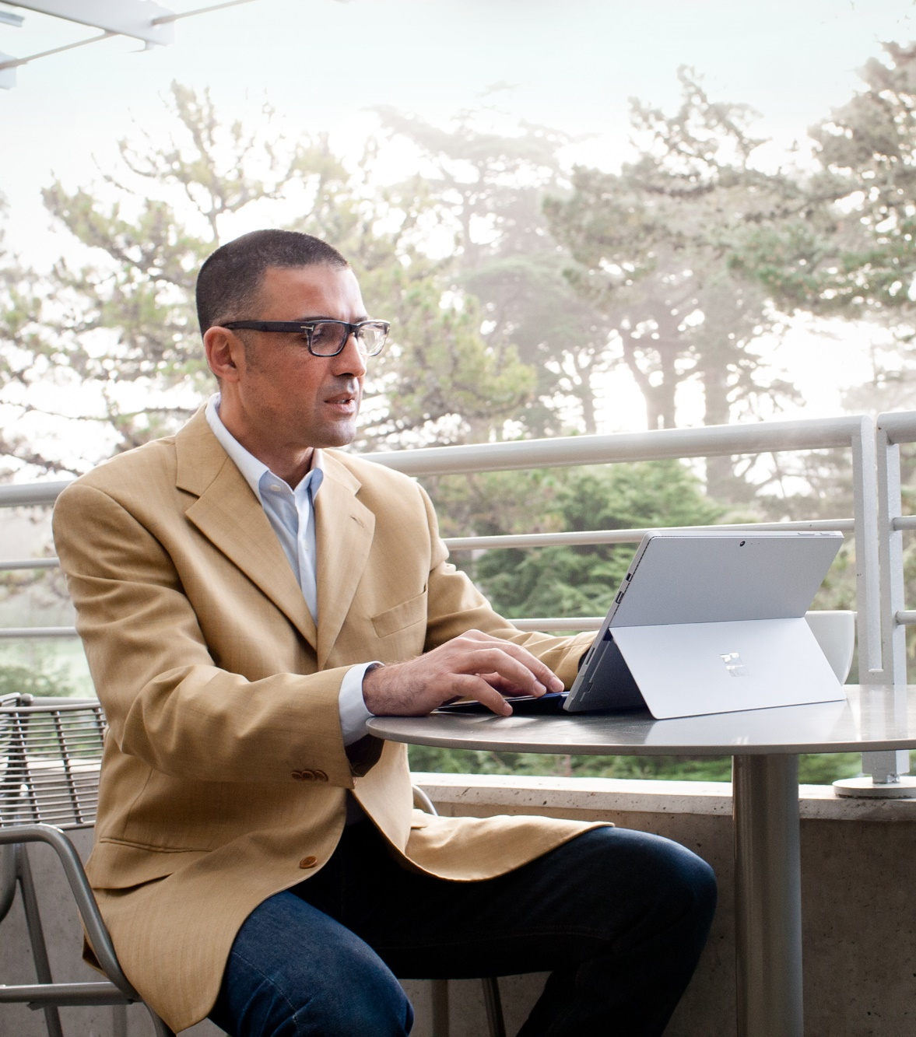
Trusted Devices Concept
At Microsoft, we never take your
trust for granted.
We offer a new class of “Trusted Devices”
with specific minimum hardware and software specs for security-minded customers.
A one-stop-shop for a total security solution.
“Businesses and users are going to embrace technology only if they can trust it.”
Satya Nadella
Notes:
Microsoft offers a one stop shop for the security you need in software and hardware so can be trusted with your security needs.
A total security solution for the cloud must begin with the device;
Security features in the hardware and Windows 10 OS strengthen end-to-end security posture

Slide 16
Windows 10 Security on Surface Devices
Virtualization Based Security
UEFI Secure Boot
Surface Enterprise Management Mode (SEMM)
Device Encryption
Windows Trusted Boot
Device Guard
Credential Guard
Windows Information Protection
Security Management²
Windows Update
Microsoft Edge
Windows Hello Companion Devices
BitLocker Admin and Monitoring
Conditional Access
Windows Defender
Trusted Platform Module
Windows Firewall
Windows Hello
BitLocker
Windows Defender Advanced Threat Protection
SmartScreen
BitLocker to Go
Device protection
Threat resistance
Identity protection
Information protection
Breach detection investigation & response
PRE-BREACH
POST-BREACH
Notes:
Key points to cover
Surface stands out as the only PC manufacturer with an additional layer of hardware security at the UEFI level
SEMM or Surface Enterprise Management Mode is only offered with Surface.
SEMM is already deployed on all your Surface device (Pro3, Pro4, Book, and Studio)
Speaker notes
Let’s revisit an earlier slide where we discussed why it is important to upgrade your PC when migrating to Windows 10. As per our earlier discussion, we know that you are going to get the full suite of Windows10 security features when you upgrade to a modern device (Device needs to have 64 bit and have UEFI secure mode enabled). However there is one additional Surface security feature which is unique to Surface and our Windows 10 customers. I want to introduce Surface Enterprise Management Mode, or SEMM. SEMM is already deployed to all of your Surface devices, you probably don’t even realize that you have this valuable enterprise management tool on your devices.

Slide 17
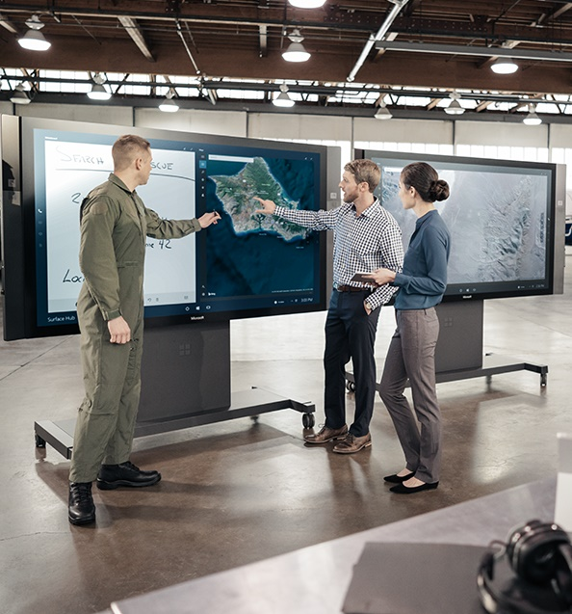
New categories, game-changing devices
(Re-)inventing categories
Natural interactions
Versatile form factors
Quality craftsmanship and design
Connected experiences
Notes:
And this is why we’re in the devices business. To allow governments to meet the growing expectation of the public to deliver a better service. They need to be able to trust and rely on technology to innovate, collaborate, communicate and make cost efficiencies.
We are redefining device categories, and empowering governments to achieve more. And to do so securely.
Our devices put people in the driver’s seat with natural and personal interactions (pen, touch, voice, gesture) that engage multiple senses.
They also push the envelope on what versatility means, by easily adapting to be more than just a smartphone or a tablet. They adapt and move with you―at a desk, in your lap, on the go, in a meeting.
Plus, we obsess over every detail. We’ve used the best cameras, so your face can be your log in. Our Surface Pens feel just right in your hand, for a paper-like experience. Everything is meticulously crafted.
And everything works together too. You can work from place to place, and swap from device to device, without any loss of productivity. You get the same connected experience every time.

Slide 18
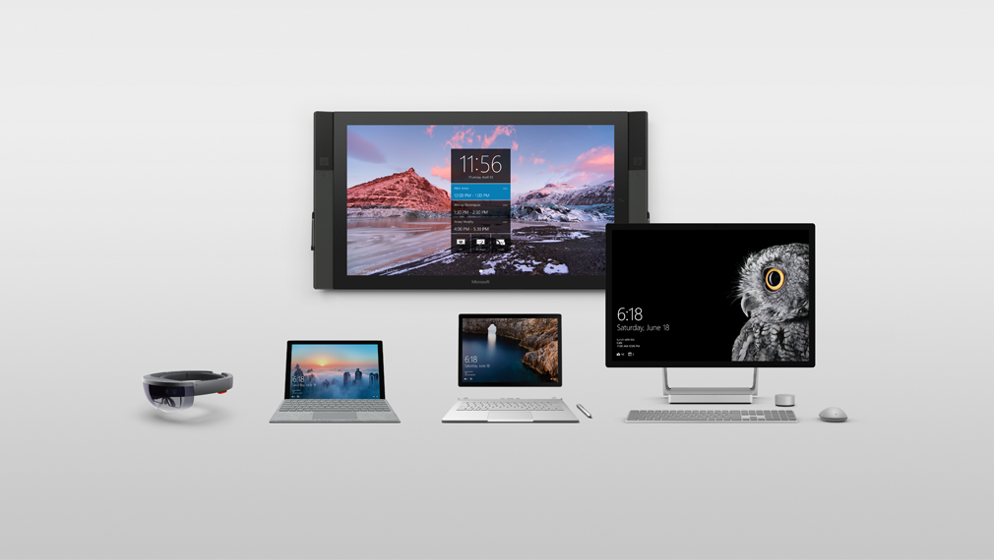
A portfolio designed around people
Natural
interactions
Versatile
form factors
Meticulously
crafted
Connected experiences
Notes:
We’re in the devices business to not just evolve and improve, but to revolutionize the way we work – the way we create, the way we innovate. To re-define and establish new categories of devices. To empower every business on the planet to achieve more.

Slide 19
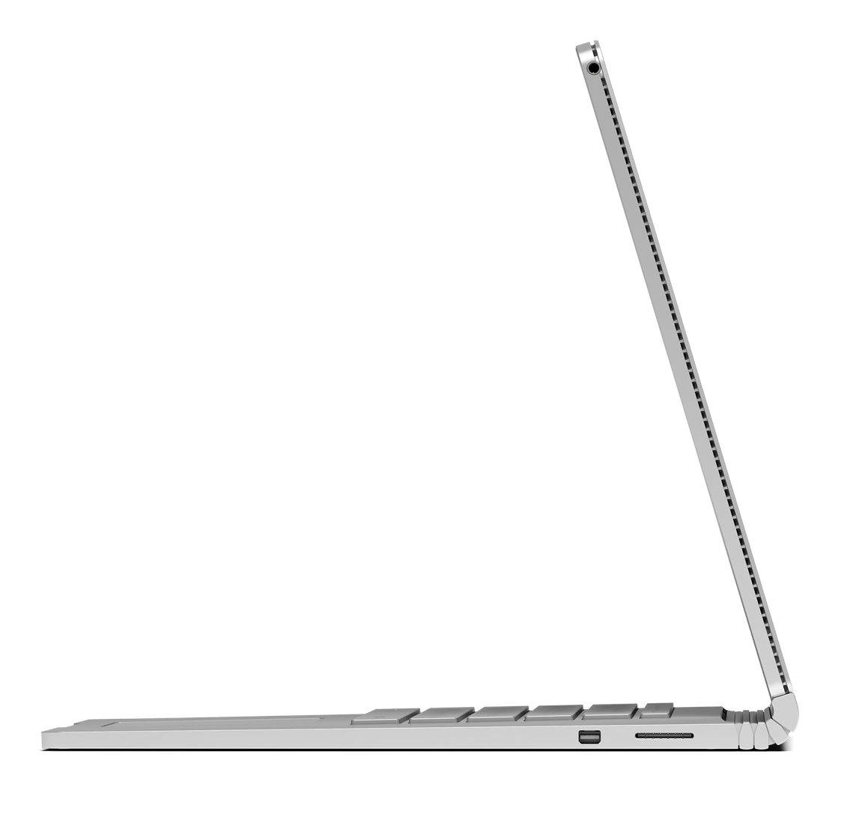

Surface in Government
Executives
Case Workers & Field Workers
Command & Control
Training & Simulation
Notes:
Here are the four key scenarios where Surface can make the most impact for your organization:

Slide 20

Executives
Typical challenges:
Limited in their ability to deliver fast, yet clear communications as they need to return to their desktop computers to access databases and organisational systems.
Legacy software requires access to a full PC, and is not built for tablet.
Need to protect confidential information means that individual mobile device configuration can be cumbersome and costly.
Tends to be long refresh cycles, and therefore there is a real need to buy devices which will last.
Notes:
Executives are increasingly needing to be mobile yet are hampered by the need to use office desktop computers for security reasons. Surface devices protect confidential information on mobile devices so security can be maintained on lighter, portable equipment.

Slide 21
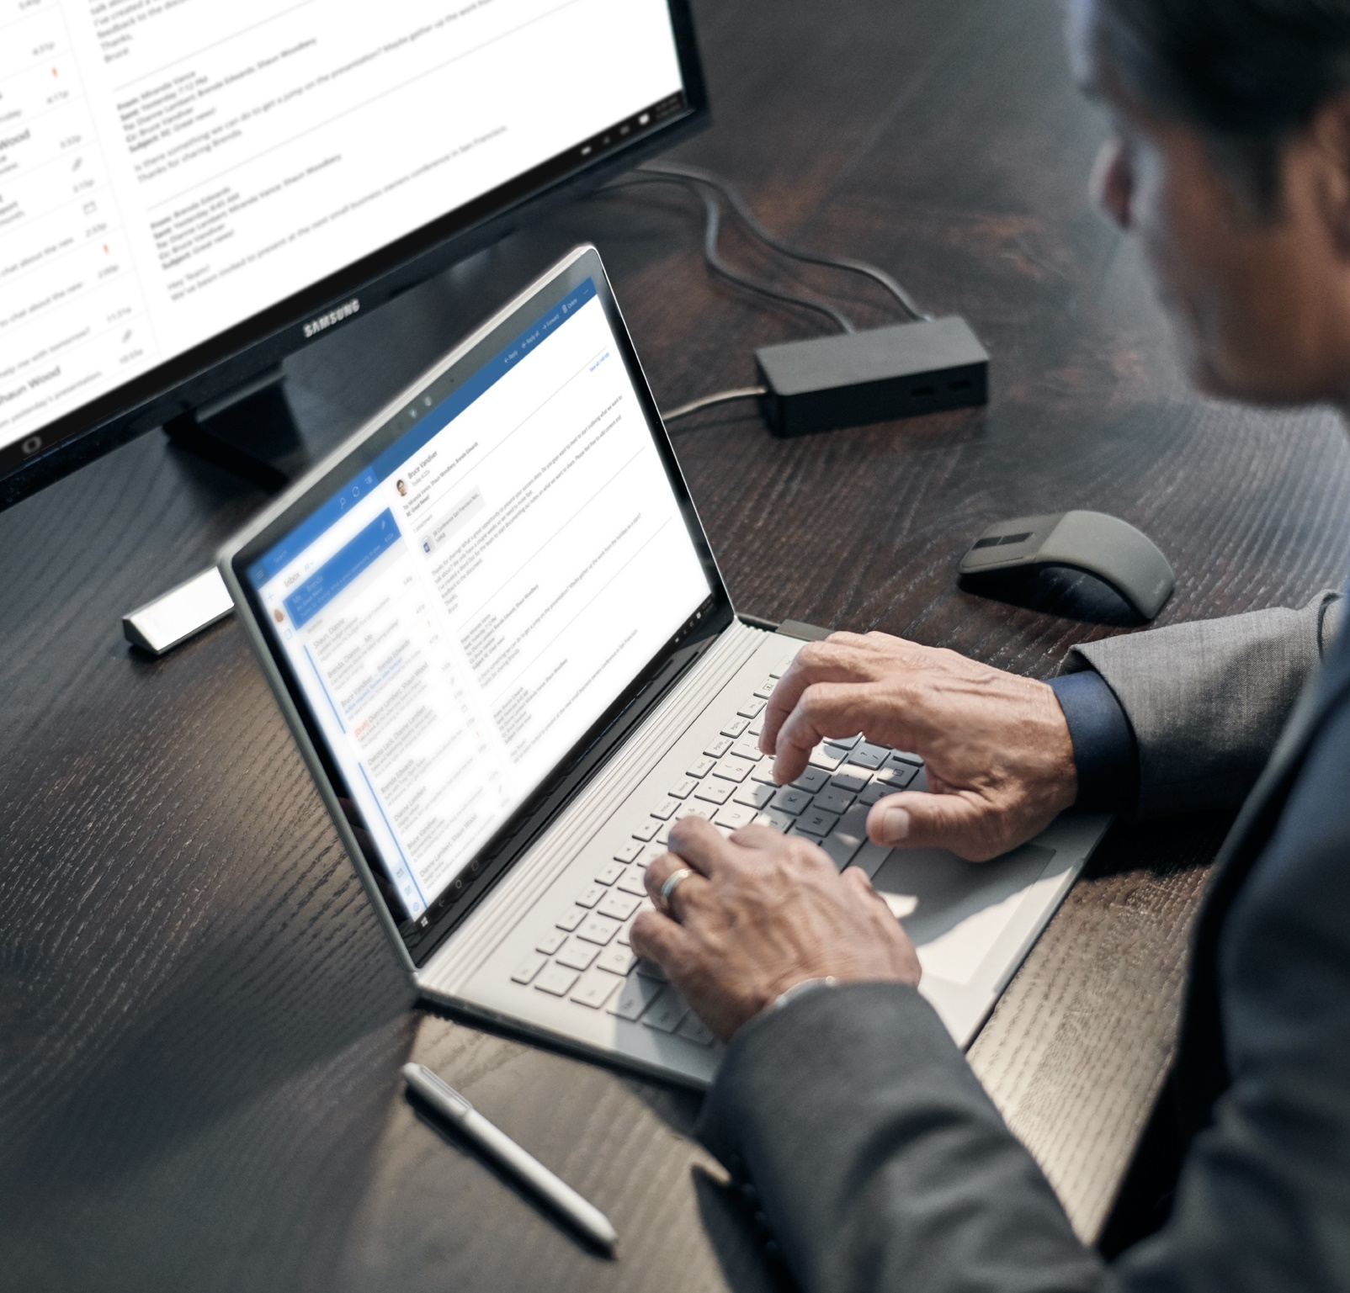
Executives
How we solve the problem:
Surface provides the best elements of a desktop, laptop, and tablet, so users can work with the best for the task in hand. This versatility can save money, as it reduces the need for multiple devices.
Windows 10 provides easy integration with existing operating systems and applications, and supports full versions of desktop apps and the full Office Suite
for productivity.
Each Surface device can be managed centrally, with security features like remote wiping,
to ensure confidential citizen
data remains protected when employees leave.
The powerful hardware and quality craftsmanship ensure that Surface devices will last throughout the long PC refresh cycles.

Slide 22
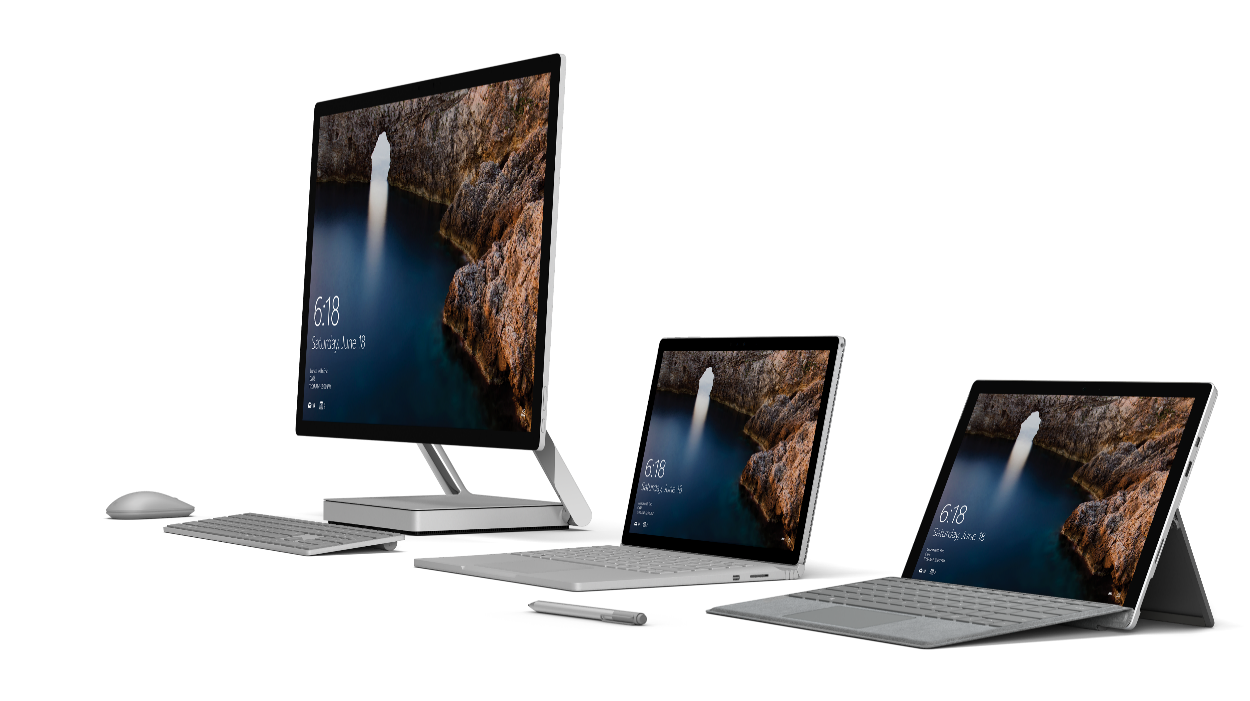
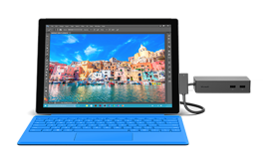
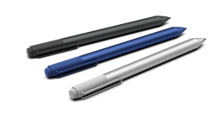


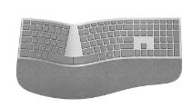

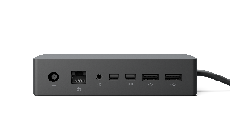
Surface for executives
BENEFITS
  Enable staff to be more effective from any location. Use full versions of desktop apps & Office for full productivity
  Eliminate the delays of logging into multiple devices throughout the day
  USB3.0, microSD, and Mini Displayport to attach peripherals
  Rich collaboration tools allow for easy note-taking and sharing using Pen or click-in type cover
  Create engaging presentations with HD touchscreen and side-by-side views
  Capture electronic signatures or write progress notes with the Surface Pen1
  Centrally managed policy and role based security and management,
  included device security
  Run the desktop software and apps you rely on such as CAVEDIGITAL Board Meeting, MetroStar eBriefing, Bigov Better City Indicators – all with slide touch
KEY ACCESSORIES
Surface Dock
From ultraportable to ultraproductive: Connect to dual monitors, speakers, a full-size keyboard and more
Surface Pen
Enables note taking, annotating changes or questions on Edge, PowerPoint, PDF and capturing customer signatures
Surface Type Cover, Keyboards & Mice
Optimized for fluid typing with well spaced mechanical keys, enlarged glass trackpads and ergonomic sculpting
Microsoft Complete
for Business
Extended service and accident protection for Surface; includes setup and reimagining support for up to three years
*Accessories sold separately.
Notes:
Surface Pro 4
12.3-inch PixelSense touchscreen display
Up to 9 hours of battery life¹
Up to 16GB RAM/256GB SSD³
i5/i7: 0.78 kg m3: 0.76 kg
Surface Pen included
¹Up to 9 hours of video playback. Testing conducted by Microsoft in September 2015 using preproduction Intel Core i5, 256GB, 8GB RAM device. Testing consisted of full battery discharge during video playback. All settings were default except: Wi-Fi was associated with a network. Battery life varies significantly with settings, usage and other factors.
³System software uses significant storage space. Available storage is subject to change based on system software updates and apps usage. 1 GB= 1 billion bytes. See Surface.com/Storage for more details.
Surface Book
13.5-inch PixelSense touchscreen display
Up to 12 hours of battery life*
Up to 16GB RAM/1TB SSD¹
1.51 kg
Surface Pen included
Up to 12 hours of video playback. Testing conducted by Microsoft in September 2015 using preproduction Intel Core i5, 256GB, 8 GB RAM device. Testing consisted of full battery discharge during video playback. All settings were default except: Wi-Fi was associated with a network and Auto-Brightness disabled. Battery life varies significantly with settings, usage and other factors.
¹ System software uses significant storage space. Available storage is subject to change based on system software updates and apps usage. 1 GB= 1 billion bytes. See Surface.com/Storage for more details.

Slide 23
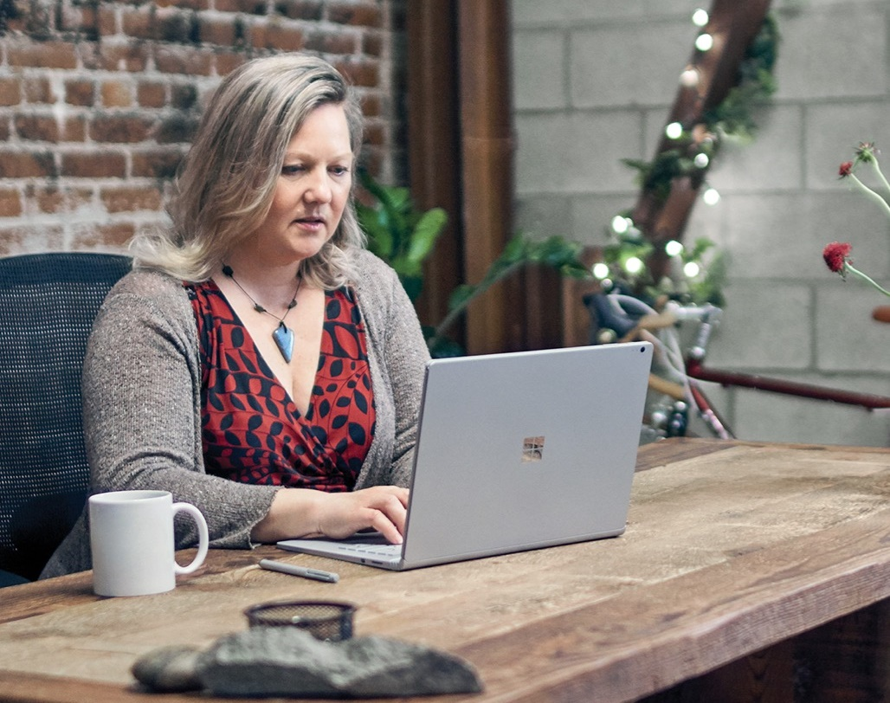
Case workers and field workers
Typical challenges:
Workers require multiple devices and duplication of effort when switching between mobile and desktop devices.
Security of information is a concern, as data loss or leaks will have a compounding impact on affected individuals.
Collaboration with other workers and departments is often difficult and time-consuming to coordinate when working on the move. This can affect the speed and accuracy of on-site decision-making.
Notes:
Case workers and field workers face similar challenges. Each needs to be mobile while maintaining secure connection with colleagues. Often their multiple devices are incompatible, leading to duplication of effort.

Slide 24

Case workers and field workers
How we solve the problem:
Enable better access to data and case content with a device that is mobile-friendly and supports desktop apps. Thin and light for easy portability, and stays charged for 9 hours.
Remote connections to internal resources through VPN and Direct Access, backed by the enterprise-grade security of Windows 10 to safeguard confidential information.
Collaborate on the move with OneDrive for Business which allows whole teams to work on the same document at the same time.
Increase transparency and reduce workload with Surface Pen real-time note taking and sharing via cloud services.
Rich collaboration with online annotation, shared field, and live discussions. Remote wipe to secure data when employees leave or devices are lost or stolen.
Fully document with HD cameras and mic. Authorize services with Pen signatures.
Notes:
Emphasise the Surface Pen here as it can help save time making case notes.
Other benefits include:
The lightweight and all-day battery life of Surface gives inspectors real-time visibility of dashboards and notifications. They can even provide remote authorization of services with a digital signature, using Surface Pen.
Capture a rich variety of information in the field – such as photos, videos, text, and audio – with the HD camera, Surface Pen, Type Cover, and microphone.

Slide 25
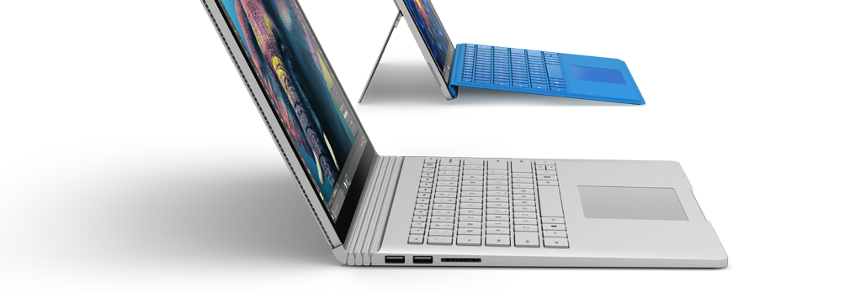
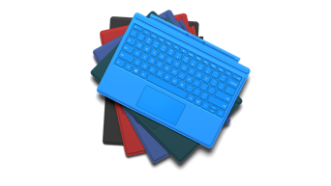
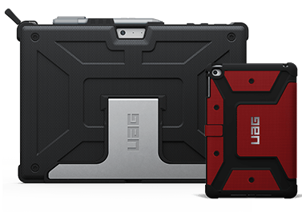
Surface for case workers and field workers
BENEFITS
  Enable better access to data and case content with a device that is mobile-friendly and supports desktop apps
  Thin and light for easy portability, with long battery life
  Increase transparency with real-time note taking and sharing via cloud services
  Rich collaboration with online annotation, shared field and live discussions. Remote wipe to secure data when employees leave, or devices are lost or stolen
  Fully document with HD cameras and mic. Authorize services with Pen signatures
KEY ACCESSORIES
Surface Dock
From ultraportable to ultraproductive: Connect to dual monitors, speakers, a full-size keyboard and more
Surface Pen
Enables note taking, annotating changes or questions on Edge, PowerPoint, PDF and capturing customer signatures
Surface Type Cover, Keyboards & Mice
Optimized for fluid typing with well spaced mechanical keys, enlarged glass trackpads and ergonomic sculpting
Durable Cases
Designed to allow versatility
*Accessories sold separately.
Notes:
Scenario 1. A case worker has a meeting early in the day with her team and uses the Surface Pro 4 to share the meeting notes on OneDrive. Then as she travels throughout the day to homes of local constituents she can quickly and accurately take notes using the pen, recording and saving to the centralized network –all protected with Windows 10 security features. Getting people to sign online documents is easy, and she can do it whilst presenting her data on a great screen.
Scenario 2. Multitasking is easy on the move when a field worker has his Surface Book. Whilst conducting visits he sees something that doesn’t seem right. He takes pictures and shares them with a colleague back at the office and receives real time feedback that he needs to take a closer look and create a new case file. He can do this whilst keeping the images on the same screen so he doesn’t have to flick back and forth between pages.
Surface Pro 4 benefits:
The tablet that can replace your laptop.
Perfect for those who prefer a tablet but want the processing power and versatility to use it as a laptop.
Beats laptops because it's thinner, lighter, and more versatile, with instant touch and pen functionality.
Surface Pro 4 features:
12.3-inch PixelSense touchscreen display
Up to 9 hours of battery life¹
Up to 16GB RAM/256GB SSD³
i5/i7: 0.78 kg m3: 0.76 kg
Surface Pen included
¹Up to 9 hours of video playback. Testing conducted by Microsoft in September 2015 using preproduction Intel Core i5, 256GB, 8GB RAM device. Testing consisted of full battery discharge during video playback. All settings were default except: Wi-Fi was associated with a network. Battery life varies significantly with settings, usage and other factors.
³System software uses significant storage space. Available storage is subject to change based on system software updates and apps usage. 1 GB= 1 billion bytes. See Surface.com/Storage for more details.
Surface Book benefits:
The ultimate laptop.
Perfect for those who prefer a laptop and want the ultimate power and versatility to work in new ways.
Beats laptops because its screen detaches to become a tablet, it has an incredible keyboard and it works with touch and pen.
Surface Book features:
13.5-inch PixelSense touchscreen display
Up to 12 hours of battery life*
Up to 16GB RAM/1TB SSD¹
1.51 kg
Surface Pen included
Up to 12 hours of video playback. Testing conducted by Microsoft in September 2015 using preproduction Intel Core i5, 256GB, 8 GB RAM device. Testing consisted of full battery discharge during video playback. All settings were default except: Wi-Fi was associated with a network and Auto-Brightness disabled. Battery life varies significantly with settings, usage and other factors.
¹ System software uses significant storage space. Available storage is subject to change based on system software updates and apps usage. 1 GB= 1 billion bytes. See Surface.com/Storage for more details.

Slide 26

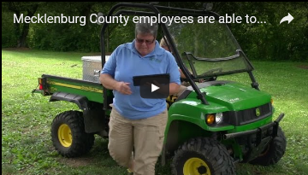
“With the Surface, it basically gives employees a full-featured computer that they can use from anywhere… Our biggest challenge now is that everyone wants one so it’s hard to keep up with the demand!”
Cliff Du Puy, Technical Services Director
Situation
Mecklenburg County, North Carolina has a population of nearly 1 million people, many of whom live in Charlotte - the fifth fastest growing city in the United States.
Solution
Equip restaurant inspectors, medical examiners, parks and recreation, social workers with Surface as a single 3-in-1 device--a tablet, laptop, & desktop. 1-person 1-device initiative: each mobile worker has phone serving as mobile hotspot
Benefits
Restaurant inspectors, medical examiners, and Parks & Rec enter findings digitally on site, saving time and resources. IT easily manage security of mobile data with BitLocker and remote wipe capability.
$3.2 million/year
saved by increased productivity in Youth and Family Services Dept.
Notes:
Mecklenburg County, North Carolina has a population of nearly 1 million people, many of whom live in Charlotte - the fifth fastest growing city in the United States.
They chose to equip restaurant inspectors, medical examiners, parks and recreation, social workers with Surface on a 1-person 1-device initiative.
Restaurant inspectors, medical examiners, and Parks & Rec can now enter their findings digitally on site, saving time and resources. IT can easily manage security of mobile data with BitLocker and remote wipe capability.
The country now saves an average of $3.2 million/year though increased productivity just in their Youth and Family Services Department.

Slide 27
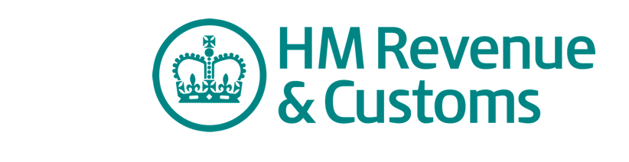

Situation
Her Majesty’s Revenue and Customers, the UK tax and customs agency was accountable for a 30% reduction of resources in the next few years. They needed to provide staff with the right tools to help transition towards a paperless process, to allow them to work and operate with more flexibly, and to make them more productive. They also want to be at the forefront of innovation in order to attract recent graduates and talent to come and work for their organization.
Partner Solution
CDW UK identified RFP opportunity 18 months earlier, introducing Microsoft. The RFP was run through Cap Gemini (the outsourcer).
200 iPads were displaced in exchange for Surface Pro for:
A familiar look and feel of Microsoft applications.
Ease of fast user adoption
Simple integration w/ existing MSFT business applications.
The customer also:
Upgraded to System Centre 2012 to better manage devices.
Upgraded to Office 365, Skype for Business – to potentially displace Google hangouts
Universal app developed to optimize for touch and go paperless
Notes:
16K Surface devices
18 mo process

Slide 28

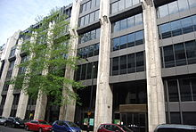

The Department for Work and Pensions (DWP) is responsible for welfare, pensions and child maintenance policy. As the UK’s biggest public service department it administers the State Pension and a range of working age, disability and ill health benefits to over 22 million claimants and customers.
DWP are one of Microsoft UK’s largest Public Sector customers for Surface devices and are now deploying Surface Hub as part of their collaboration strategy. The first installation in DWP was 'white gloved' given the complex Lync 2010 environment, this was successful and DWP are now planning the rollout of the remaining 10 devices.

Slide 29

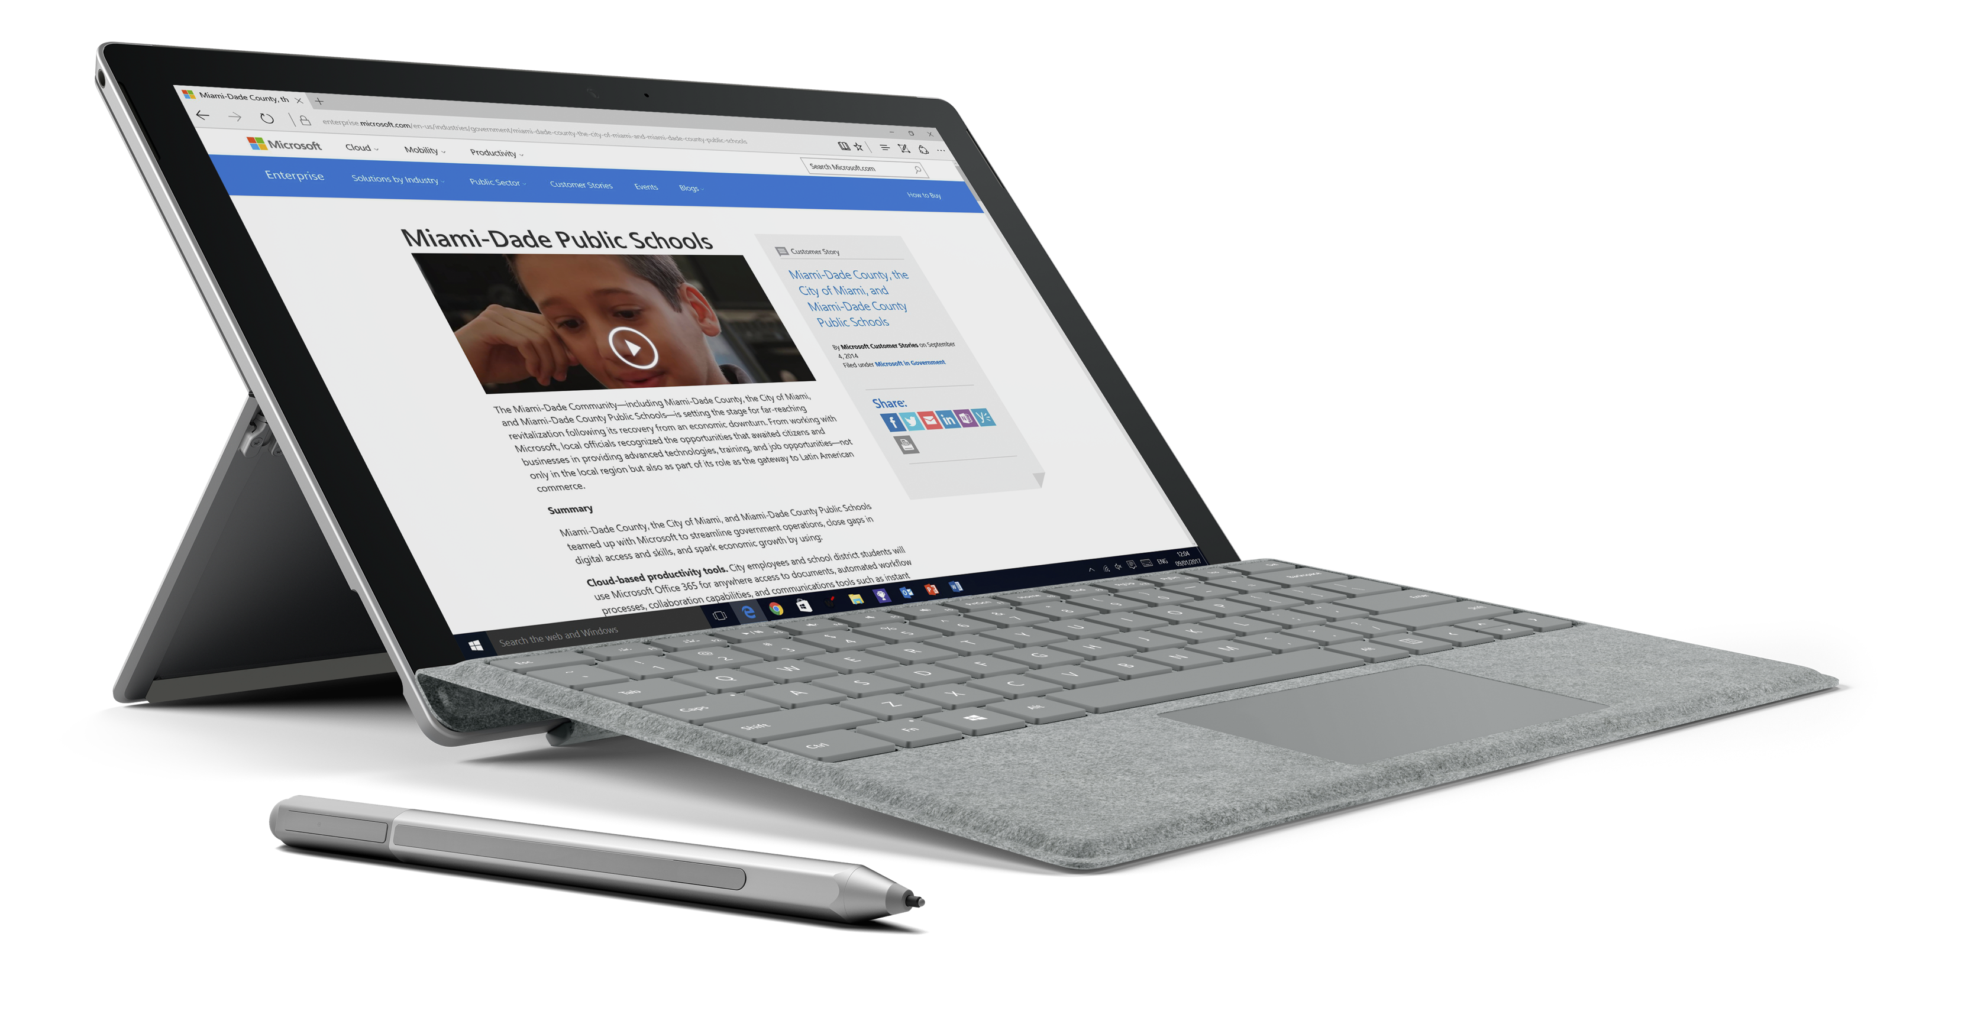
“We conducted a comprehensive analysis of other products on the market, and we found that Surface devices met our needs best in terms of performance, application compatibility, multitasking behavior, and user experience.”
Marco Sanchez
Network Administrator
Situation
Miami's metro area is the eighth most populous and fourth-largest urban area in the United States, with a population of around 5.5 million.
Solution
Equip inspectors with Surface Pro as a single 3-in-1 device--a tablet, laptop, & camera. For executives, Surface Pro replaces laptop, and with docking station becomes desktop. Access all inputs needed to be productive: pen, voice, touch, keyboard, & mouse.
Benefits
Fewer trips between office/car and site for inspectors, and enable on-site report writing.
Permanent access to information systems from any place. Performance gain >20% when running multiple apps vs. previous laptop.
Notes:
Miami's metro area is the fourth-largest urban area in the United States, with a population of around 5.5 million.
As part of their ‘smart government strategy’ they chose to equip inspectors with Surface Pro as a single 3-in-1 device – a tablet, laptop, & camera. For executives, Surface Pro replaces a laptop.
The inspectors are able to use all of the inputs to increase productivity: pen, voice, touch, keyboard, & mouse.
This means fewer trips to and from the office, enables report writing, and provides permanent access to information systems from any place.
They’ve experienced a performance gain of more than 20% when running multiple apps versus on their previous laptops.

Slide 30

Command & Control
  Typical challenges
  Commanders’ success depends on:
  Clear communication.
  Secure messaging.
  Access to legacy business systems.
  Data analytics.
  Communicate with a dispersed worldwide team.
  Collaboration in the public sector is centered around the whiteboard, while using personal devices and consumer software to integrate modern technology.
Notes:
Command and Control tend to use static white boards, projectors and conference systems. These simply add to the challenges they face.

Slide 31

Command & Control
  How we solve the problem:
  Surface Hub empowers the command centre to collaborate.
Commanders can plan, direct and co-ordinate personnel, equipment, communications, facilities, and procedures while controlling human resources and operations in the accomplishment of a mission.
Notes:
Surface Hub is a powerful team collaboration device designed to advance the way people work together naturally. It provides agencies across the public sector with a telecommunications device for groups to collaborate on, utilizing advanced technology, while leveraging their current investments in telecommunications software, legacy business systems, and security systems.
Surface Hub provides government works with a device that is designed for:
Clear and concise communications
Collaboration with any user
A platform for amazing large screen apps
Advanced technology for the modern workplace
Perfect for teams that need come together in real-time and collaborate. Surface Pen empowers a turnkey solution of the traditional whiteboard, which is a preferred tool of commanders.
Beats your average video conference and leverages Skype for Business deployment in the majority of public sector agencies.
Email whiteboard creates and sends a digital copy of operating instructions, ensuring clear communication of orders.
See it all on the big screen and work with the emerging ecosystem of immersive large screen apps to allow leaders to better communicate instructions.
With wide-angle, high-definition cameras, infra-red presence sensors and high-performance microphones, Surface Hub brings teams together seamlessly.

Slide 32
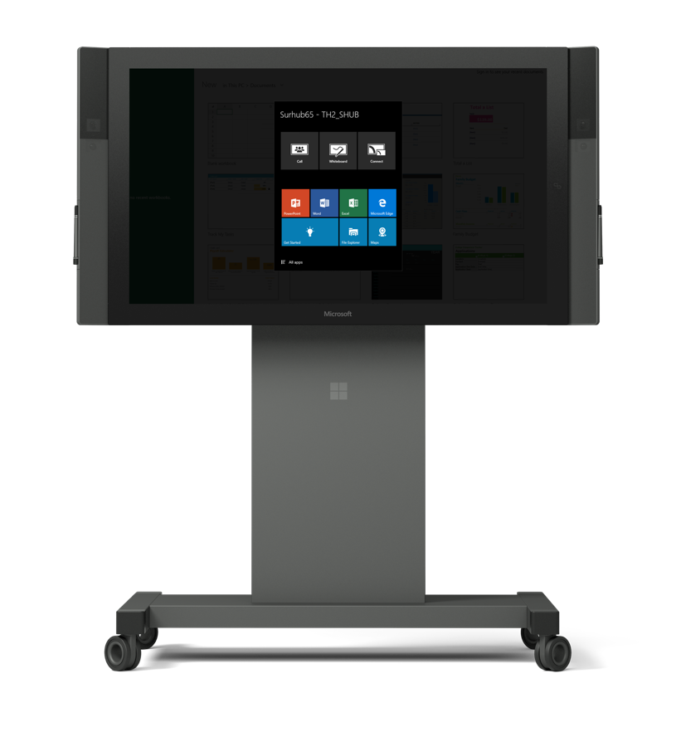
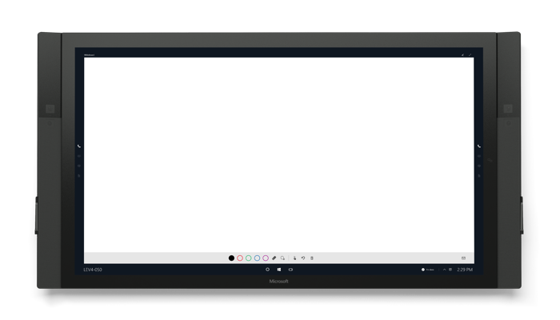
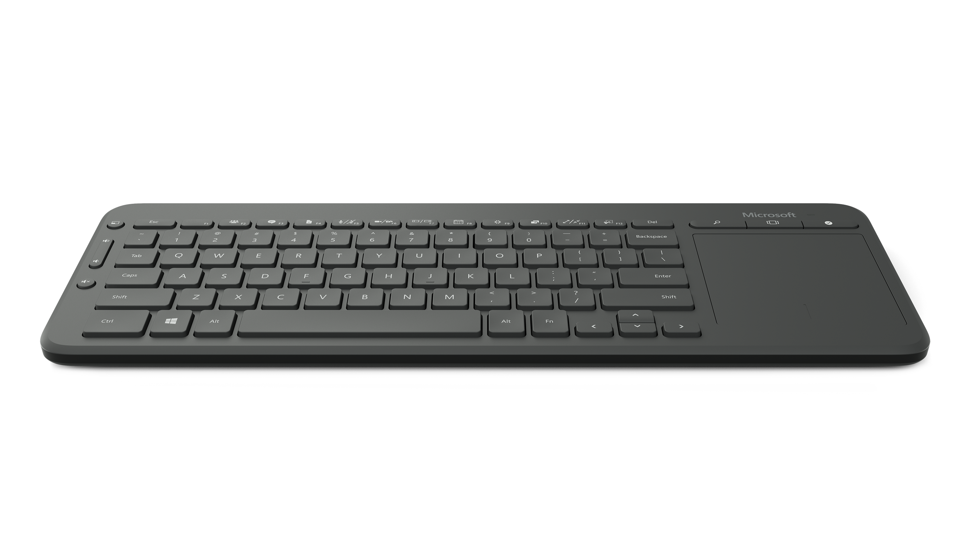
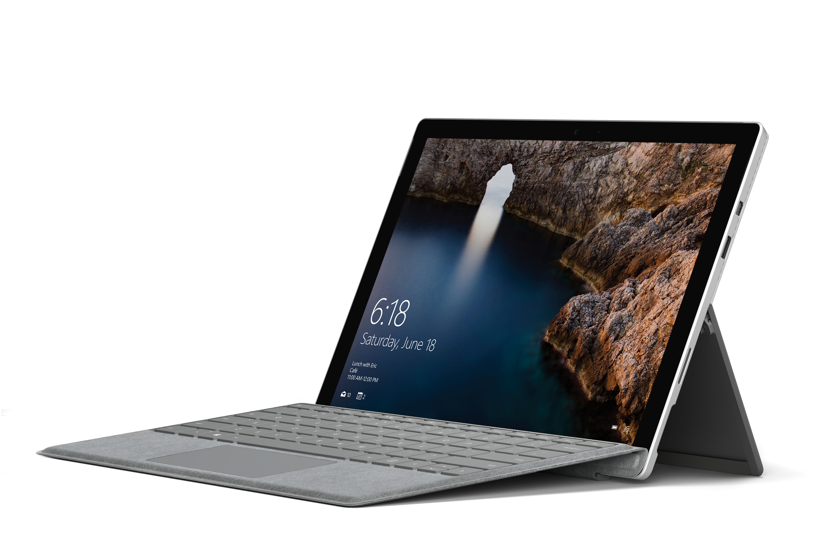

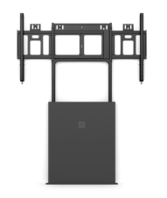
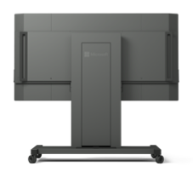
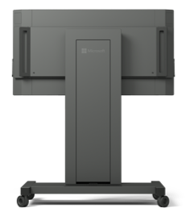
Surface for command & control
BENEFITS
  Arrange personnel, equipment, communications, facilities and procedures in the accomplishment of a mission
  Skype for Business keeps everyone on the same page. Remove users see the screen, annotations, and the people in the room
  The brilliant large touch screen makes it easy to focus in on a
  maps and data, using hands
  Empowers a turnkey solution of the traditional pen and whiteboard, which is a preferred tool of commanders
  Creates and sends a digital copy of operating instructions,
  ensuring clear communications of orders to all personnel
  Use Surface or other devices to project wirelessly onto Surface Hub
  Integrates ProCap touch technology, HD cameras, stereo speakers, with either 4K or HD resolution
  Powered by Microsoft UWP and HTML 5 strategy, numerous apps can already be ported directly to the Hub
Pen / Whiteboard
Empowers a turnkey solution of the traditional whiteboard, which is a preferred tool of commanders
Surface Hub Keyboard
Connect via Bluetooth for quick typing and trackpad. Shortcuts include Skype for Business and quick connection to projector and whiteboard
Surface Pro 4
KEY ACCESSORIES
Wall or Floor
Support Mounts
Fixed and stable placement
Rolling Stand
Easily move between spaces
*Accessories sold separately.
Notes:
Discover how Surface Hub can help command and control communicate better:
Scenario 1: Command and control wants to run a conference call with a department in another state, this will cover some very sensitive information. They securely access the hub, then work together on Skype for Business to run through the performance metrics of the nationwide program.
Scenario 2: In a brainstorm session participants use the Surface Pen to write notes all over the screen, which hub automatically saves. Three people are marking the documents at one time, all recognized as individuals with hubs screen technology. The notes are then shared after the meeting on the secure server.
Scenario 3: After a meeting one of the participants wants to forward on the document to a colleague to look at as it might be of interest to him, but the security protection within Windows 10 kicks in and prevents the colleague accessing the document before he receives permission – making sure no sensitive data is shared when it shouldn’t be.
The key features that empower these scenario are:
Skype for Business
Pen/Whiteboard
Email Whiteboard
Large screen apps
Key features of the Surface Hu:
Whether 84” or 55”, Microsoft Surface Hub offers a responsive and natural inking experience, advanced touch capabilities, Windows 10 and Microsoft Office, including Skype for Business and PowerPoint.

Slide 33
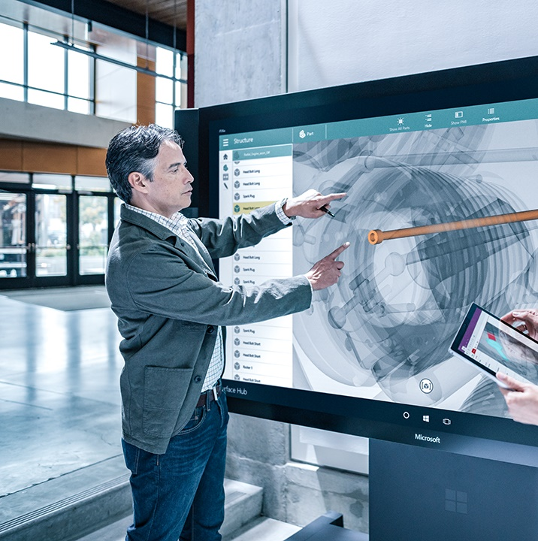
Training & Simulation
  Typical challenges
  Clear communication
  Secure messaging
  Access to legacy business systems
  Data analytics
  Communicate with a dispersed worldwide team
  Tools that don’t keep up (whiteboards, projectors)
Notes:
Training and simulation in the public sector is centered around static whiteboards, projectors and conference systems while using personal devices and consumer software to integrate modern technology.

Slide 34

Training & Simulation
  How we solve the problem:
Surface Hub’s collaboration tools means you can run a training session for case workers easily. Skype for Business provides the access, and screen sharing on Windows 10 means the trainee can see exactly what the instructor is referring to. They can make notes together on a shared document as they go, and then the group can be set off on an exercise whilst the instructor takes a back seat.
Large screen apps running industry software make the collaboration effortless, whilst being secure in the knowledge no sensitive information will leave the room.
Notes:
As with all government roles, security is an issue with training and simulation. Collaboration is vital but the current way of working – whiteboards and projectors – leaves information open to security risks.
With Surface Hub, collaboration is easy and secure.

Slide 35
Surface for training & simulation
BENEFITS
  Reduce the valuable time that is typically wasted by trying to connect and get remote participants on board
  Leverages the emerging large screen app portfolio that utilizes familiar solution providers and gestures
  Empowers a turnkey solution of the traditional pen and whiteboard, which is a preferred tool of commanders
  Creates and sends a digital copy of operating instructions, ensuring clear communications of orders to all personnel
  Premium A/V Experience
  Integrates ProCap touch technology, HD cameras, stereo speakers, with either 4K or HD resolution
  Familiar LOB Solutions
  Powered by Microsoft UWP and HTML 5 strategy, numerous apps can already be ported directly to the Hub
Pen / Whiteboard
Empowers a turnkey solution of the traditional whiteboard, which is a preferred tool of commanders
Surface Hub Keyboard
Connect via Bluetooth for quick typing and trackpad. Shortcuts include Skype for Business and quick connection to projector and whiteboard
KEY ACCESSORIES
Wall or Floor
Support Mounts
Fixed and stable placement
Rolling Stand
Easily move between spaces
*Accessories sold separately.
Notes:
Surface Hub is an off-the-shelf multi-touch enabled device designed for training and simulation, whereby various types of skills can be acquired in a controlled environment without the need of high cost assets, risk to human life, and co-located instructors.
Scenario 1: The trainer has a pre-prepared PowerPoint presentation that he wants to display on Surface Hub’s large screen. Surface Hub is ideal for larger settings like medium and large conference rooms. The 84” model allows three people to comfortably interact with the screen simultaneously. With 4K resolution on a very large display, it also makes a great place to share and analyze data. With natural inking and advanced touch capabilities at its core, the 84” model makes collaborating on a large screen both inviting and easy.
Scenario 2: Participants are based in different states. The trainer uses Skype for Business to give each trainee secure access to his teaching materials.
Scenario 3: I need help devising a third scenario please.
The key features that empower this scenario are:
Large screen apps
Premium A/V experience
Familiar LOB solutions

Slide 36



“Students today are digital natives, and you have to engage them in the way they like to learn.”
Mary Ripley, Chief Digital Officer
U.S. Naval Institute
Students at the U.S. Naval Academy studied the War of 1812 in the Chesapeake Bay on a “schoolhouse at sea,” with a whole footlocker of learning materials packed into the compact Surface Pro.
U.S. Naval history met modern technology in spring 2016 when 10 U.S. Naval Academy midshipmen and their instructors relived history on the Lynx, a replica Baltimore Clipper tall ship, in the Chesapeake Bay.
“West Point cadets [at the U.S. Military Academy] can relive history by visiting battlefields, but U.S. Naval Academy students can’t do that, because many naval battles were at sea,” explains Mary Ripley, Chief Digital Officer at the U.S. Naval Institute, a sponsor of the two-day class. “We want future military leaders to learn and understand their history so that they can make the best possible decisions in the future.”
The Schoolhouse at Sea team acquired 20 tablets for students and faculty, loaded them with course materials—much of it published by the Naval Institute—and loaned the devices to students two weeks before setting sail. The tablets were also loaded with the latest version of Microsoft Office, courtesy of a Naval Institute Microsoft Office 365 subscription. Students did all their advance reading and note-taking on the Surface Pro 4 devices—no paper, no clutter.

Slide 37
Surface Pro users get stuff done…
>90
>60
10
%
%
%
Agree or strongly agree they get more done away from their desk
Agree or strongly agree they are more satisfied with their ability to get things done
increase in productivity
Forrester Research, Microsoft Surface Pro 3 Delivers Reduced Device Costs And Improved Revenue, June 2015. Statistics based on using a Surface Pro 3 device.
Notes:
The results – in terms of efficiency, productivity and cost-savings - speak for themselves.

Slide 38
One device to to rule them…
$615
saved on device spend
Forrester Research, Microsoft Surface Pro 3 Delivers Reduced Device Costs And Improved Revenue, June 2015. Statistics based on using a Surface Pro 3 device.
Notes:
The results – in terms of efficiency, productivity and cost-savings - speak for themselves.

Slide 39
Surface Hub total economic impact
$1.5
$1
Installation and ongoing costs
$1,065,697
Millions 3-year analysis
Device costs
$0.5
in year 3
Sales improvement enabled
by Surface Hub client meetings
Meeting productivity
Annual benefit after full ramp up
of Surface Hub devices
$0
Meeting productivity
$1.4m
Benefits
$620k
Costs
Forrester Research, Microsoft Surface Pro 3 Delivers Reduced Device Costs And Improved Revenue, June 2015. Statistics based on using a Surface Pro 3 device.
Notes:
Don’t just take our word for it.
A Forrester Total Economic Impact study has studied the financial benefits on organizations.

Slide 40
Surface Hub ROI
ROI
138
9
Months payback
%
Notes:
Don’t just take our word for it.
A Forrester Total Economic Impact study has studied the financial benefits on organizations.

Slide 41
What Surface Hub users say…
“We had a client meeting to propose a project. Instead of using the whiteboard, we used the Surface Hub, and it was incredibly successful.“
Director of Design and Construction,
Architecture Firm
“Emailing the OneNote files after a meeting saved time
on every meeting that uses the Surface Hub.“
COO,
US law firm
Forrester Research, Microsoft Surface Pro 3 Delivers Reduced Device Costs And Improved Revenue, June 2015. Statistics based on using a Surface Pro 3 device.
Notes:
Don’t just take our word for it.
A Forrester Total Economic Impact study has studied the financial benefits on organizations.

Slide 42
Surface Hub productivity
15-23
$25
Minutes saved on pre
and post meeting tasks
In printing costs
saved per meeting
20%
Increase in sales from client meetings leveraging Surface Hub
Forrester Research, Microsoft Surface Pro 3 Delivers Reduced Device Costs And Improved Revenue, June 2015. Statistics based on using a Surface Pro 3 device.
Notes:
Don’t just take our word for it.
A Forrester Total Economic Impact study has studied the financial benefits on organizations.

Slide 43
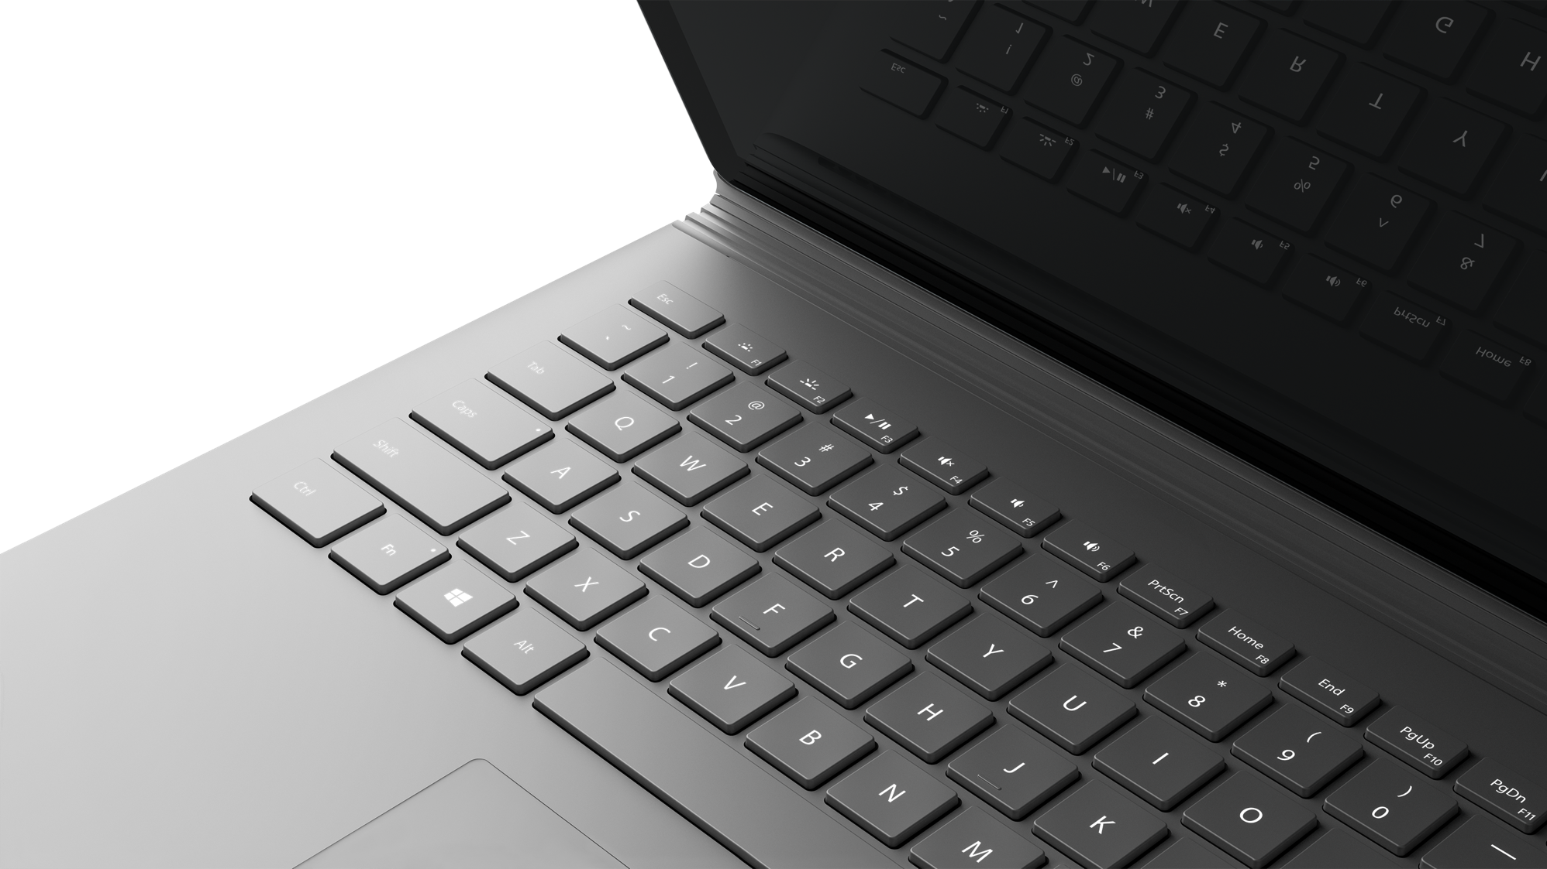
Next Steps

