Slide 1
Read me
Start by understanding the value proposition for Microsoft Devices
as a catalyst for Digital Transformation (pitch deck).
Use this industry deck to convey the value of the portfolio to this specific audience. Key scenarios and customer stories are included.
For product deep dive decks, use the Microsoft Book, Microsoft Studio, Microsoft Surface Pro, Microsoft Lumia, or Microsoft HoloLens decks.
For Microsoft sellers
Windows in Retail Deck
Windows Security in Retail
MSFT Devices Pitch Deck: visit Infopedia/Sales & Marketing/Devices (1st party) then click Portfolio.
Product decks: visit Infopedia/Sales & Marketing/Devices (1st party), then select the product of interest.
Industry apps & demos: Click here for the latest Surface apps and demos deck for Manufacturing.
For Partner sellers
Talk to your Microsoft PCMM or PSE for the latest readiness and marketing content. It lives on Drumbeat.
Notes:
For more information on the Microsoft Devices value proposition for all businesses, take a look at the Microsoft Device Portfolio pitch deck [add link].
For more deep-dive and technical information on each product, use the following decks:
Microsoft Surface deck [add links]
Microsoft Book deck
Microsoft Studio deck
Microsoft Surface Pro 4 deck
Microsoft Lumia deck
Microsoft HoloLens deck

Slide 2
Let’s discuss your current business challenges
Notes:
Jot these down with Surface Pen on the screen…
Pressures on your industry
Challenges your business is facing. Do they fall into these catagories:
1. empowering employees
2. engaging with customers
3. finding operational efficiencies
4. transforming your products or services
How does technology currently play a role?
How is technology holding you back?
What are the main user types/scenarios in your business?
What technology do they currently use?
What sort of improvements would you like to see? Are there metrics you’re trying to meet? (increased productivity, improved operations, improved sales close rates?)

Slide 3
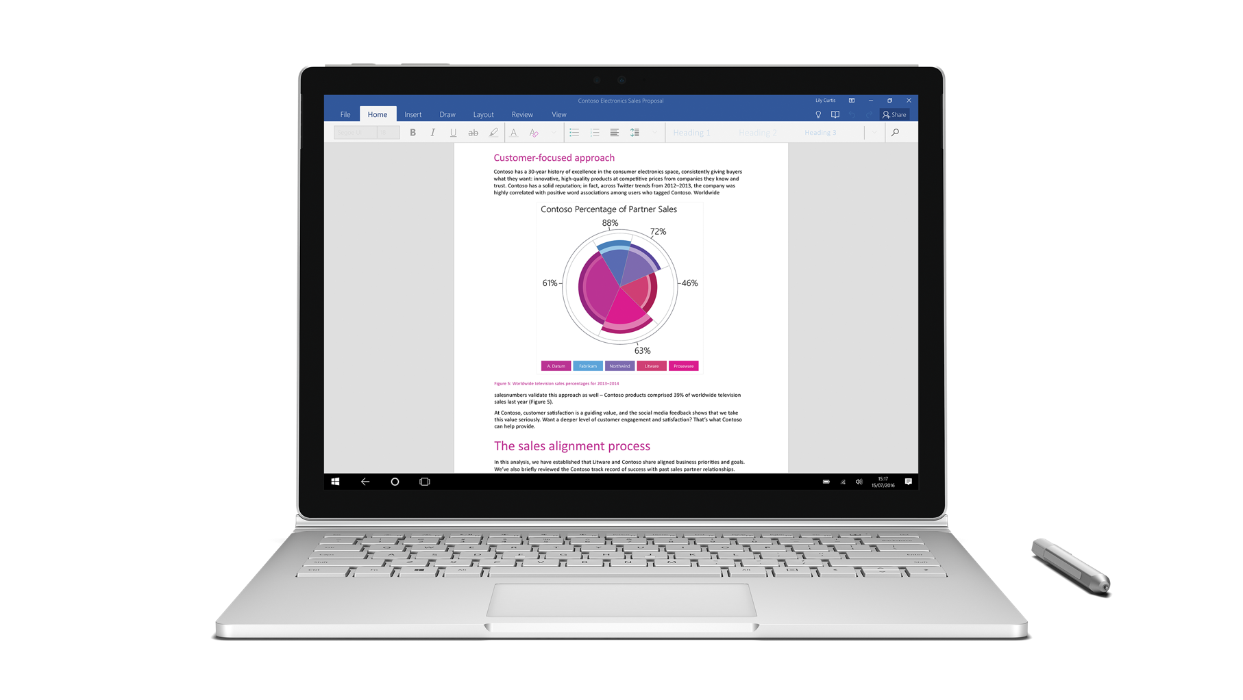
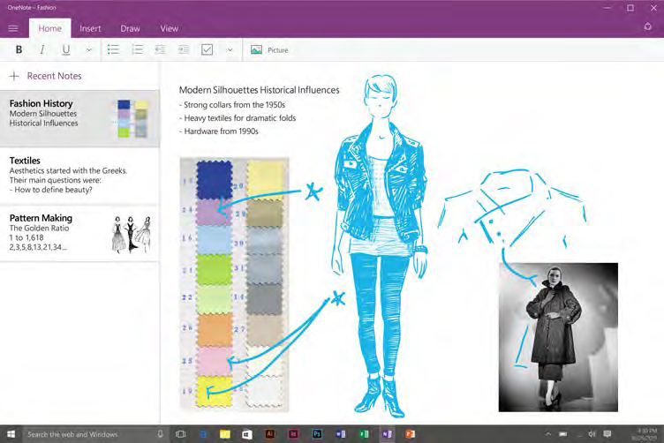
Microsoft Devices
for Retail
Name
Title

Slide 4

Retail landscape
New demands
Customer delight
Personalized shopping experiences
Augmented loyalty programs
The modern workforce
Demand-driven supply chain TBC
The rise of mobile and the digitally connected customer
The union of cloud and mobile
Notes:
The bullets below are a prompt for some of these key themes. Pick and choose, and bring in others, to suit your customer. ​
Bullet point 1: Customer delight is intrinsically linked to sales. Low delight = low sales. To minimize showrooming (viewing in-store, buying cheaper online) the retail store needs to be attractive enough for consumers to relate to it and believe in it. Despite being the first generation born into a digital society, Millennials spend most of their retail dollars at bricks-and-mortar stores. They’re interested in experiencing things and customizing their shopping experience (price, promo, delivery options). Conversely, Millennials want to feel valued as customers and, if not, their feedback is instant, widespread and social.
Bullet point 2: Adding a personal/human touch, that is only possible face-to-face, makes in-store interactions valuable and irreplaceable. Millennials expect a customer-centric experience that’s tailored to deliver on their wants and needs right away. Retailers need to develop an omni-channel strategy (combining the advantages of physical stores and the information-rich, convenience of online shopping).
Bullet point 3: Augmented loyalty programs demonstrate added value to customers. They provide a more personalized shopping experience. Retailers drive sales with tangible benefits and relevant product /service recommendations
Bullet point 4: Attracting and managing the modern workforce has a number of challenges yet it is vital in order to maintain high level of responsiveness and face-to-face interaction. Competition for top talent continues to increase and millennials expect premium tools that are at least as good as their personal devices and experiences. They are attracted by sophisticated mobile, social and cloud technologies. Equally there is a need to accommodate an ageing workforce with easy-to-use tools.
Bullet point 5: Digitally-connected customers have information at their fingertips about competitors’ pricing and availability. This knowledge makes them powerful. Retailers have the opportunity to offer more immersive/engaging customer service/shopping experiences and enhance productivity behind the scenes with the use of mobile point-of-sale devices. These can alleviate pressure on checkouts, close quick sales and reduce abandoned baskets. However, retailers need to factor in the cost of purchasing additional IT tools to manage the devices, the need to rebuild existing line-of-business applications for new operating systems and the limited functionality of some consumer devices
Bullet point 6: Customers expect quick response times and custom ordering and shipping options. Retailers need to find operational efficiencies through group collaboration and informed decision making to accommodate this.
Bullet point 7: Start ups (disrupters) are as threatening as ever due to access to big data and more affordable cloud services combined with access to even more mobile tools. Companies need an agile and empowered management model in order to make informed decisions around all the data they now have access to and react to customer demands more quickly.

Slide 5
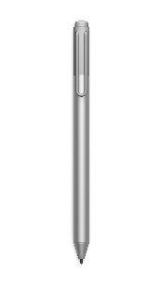


Built on Windows 10
Safer and more secure
More productive
More personal
Windows Hello
Device Guard
Windows Defender ATP
Windows Information Protection
Credential Guard
Windows Ink
Office + Windows
Microsoft Edge
Azure Active Directory
Mobile Device Management
Dynamic Provisioning
Windows Store for Business
Cortana at Work

Slide 6





Windows 10 security for modern devices
Device protection
Threat resistance
Identity protection
Information protection
Breach detection, investigation, and response
Virtualization-based security
UEFI Secure Boot
Windows Trusted Boot
Windows Update
Trusted Platform Module
Device Guard
Microsoft Edge
Windows Defender
Windows Firewall
SmartScreen
Credential Guard
Windows Hello Companion Devices
Windows Hello
Device Encryption
Windows Information Protection
BitLocker Admin and Monitoring
BitLocker
BitLocker To Go
Security Management
Conditional access
Windows Defender Advanced Threat Protection
Pre-breach
Post-breach

Slide 7

Secure your identities
A retail associate is carrying a modern POS device around the sales floor, which she uses to complete customer purchases. She logs in to this Windows 10 device.
RETAIL ASSOCIATE
Engages with customers to sell products
Uses POS devices, mobile or fixed
Handles customer credit card information
Windows Hello*
Enables native support of multi-factor authentication—such as biometrics or companion devices—to validate users.
Helps ensure only authenticated users can sign-in to the device and gain access.
* Windows Hello requires specialized hardware such as fingerprint reader, illuminated IR sensor, or other biometric sensors depending on the authentication enabled
Notes:
Suggested slide time: 5 minutes
Key points to cover
Transition to scenario stories to talk about Windows 10 features in the day of a retail organization.
Here, focus on Windows Hello.
Speaker notes
Use case
I’d like to step back now to the roles within your organization—to try to put their challenges in context.
Let’s look at a typical day in the life of a retail organization, possibly similar to yours. As you know, there are numerous roles that come together to keep the organization running. Much of your team work on the sales floor each day, while others are at the headquarters.
We’ll start by examining your front-facing role, the sales associate. These people are out on the floor engaging with customers and making the sale, either at traditional sales terminals or more mobile devices.
A retail associate carries a POS device around the floor. In this modern POS and service scenario, the device seamlessly connects to credit card readers and barcode scanners and she can also use the device to help shoppers find additional products/sizes online—and order it for them.
The device makes the associate and customer experience efficient, but it accesses sensitive data such as customer credit cards and addresses. It needs to be secure to ensure only the right people have access to the data it contains.
That’s where Windows 10 features come in. As the associate boots up her Windows 10 device, she must login using multi-factor authentication such as Next Gen Credentials (NGC). NGC goes beyond passwords to use things like biometrics or PIN validate by one-time password (OTP), code, or phone factor. This measure provides an extra layer of security against hackers and helps prevent the wrong person from logging and accessing the data on her device.
As well, Windows Hello¹ can enable multiple users to set up accounts on the same device; meaning your retail associates can share a device.
Real data
POS malware is a primary source of stolen credit cards.² <Note to presenter: data is retail-specific>
POS devices are particular at risk for malware, which can copy credit card data from consumers through check-out systems used in retail. Malware can scan, capture and send payment card data to a waiting command-and-control (C&C) center. POS malware may include stealing a cardholder’s name and account number; or, more commonly, may store information relating to the card holder’s account, encrypted PIN and other data. ³ <Note to presenter: data is retail-specific>
Recent incidents of card-scraping malware have hit the Hard Rock Hotel & Casino and Wendy’s, for example. For example, in the case of Wendy’s restaurants, approximately 300 restaurants were impacted. ^{4,5} <Note to presenter: data is retail-specific>
Features
Windows Hello ¹ requires two or more factors of user validation, such as biometrics (fingerprints) and your device, to set up the credentials you will use for authentication. This makes it harder for an attacker to actually compromise the devices your team uses. With Windows 10, you can protect devices so that only the right person signs in to a device and gains access to data, such as personal customer data and account numbers.
Benefits
The takeaway here is that no matter where they are, only the right people can log in to their device. No one else.
For the presenter
To learn more about Windows Hello and multi-factor authentication for yourself, reference the Windows 10 Commercial Storybook https://microsoft.sharepoint.com/sites/Infopedia_G02KC/Pages/Custom/Windows10Storybooks.aspx,
[Advance slide]
Notes
¹ Windows Hello requires specialized hardware such as fingerprint reader, illuminated IR sensor, or other biometric sensors depending on the authentication enabled.
² https://www.proofpoint.com/us/threat-insight/post/abaddonpos-now-targeting-specific-pos-software
³ http://www.zdnet.com/article/internships-become-bait-to-infect-retailers-withnew-point-of-sale-malware/
⁴ https://www.bluefin.com/bluefin-news/a-classic-tale-of-malware-evolution-abaddonpos/
⁵ https://consumerist.com/2016/05/11/investigation-at-wendys-turns-up-malware-payment-breach-at-300-restaurants/

Slide 8

Secure your identities
A VP of operations starts his day and opens a genuine-looking email, appearing to come from a trusted source. He sees a URL included in the mail and clicks it.
CORPORATE EXECUTIVE
Oversees global operations
Receives lots of high-priority email
Engages and collaborates with suppliers and team
Credential Guard
Stores his user access token credentials away from the operating system in a virtualized environment.
Protects credentials—even if something happens to his device, his tokens aren’t exposed and he is better protected.
Notes:
Suggested slide time: 4-5 minutes
Key points to cover
Here, focus on Credential Guard functions and benefits.
Speaker notes
Use case
Now let’s move to the headquarters, where an executive is reading email. This VP of operations clicks on a genuine looking email that appears to come from one of her business partners. He sees a link in the email and clicks it—but unbeknownst to him, it contains malware. The link activates the code and ultimately gives the hackers a way insider his machine to see his activity. Now, consider that this executive is often handling sensitive data—which, if in the wrong hands, could be compromised.
Real data
Among the top 10 most popular hacking methods are unmanaged personal devices and compromised accounts. ¹ <Note to presenter: this is a general statistic, not retail specific>
In fact, a recent massive data breach at Target is attributed to hackers breaking in to the retailer’s network and using credentials stolen from one of Target’s suppliers. The hackers gained login username and password from the HVAC company that serviced Target stores. The vendor had access rights to Target’s network, to enable them to perform tasks remotely. Well, the attackers used those access credentials to move about—undetected—within the Target network. They uploaded malware onto the company’s POS systems, which were then used to steal data from 40M debit and credit cards in the US, Brazil, and Russia. ² <Note to presenter: this is retail-specific, global>
Features
Behind the scenes, Credential Guard protects the user access tokens that are generated once your users have been authenticated. So even if a device is compromised, the credentials are not available to the attacker. With user access tokens, an attacker could access your resources by effectively impersonating a user’s identity. Credential Guard stores user access tokens within a virtualization-based security environment running on Hyper-V, away from the Windows 10 kernel. This helps safeguard you from Pass-the-Hash and other advanced persistent attacks. And Credential Guard can be enabled using Group Policy, making it easy and familiar for your IT staff to administer using the existing management tools they have in place.
There is one more feature that has been around for a while—BitLocker—that we should also briefly cover. In the event that a device is stolen (for example, if your retail associate sets down the device and a thief picks it up), the content within it is better protected and encrypted with BitLocker.
Benefits
User credentials—and the data on their devices—are better protected against theft, breach, and phishing—all with no additional hardware required.
For the presenter
To learn more about Credential Guard for yourself, reference the Windows 10 Commercial Storybook https://microsoft.sharepoint.com/sites/Infopedia_G02KC/Pages/Custom/Windows10Storybooks.aspx
[Advance slide]
Sources
¹ https://www.balabit.com/news/press/social-engineering-leads-the-top-10-list-of-most-popular-hacking-methods-balabit-survey-results-from-black-hat-usa
² http://www.computerworld.com/article/2487425/cybercrime-hacking/target-breach-happened-because-of-a-basic-network-segmentation-error.html

Slide 9

Enhance threat resistance
A store manager is reading reports and receives a genuine-looking email from her corporate IT team. It instructs her to install a new workforce management app to be used in her store.
STORE MANAGER
Manages staff, inventory, and bottom line
Uses modernized POS across stores
Collaborates with store leadership and corporate headquarters
Device Guard
Restricts what can be installed on the device and allows her to only install apps that are trusted and approved by IT.
Works behind the scenes to help prevent unauthorized apps from gaining access to the company’s network.
Notes:
Suggested slide time: 4 minutes
Key points to cover
Device Guard feature function and benefits.
Speaker notes
Use case
The store manager receives an email that appears to come from company headquarters. It instructions her to install a new workforce management app.
When she attempts this action, Windows Device Guard makes a determination on whether that app is trustworthy. It locks down the device, not permitting her to install anything not approved by the company.
Real example
In a similar example to the hypothetical scenario, US grocery retailer Sprouts Farmers Market became victim to phishing hackers who sent phony emails to company employees. The emails appeared to come from Sprouts corporate headquarters and asked for W-2 and other employee payroll data. The email was fake, and the employee unwittingly sent employee data to criminals. ¹ <Note to presenter: statistic is retail and US-specific>
Even if a hacker does not steal data, the security breach can still harm your company reputation or cause loss of business.
As an example, 45% of security incidents in the retail sector involve denial-of-service (DoS) attacks—which overwhelm a retailer website with malicious traffic and grind operations to a halt. These can take days to rectify—days when you are losing business. ² <Note to presenter: data is retail-specific; global)
When e-commerce retailer Amazon’s site went down in 2013 for less than an hour, the estimated cost to the company for that downtime was nearly $US5M in lost sales. While not ever attributed to a hacker for certain, it is worth pausing to consider the implications. ³
<Note to presenter: statistic is retail and US-specific>
As well, these outages or breaches can erode trust. “Reports show that in the retail industry…once a company experiences a breach they can, on average, expect 12% of customers to stop shopping with them.” ⁴ <Note to presenter: statistic is retail-specific>
Features
Device Guard can help protect the Windows system core and helps prevent untrusted apps and executables (like those that could be found in email, in our scenario) from starting.
With Device Guard you can lock down devices, granting access only to apps from trusted sources. Device Guard uses hardware-based isolation and virtualization to help protect itself and the Windows system core from vulnerability and zero-day exploits.
Its Hyper-V Code Integrity Service feature enforces best practices for running drivers and other software at the highest level of privilege.
Here’s more about what Device Guard can do:
Protect against malware.
Help secure your environment and prevent untrusted apps and code from running by using the ultimate form of app control. Using virtualization-based security, the Device Guard feature in Windows 10 offers a solution more powerful than traditional app control products, providing rigorous protection from tampering and bypass.
Hardware rooted app control.
Device Guard uses virtualization-based security to isolate and help protect Device Guard features, such as the Hyper-V Code Integrity Service (HVCI), from malware and attacks, even if Windows itself has been compromised. HVCI enables Device Guard to help protect kernel mode processes from in-memory attacks, giving you a strong defense against zero-day exploits.
Only run trusted apps.
Device Guard helps enable your IT department to decide which software vendors and apps can be trusted within your environment. IT can designate as trustworthy the right combination of apps for your organization, from internal line-of-business apps to everything from the Windows Store to apps from specific software vendors. Device Guard works with Windows Classic apps and Universal Windows Platform apps, and it includes tools that make it easy to sign your existing apps.
Benefits
In our scenario story, when the store manager attempted the action on the corporate device, she was stopped. The app might have activated malware, but with Device Guard installed, apps have to first earn their trust—before a breach can happen.
With Device Guard on Windows 10, you are in control of your environment and a step ahead of malware. You can help safeguard against threats—current and future—all built in, at no extra cost.
For the presenter
To learn more about Device Guard for yourself, reference the Windows 10 Commercial Storybook https://microsoft.sharepoint.com/sites/Infopedia_G02KC/Pages/Custom/Windows10Storybooks.aspx
[Advance slide]
Sources
¹ http://www.computerweekly.com/news/450279834/Phishing-attack-at-US-retailer-underlines-need-for-proactive-security
² http://www.verizonenterprise.com/resources/reports/rp_2016-DBIR-Retail-Data-Security_en_xg.pdf
³ http://venturebeat.com/2013/08/19/amazon-website-down/
⁴ http://www.forbes.com/sites/elenakvochko/2016/04/04/trust-as-product-strategy/#35a8c7e058d2

Slide 10
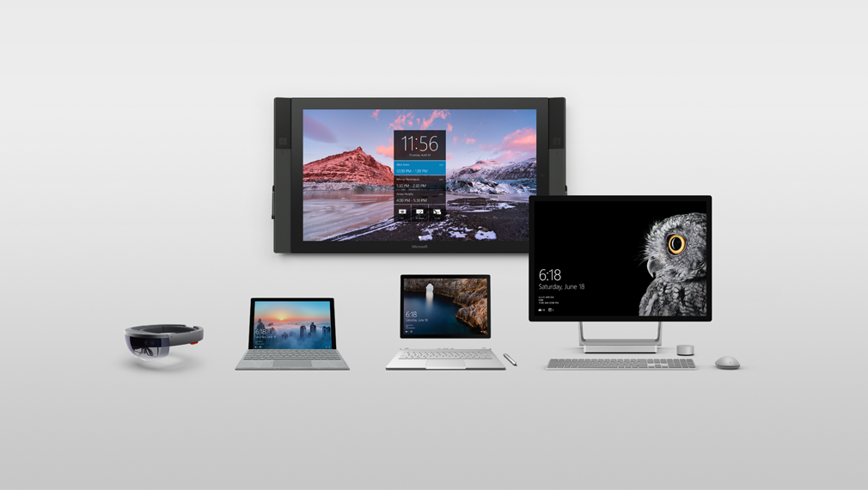
A portfolio designed around people
Natural
interactions
Versatile
form factors
Meticulously
crafted
Connected experiences
Notes:
We’re in the devices business to not just evolve and improve, but to revolutionize the way we work – the way we create, the way we innovate. To re-define and establish new categories of devices. To empower every business on the planet to achieve more.

Slide 11
Demo

Slide 12
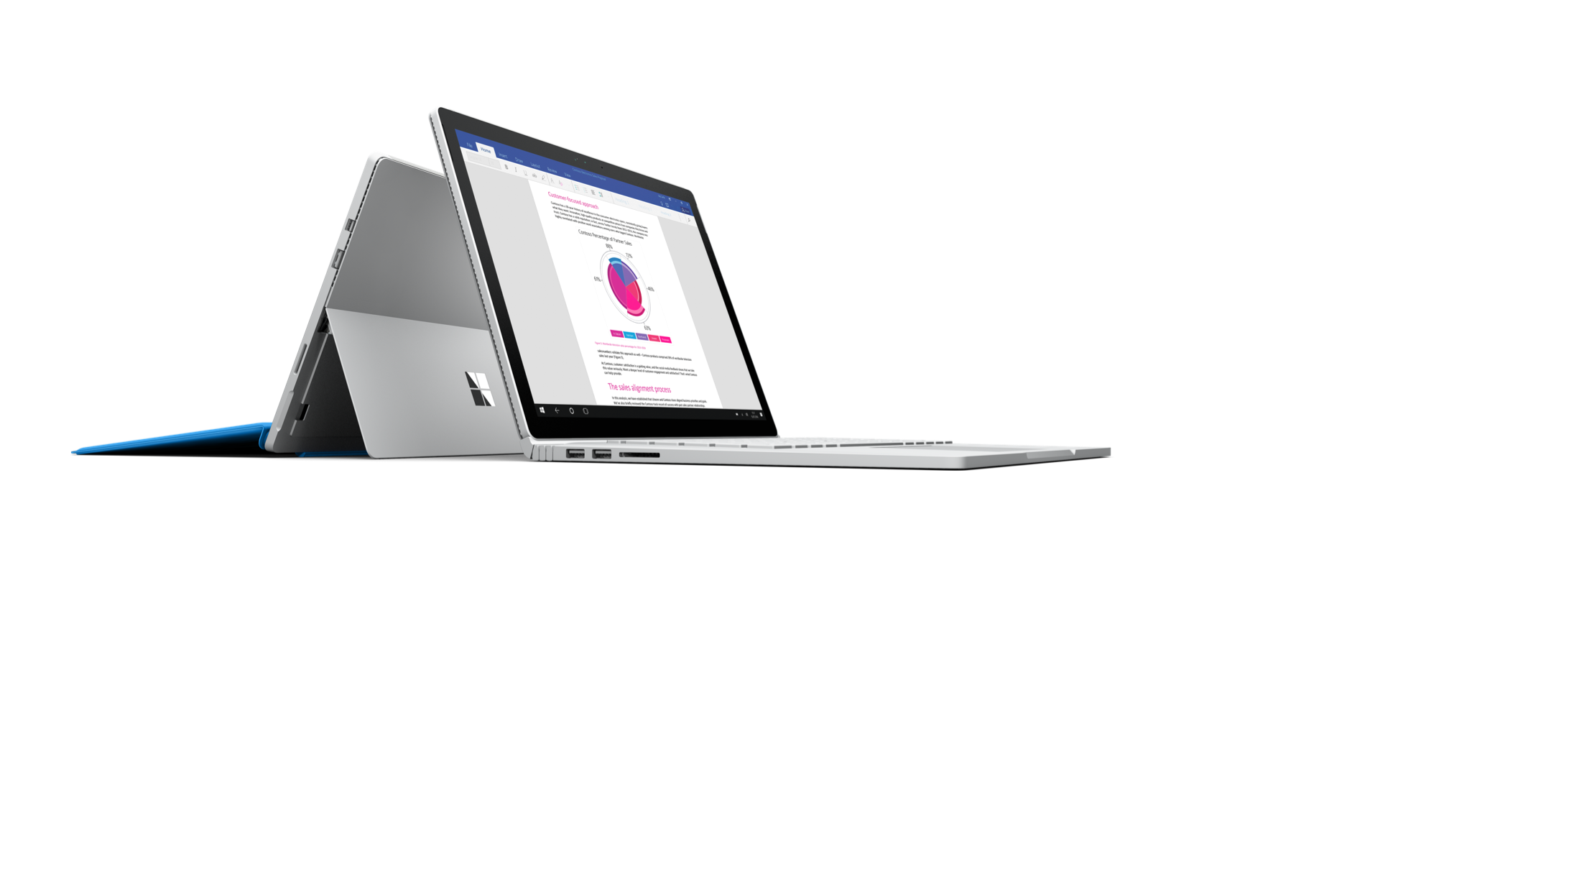
Where Microsoft devices stand out
Modern POS
Assisted Sales
Store Operations
Retail Execution
Notes:
SLIDE INTRODUCING 4 KEY STRENGTHS OF MICROSOFT DEVICES

Slide 13

Traditional Point of Sale
Current challenges
Bulky terminals
Cumbersome to use
Staff chained to a fixed point
Hard to capture data
Limited up-sell and cross-sell opportunity
Barriers
Notes:
SLIDE TO SHOW PROBLEMS WITH TRADITIONAL POS
Bulky - terminals take up floor space
Can be awkward to use
Staff chained to fixed point checkouts – limited service and sales opportunities
Hard to enter customer data
Limited options for flagging up potential up-sells and cross-sells – only small checkout ‘add-ons’ (Staff have to send customers AWAY from the till to find/buy something else – a potentially lost sale)
Countertop as physical barrier to human interaction

Slide 14
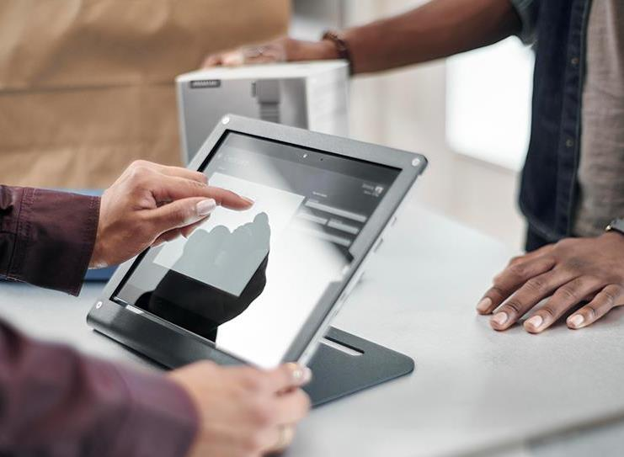
Surface mPOS
Smaller footprint
Faster logins
Intuitive
Quicker to transact
Productivity gains
More conversions
Natural interactions
Bigger baskets
Notes:
SLIDE TO SHOW HOW SURFACE SOLVES Modern Point of Sale (mPOS) PROBLEMS (FROM PREVIOUS SLIDE) AND PRESENTS NEW OPPORTUNITIES
Small – Frees up space for promotional material and stock
Faster logins – with the Windows Hello cameras on Surface, employees can log in instantly with their smile
Intuitive – Hi-res touchscreen; staff can capture customer data
Less queuing – Customers can buy/return products anywhere (mention secure signing using Surface Pen; mention secured credit card reader)
Productivity – staff can use it to do inventory management, or other tasks
Conversions – Reduces gap between helping/advising a customer and making the sale
No sales desk (a physical barrier) – More natural personal interaction with customers – better shopping experience
Motivates sales staff to be more proactive, physically help customers find things – more upsell/cross-sell opportunities

Slide 15
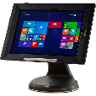
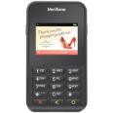
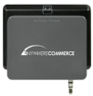


Surface for mPOS
BENEFITS
Easily move throughout the store
Surface Pro 4 and Surface Book are thin, light and can be used as a full laptop
with keyboard and mouse or quickly convert to tablet mode
Connect to wireless chip and pin for payments from anywhere in the store
Surface devices all move to meet various angles: standing at a counter, bent over a
screen with a customer or anywhere else
Multiple inputs make it easy for associates to engage quickly
Surface was designed for touch, pen, type, mouse, trackpad and voice
Securely share devices among employees
Windows Hello cameras allow for quick, multiple logons
Helps secure data and corporate access via remote lockdown if lost or stolen
Small footprint
Premium thin light designs take up little space on your counter
Surface Book and Surface Pro connect via ports or Bluetooth to chip and pin, receipt printers, cash drawers, USB 3.0, SD card and miniDisplay ports
Manageability
Easily managed by IT with existing management tools
KEY ACCESSORIES
Retail stands
Make touch interactions on a counter easy. Some models stay locked down while other release with RFID technology
Verifone Solutions
Operates across multiple generations of smart devices or in standalone mode
Anywhere-Commerce Solutions
Transforms smartphones, tablets and PCs into mPOS solutions
Bluebird Pideon Solutions
Enables payment in full with credit cards of all types
Microsoft Complete
for Business
Extended service and accident protection for Surface; includes setup and reimagining support for up to three years
*Accessories sold separately.
Notes:
Surface Pro 4
12.3-inch PixelSense touchscreen display
Up to 9 hours of battery life¹
Up to 16GB RAM/256GB SSD³
i5/i7: 0.78 kg m3: 0.76 kg
Surface Pen included
¹Up to 9 hours of video playback. Testing conducted by Microsoft in September 2015 using preproduction Intel Core i5, 256GB, 8GB RAM device. Testing consisted of full battery discharge during video playback. All settings were default except: Wi-Fi was associated with a network. Battery life varies significantly with settings, usage and other factors.
³System software uses significant storage space. Available storage is subject to change based on system software updates and apps usage. 1 GB= 1 billion bytes. See Surface.com/Storage for more details.
Surface Book
13.5-inch PixelSense touchscreen display
Up to 12 hours of battery life*
Up to 16GB RAM/1TB SSD¹
1.51 kg
Surface Pen included
Up to 12 hours of video playback. Testing conducted by Microsoft in September 2015 using preproduction Intel Core i5, 256GB, 8 GB RAM device. Testing consisted of full battery discharge during video playback. All settings were default except: Wi-Fi was associated with a network and Auto-Brightness disabled. Battery life varies significantly with settings, usage and other factors.
¹ System software uses significant storage space. Available storage is subject to change based on system software updates and apps usage. 1 GB= 1 billion bytes. See Surface.com/Storage for more details.

Slide 16

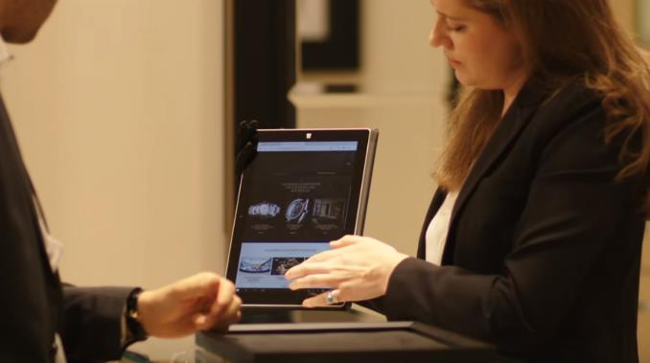

“ Clients are our guests.
It is important that they feel they get the best experience in store.”
Damian Otwinowski
Retail Director, London Flagships,
Aurum Holdings
Aurum Holdings is the largest prestige jeweler in the UK. Their luxury offerings necessitate a complimentary sales environment.
Retail is about the whole experience. Aurum chose the Surface because it is one device that meets many needs. Retail associates use it to engage customers from the very first step of their journey through exploring options that might not be available in store to the completion of the sale – all with one sleek, clean device.
One of our most recent additions to our software suite is our extended aisle technology. We developed a Universal Windows Platform app which acts as a container for our standard ecommerce site. This container enabled us provide an in store platform for customer assisted online transactions, where payment can be taken by using a standard chip & pin payment terminal. We are also table to use Windows 10 kiosk mode to instantly deploy a self-service version of this application, whilst still using standard payment terminals when the customer checks-out. The most startling aspect of this project is the delivery timescales; using Windows 10 we were able to build this capability in days, an approach which saved us from an otherwise huge project cost.
PLAY VIDEO
Notes:
SLIDE TO SHOW CUSTOMER CASE
Video: https://www.youtube.com/watch?v=rINr-yJKYNI&t=35s

Slide 17

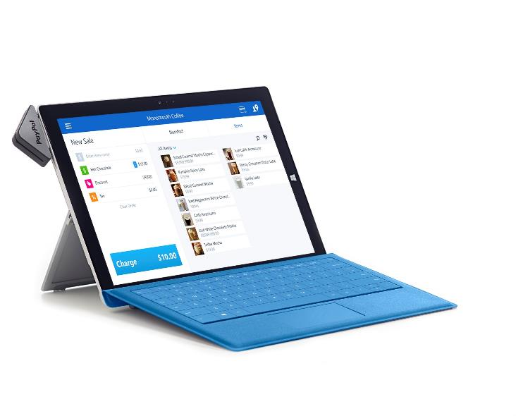
“ PayPal Here has had a
huge impact on my business.
I can take a payment at a client site, on the street or even at a networking event.”
Jennifer Rashkin
SocialPop Marketing
Situation
Business owners have a lot on their plates, especially small business owners. They often have to stretch their resources to run their basic operations while providing outstanding service to their customers.
Solution
Paypal Here partners with Surface to help business owners get the most out of their time and resources. Business owners get the productivity of Office on the same device they can use to process payments. This fully mobile solution frees business owners up to do more than ever, meeting customers where they are.
Benefits
PayPal Here and Surface offer flexible solutions for small business owners. There are a range of point of sale solutions, so they can take payments with a mobile card or chip reader. Businesses can also pull a variety of customizable reports to see what’s selling where and when. From inventory management to reservations, PayPal Here on Surface was designed to address your specific business needs.
PLAY VIDEO
Notes:
2 MINS: SLIDE TO SHOW CUSTOMER CASE
Video: https://www.youtube.com/watch?v=ZsuvmMP9wZE&feature=youtu.be
WHO they are
WHAT they do
WHY the Surface
HOW they use it

Slide 18




“With the Surface, it takes only 4 seconds to capture a customer transaction. This is a significant time savings, especially when you consider the fact that we serve 1 million customers a year.”
Jennifer Baird
President of Stitch It Canada’s Tailor
Situation
Stitch It Canada’s Tailor prides itself on fast turnaround and great service. Old barcode scanners weren’t’ working and tailors spent time running between the back room scanner and the POS at the front desk.
Solution
To keep both at high levels as the company expands, Stitch It deployed Microsoft Surface 3 devices in all 75 Canadian stores. Employees use the devices to scan work milestones into the company’s point-of-sale system with greater efficiency and then send customers emails to let them know that their garments are ready.
Benefits
Eliminated the need to dock the scanner to the POS computer saving time and money with Surface 3. Also improved data accuracy and low support needs, which frees up IT team for critical projects.
PLAY VIDEO

Slide 19

Current challenges in assisted sales
Most devices built for one function
Customers are now better informed than sales staff
Experience is clunky
Notes:
SLIDE TO SHOW CURRENT CHALLENGES WITH ASSISTED SALES
Devices are typically built for one function – either they serve as super small mobile mPOS systems (smart phones for example) or they are optimized for web browser with a customer
Customers often know more than staff about latest price promotions, product choices and reviews and delivery options. Sales staff need all that information at their fingertips plus the ability to move about the store and find inventory quickly so customers can see, touch and experience products on the spot.
Online experiences are generally smoother, so sales staff need customer data to quickly understand loyalty and purchase patterns and keep customers in the store and engaged.
Common Devices used in this space:
Apple iPad (less secure, not as easy to manage compared to Windows devices)
In-store kiosks (not mobile, less engaging for customer to use with a sales representative)
Small devices such as smart phones (don’t lend themselves to bright, large images of products)

Slide 20
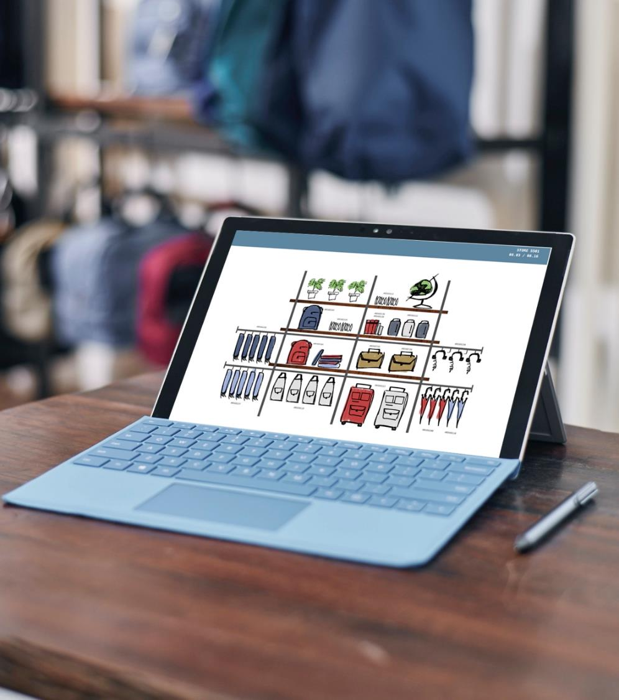
Assisted Sales
with Surface
High resolution PixelSense screens
Thin, light, premium design
Windows Hello for security and easy login
Versatile designs for use as tablet or laptop
Manageable like any other Windows 10 device
Engage with multiple senses – touch, sound, sight
Multiple ports for easy plug in to printers,
card readers, extra storage
Software shown is sold separately
Notes:
SLIDE TO SHOW HOW SURFACE SOLVES ASSISTED RETAIL PROBLEMS (FROM PREVIOUS SLIDE) AND PRESENTS NEW OPPORTUNITIES
Sales associates can instantly access information about products, offers, stock levels while with customers on the shop floor
Surface can take the knocks/withstand the rigors of retail (third-party enclosures like Armor Active are available for added protection)
Touchscreen customer kiosks = more engaging customer interactions – more cross-sell/up-sell
Same speed and quality customers are used to shopping online at home
Mention:
Surface Pen = accurate and intuitive – used to take notes/capture customer signatures.
Range of Windows applications specially made for retail (e.g. Dynamics Clienteling, NCR Sales Advisor)

Slide 21
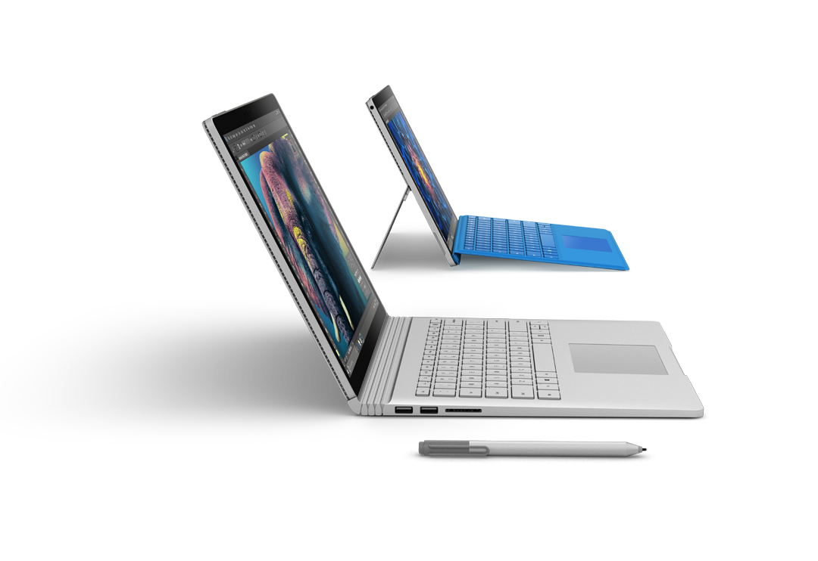
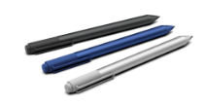
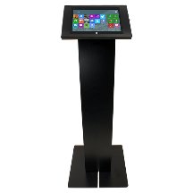
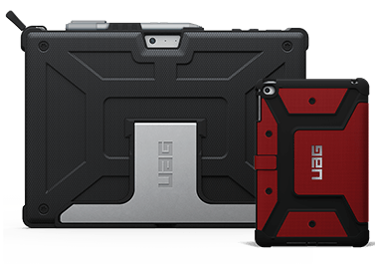
Surface for assisted sales
BENEFITS
Arm sales associates with more information about products and customers
Connect wirelessly or plug into Surface Dock with one connection
Touch, pen and voice allow easy access to information
A durable 2 in 1 device that withstands the rigors of retail
Durable magnesium casing
One year standard warranty with optional 3 or 4 years
All Surface devices are designed to move into multiple modes of work
Easily move throughout the store
Surface Pro 4 and Surface Book are thin, light and can be used as a full laptop with keyboard and mouse or quickly convert to tablet mode
Surface devices all move to meet various angles: standing at a counter, bent over a screen with a customer or anywhere else
Multiple inputs make it easy for associates to engage quickly
Surface was designed for touch, highly responsive pen, type, mouse, trackpad and voice
Securely share devices among employees
Windows Hello cameras allow for quick, multiple logons
Helps secure data and corporate access via remote lockdown if lost or stolen
Manageability
Can be simply and easily managed by IT with existing management tools
KEY ACCESSORIES
Surface Pen
Designed for Surface Pro 4, Surface Pen is a great tool for jotting down notes, sketching, or just taking a screenshot
Kiosk
Designed for easy access and security
Cases
Durable cases designed to allow versatility
*Accessories sold separately.
Notes:
Surface Pro 4
12.3-inch PixelSense touchscreen display
Up to 9 hours of battery life¹
Up to 16GB RAM/256GB SSD³
i5/i7: 0.78 kg m3: 0.76 kg
Surface Pen included
¹Up to 9 hours of video playback. Testing conducted by Microsoft in September 2015 using preproduction Intel Core i5, 256GB, 8GB RAM device. Testing consisted of full battery discharge during video playback. All settings were default except: Wi-Fi was associated with a network. Battery life varies significantly with settings, usage and other factors.
³System software uses significant storage space. Available storage is subject to change based on system software updates and apps usage. 1 GB= 1 billion bytes. See Surface.com/Storage for more details.
Surface Book
13.5-inch PixelSense touchscreen display
Up to 12 hours of battery life*
Up to 16GB RAM/1TB SSD¹
1.51 kg
Surface Pen included
Up to 12 hours of video playback. Testing conducted by Microsoft in September 2015 using preproduction Intel Core i5, 256GB, 8 GB RAM device. Testing consisted of full battery discharge during video playback. All settings were default except: Wi-Fi was associated with a network and Auto-Brightness disabled. Battery life varies significantly with settings, usage and other factors.
¹ System software uses significant storage space. Available storage is subject to change based on system software updates and apps usage. 1 GB= 1 billion bytes. See Surface.com/Storage for more details.

Slide 22

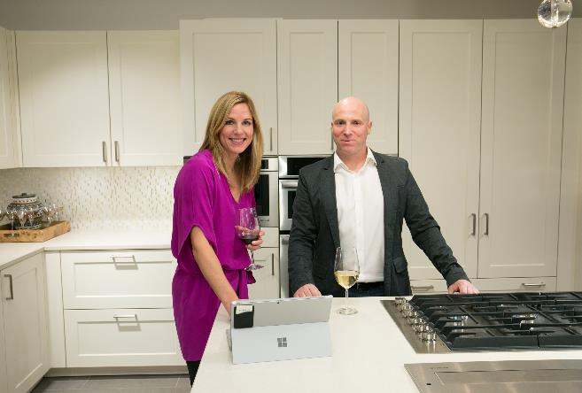
“From the moment we introduced employees to Surface, they loved it and could immediately see its potential. Ultimately, we are most excited about the benefits that Surface has provided our guests – beginning with an outstanding experience from the moment they walk into Pirch, to the product selection and the ease of communications throughout the entire process.”
Craig Hills, Director of Digital Operations
Situation
Pirch is a luxury home appliance retailer focused on enhancing the customer buying experience in their new flagship store in New York’s SoHo neighborhood.
Solution
Pirch has implemented Surface Pro and their custom app, Pirch Advisor, to help evolve their business model and enhance the customer experience. Pirch Advisor is built on Azure and it utilizes Microsoft Office 365, pen and touch for everything from customer-facing tasks to managing backend business operations.
Benefits
Surface plays a large part in powering premium, in-store experiences that Pirch offers its customers, the devices have changed PIRCH’s workflow and the customer buying experience.
PLAY VIDEO
Notes:
Watch customer evidence video: https://www.youtube.com/watch?v=UwyJKi8hWz0&t=3s

Slide 23

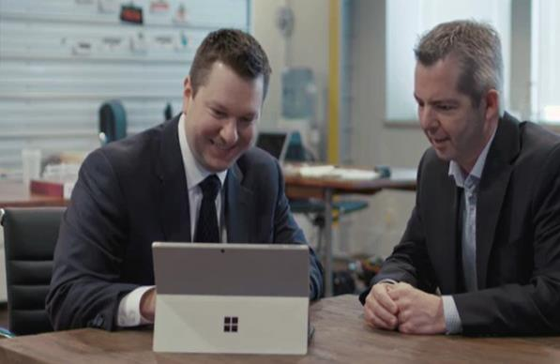
“Surface helps me show my customers and potential clients that I'm there to help—and that I mean business. Within minutes of arriving, I can have my Surface set up and ready to start the presentation. I'm not wasting their valuable time. ”
Melissa Regna, Sales Consultant
Situation
Since 1971, Paychex has offered personalized service to differentiate its HR services. To remain the trusted partner and IT leader that its customers have come to know, Paychex carefully researched and tested a variety of tablets and 2-in-1 devices in hopes of replacing the heavy, dated laptops.
Solution
Surface fit the bill as the perfect road-warrior companion with its PC-grade performance, long-lasting battery life, and sleek, easy-to-use design. Paychex has deployed 2,750 Surface devices running Windows 10, the most advanced and secure Windows to date.
Benefits
Michael Hansen, endpoint services manager at Paychex, says the deployment has already made a positive impact on the bottom line and employee satisfaction. “With Surface, our sales consultants are more confident than ever to represent Paychex as an advanced, tech-savvy company—not just another payroll and HR services shop.”
PLAY VIDEO

Slide 24

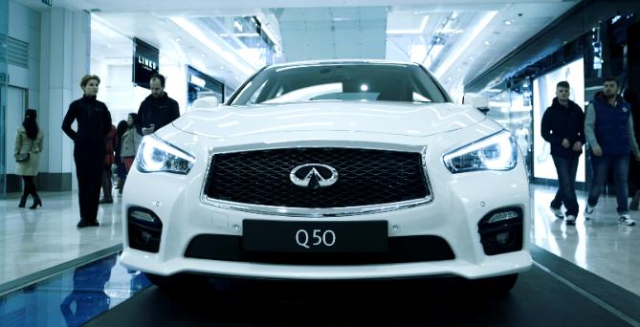
“ Microsoft is a clear global leader in developing new ways for people to interact with technology at home, at work or on the move. The decision to collaborate across the business is a clear one.”
Brendan Norman
Managing Director, Infiniti Retail Group
Situation
Infiniti was embarking on a retail reinvention, moving from dealerships to a sales channel model where the brand and product are taken to where the customer is, specifically premium shopping malls.
Solution
Infiniti chose the Surface to showcase their digital experience, which lets customers and sales staff collaborate on everything from model to color to options in a more personal environment. Sales staff use the Surface throughout the customer engagement from the retail floor, to the test drive and ultimately the signing of a contract.
Benefits
The Surface delivers intuitive, responsive, and vivid experiences, resulting in positive consumer feedback. Sales guides like the devices because they are ‘lightweight’ and user-friendly. While customers value the speed with which they can visualize, and configure their car – and even calculate various finance options. All while fully integrating with existing IT systems.
PLAY VIDEO
Notes:
2 MINS: SLIDE TO SHOW CUSTOMER CASE
WHO they are
WHAT they are doing/aiming to do
WHY the Surface
HOW they use it

Slide 25


“ We’re able to go out to wherever the customer is,
and never once have to
step into a sales office.”
Johnny Crowe
Owner, WaterSports Central
Situation
WaterSports Central has sold high-end water craft for 15 years, and was looking for a way to better serve their customers. They wanted the flexibility to meet their customer where they are, without going to a sales office or sacrificing the selling experience.
Solution
The Surface gives WaterSports’ sales team the best tool to provide a premium sales experience, and closes sales faster. By being able to look at options while they’re out on the water, customers are more driven to make a decision. They can even complete entire transaction while having fun and using the product.
Benefits
WaterSports provides a high-end experience to customers, driving sales, and shortening the sales timeline. Customers are tech savvy, and using the Surface the sales team can now provide options, build schedules, and payment options right away.
PLAY VIDEO

Slide 26
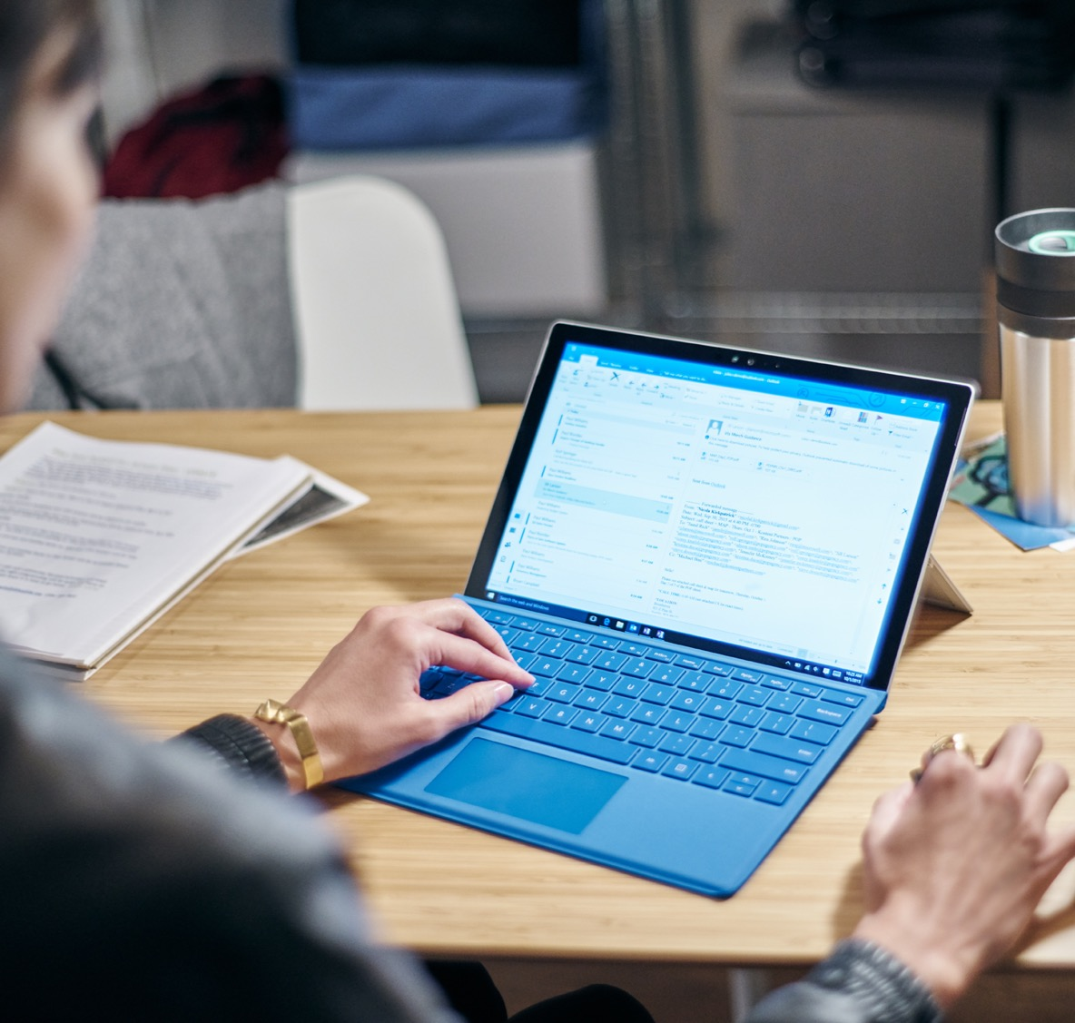
Store operations
Store manager pressures
Store managers isolated from the sales floor
They rely on access to real-time data
They need to respond to Head Office
Constantly balancing corporate demands
with sales floor responsibilities
Software shown is sold separately
Notes:
SLIDE TO SHOW CURRENT CHALLENGES WITH STORE OPS
Store managers often isolated from the sales floor as they need to have constant access to back-office systems.
They need real-time visibility on operational KPIs, sales data, and online customer channels.
Store managers have to stay responsive to the latest requests, policies, news and reports from Head Office.
They need to balance corporate demands and sales floor responsibilities to create a seamless, connected service.
Common devices used in this space:
Traditional laptops (heavier, don’t allow the device to shape to manager’s needs)
Traditional desktops (don’t allow the manager to keep an eye on the floor)
Ipads (no ports, can’t use with mouse and trackpad to get more labor intense tasks done)

Slide 27

Store operations with Surface
Thin, light designs allow managers to keep an eye on the floor while getting other work done
Premium touch screen devices attract
top talent
Connects into full desktop experience when needed – plug in to peripherals and work with trackpad and mouse
Software shown sold separately
Notes:
SLIDE TO SHOW HOW SURFACE SOLVES STORE OPS CHALLENGES (FROM PREVIOUS SLIDE)
Allows managers to move away from the back office → increase involvement on the sales floor
Powered by Intel®Core™ processors, supports standard retail applications and the full Office Suite → managers can do everything they’d normally do at their desk – including monitoring store performance in real time.
Surface can also connect to external monitors, a full keyboard and mouse, printers, and other USB devices, → full desktop experience
Experience for store managers = fast, easy, joined-up, efficient, productive, seamless

Slide 28
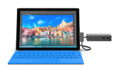





Surface for store operations
BENEFITS
Keep an eye on the floor
  Connect to multiple monitors, printers mice for full desktop mode
  Move into tablet mode to walk around the store and engage
  Jump in and train employees or support customers. Surface devices move to meet various angles: standing at a counter, bent over a screen with a customer or at a desk
  Premium touch screen devices attract top talent
  Connects into full desktop experience when needed – plug in to peripherals and work with trackpad and mouse
  Use Surface Pen to annotate, take notes and collect signatures
  Powerful enough to run your preferred software
  Intel® Core® processors
  Up to 1 TB storage
  Runs Windows 10 full software and apps
  Ensure everyone's on the same page
  Annotate and sign off on visual merchandizing instructions on screen
  HD cameras for visual merchandising proof
Security is at a premium
  Windows Hello cameras allow for quick, secure logons
  Windows 10 helps secure customer data and confidential financial information
KEY ACCESSORIES
Surface Dock
From ultraportable to ultraproductive: Connect to dual monitors, speakers, a full-size keyboard and more
Surface Pen
Designed for Surface Pro 4, Surface Pen is a great tool for jotting down notes, sketching or just taking a screenshot
Surface Keyboards
& Mice
Optimized for fluid typing with well spaced mechanical keys, enlarged glass trackpads and ergonomic sculpting
Microsoft Complete
for Business
Extended service and accident protection for Surface; includes setup and reimagining support for up to three years
*Accessories sold separately.
Notes:
Surface Pro 4
12.3-inch PixelSense touchscreen display
Up to 9 hours of battery life¹
Up to 16GB RAM/256GB SSD³
i5/i7: 0.78 kg m3: 0.76 kg
Surface Pen included
¹Up to 9 hours of video playback. Testing conducted by Microsoft in September 2015 using preproduction Intel Core i5, 256GB, 8GB RAM device. Testing consisted of full battery discharge during video playback. All settings were default except: Wi-Fi was associated with a network. Battery life varies significantly with settings, usage and other factors.
³System software uses significant storage space. Available storage is subject to change based on system software updates and apps usage. 1 GB= 1 billion bytes. See Surface.com/Storage for more details.
Surface Book
13.5-inch PixelSense touchscreen display
Up to 12 hours of battery life*
Up to 16GB RAM/1TB SSD¹
1.51 kg
Surface Pen included
Up to 12 hours of video playback. Testing conducted by Microsoft in September 2015 using preproduction Intel Core i5, 256GB, 8 GB RAM device. Testing consisted of full battery discharge during video playback. All settings were default except: Wi-Fi was associated with a network and Auto-Brightness disabled. Battery life varies significantly with settings, usage and other factors.
¹ System software uses significant storage space. Available storage is subject to change based on system software updates and apps usage. 1 GB= 1 billion bytes. See Surface.com/Storage for more details.

Slide 29
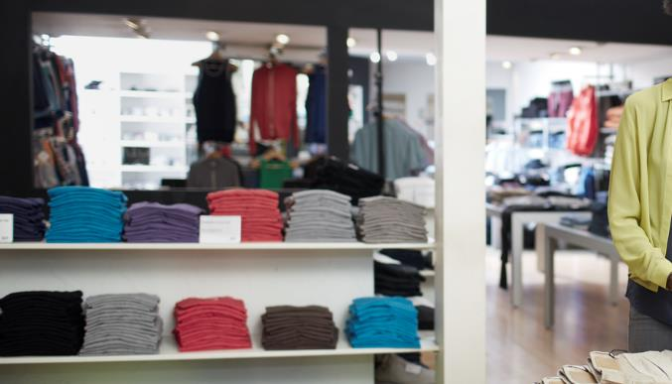
Macy’s
We believe that our partnership with Microsoft to create and leverage best-in-class technology will allow us to make the customer experience more seamless across all channels and mitigate the disruption impacting today’s retail environment.
Sue McMahon, Group VP
Macy’s, a US retailer with over 150 years of history and over 700 department stores, was looking to identify potential friction in the customer journey and aggressively solve for it.
They transformed their stores through technology by giving our leaders all the communication, information and data they need at their fingertips, without tethering them to a desk.
Solution
“By providing Microsoft Surface devices, we’ve made them mobile. By giving them Microsoft Office 365, we’ve enabled unprecedented collaboration and access to information, providing for “one version of the truth.”
Every device also has our own internal solution called MyStore, which we built in partnership with Microsoft to provide real-time KPI results and staffing levels. And through MyStore on their devices, managers now have single sign-on access to the more than 30 applications, reports and tools they use most often.
Results
With easy access to real-time results and vital information while out on the sales floor, managers are better equipped to coach and support associates, assist customers, perfect displays and make adjustments on the fly to maximize sales. Enabling store leaders to spend more time on the sales floor, collaborate more effectively and make more informed decisions has had a positive impact not just on day-to-day store operations but also on reducing staff turnover.
Notes:
2 MINS: SLIDE TO SHOW CUSTOMER CASE
WHO they are
WHAT they aiming to do
WHY the Surface
HOW they use it

Slide 30

Priorities in operational efficiencies
Effective distribution
Sharing intelligence
Using data to drive efficiencies
Notes:
PRIORITIES IN SUPPLY CHAIN MANAGEMENT
Distribution = Getting the right product to the right place at the right time
Sharing intelligence → boost sales, increase in-store goods availability, maximize efficacy of promotions
Using data to drive overall efficiencies, e.g. using ordering and delivery info to inform in-store retail activities
Common Devices used in this space:
Surface Hub
Surface Hub is a powerful team collaboration device designed to advance the way people work together naturally. Microsoft and SoftBank Robotics are linking Surface Hub panels to the Azure cloud services platform to make shopping easier for shoppers in stores. The Surface Hub will make purchase recommendations based on an analysis of data collected from stores, customers, point-of-sale purchases, smartphones, e-commerce sites and other sources.

Slide 31

Operational efficiencies with Surface
Better data visualization and decision making with Surface and Power BI
Makes inventory management simple
Save travel expenses by collaborating
in real time across multiple locations
Touch and annotate right on the screen so people in all offices & warehouses can stay on the same page
Secure with Windows 10
Software shown is sold separately
Notes:
SLIDE TO SHOW HOW SURFACE IS RELEVANT TO RETAIL EXECUTION
Inventory management simple.
Runs full Office Suite and supports retail apps like Visicom SFA and ESRI ArcGIS → staff can work productively from anywhere.
Cameras in the Surface and Lumia devices = perfect for capturing in-store images and sharing product images.
Supports full Skype for Business and OneDrive for Business → enables real-time collaboration between sales reps, warehouse staff and head office.

Slide 32
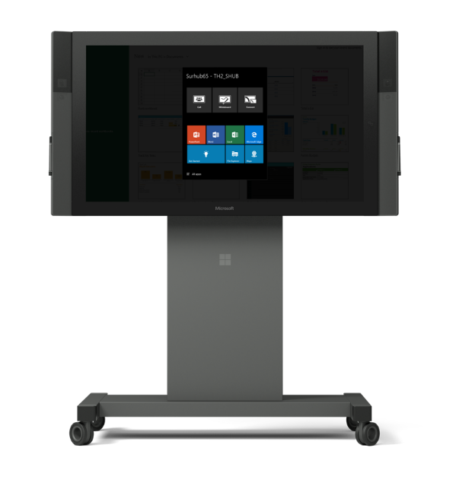
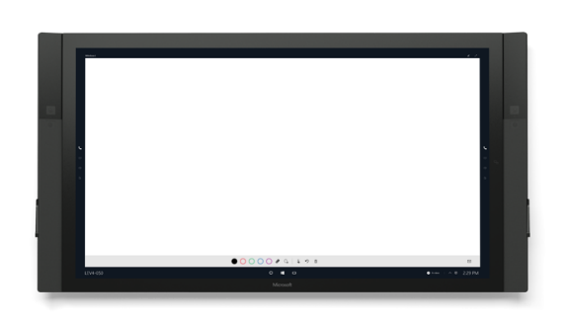
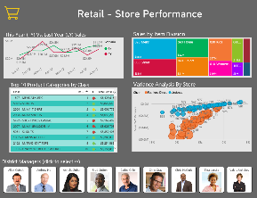
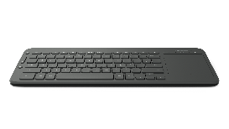

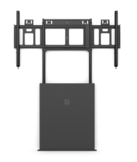
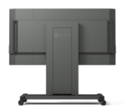
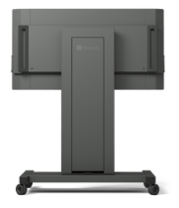
Surface Hub in operational efficiencies
BENEFITS
Stay competitive with world class decision-making tools
  Intel® Core™ i7 processor runs data visualization tools for keeping eyes on inventory, supply chain, traffic flow and product demand
  Large HD touch screen allows for easy multitasking: view data and whiteboard
  Quality conferencing with wide-angle HD cameras, dual speakers and microphones
  Runs Windows 10 UWP apps including O365 and Power BI
  Engaging and productive meetings
  Scheduled or spontaneous meetings. Invite Surface Hub as a resource to a meeting or tap to start a meeting and invite remote guests.
  Communal OS allows users to walk up and use the device without authenticating, removing common technology barriers
  Easy to share content with inkback and touchback with remote devices
  Once ideas are worked out and decisions made, send content to attendees with a tap
  Bring together any relevant information off any operating system
Surface Hub Keyboard
Connect via Bluetooth for quick typing and trackpad. Shortcuts include Skype for Business and quick connection to projector and whiteboard
KEY ACCESSORIES
Wall or Floor
Support Mounts
Fixed and stable placement
Rolling Stand
Easily move between spaces
*Accessories sold separately.
Notes:
SURFACE HUB FEATURES FOR STORE OPS
One-touch meeting start. On average, it take thirteen minutes to start a meeting. With our communal design, with one-touch your meeting will start. Audio, video, and Whiteboard are automatically launched at the start of your meeting. No more “can you see me, can you hear me?”, participants can get to work right away.
Scheduled meetings are supported via Exchange, which is a turn-key solution, there is no change or special process required to use Surface Hub. However not all meetings are planned. By simply touching the Whiteboard icon or picking up the pen, teams can begin collaborating, one can add in remote participants by simply calling people via Skype for Business.
Runs Windows 10 for enterprise-grade security. Any Windows 10 app can be used on Surface Hub. Universal apps run natively without any authentication required. Desktops apps can be accessed from your personal devices via wired or wireless ingest. HTML 5 apps can be run via the Microsoft Edge platform.
Inking. The hardware within Surface Hub supports an unmatched large screen inking experience. The inking experience is fluid and natural, the ink feels as if it were coming out of the pen itself. The experience is possible due to the projected capacitive technology with Surface Hub, which is the same technology we experience in our mobile devices. The hardware within the pen is the customized to ensure ease of use and premium integration within the ink experience
Engaging everyone. The hardware design of Surface Hub ensures that remote participants are engaged just as if they were in the room. Wide angles cameras are installed to ensure the remote participants can see everyone in the room. The dual HD cameras are place at eye-level, for a more personal experience. A four element microphone array is optimized for voice and eliminates background noise.
Share content. Content is no longer just presented, it is also created. Your content is designed to be taken with you to any device. Within the OneNote Whiteboard, with one tap you can send your whiteboard to any device and continue to work on ideas after your session is over.
Project content. No meeting is without adding content to enrich the conversation. Personal computers can be projected into the hub wirelessly via miracast or wired via a display out port. Surface Hub supports cross platform devices such as Win7, Win8.1, Win10, iOS, OSx, and Android. Windows devices had the additional features of inkback and touch back, where one can operate their computer directly from the Surface Hub.
Common applications
O365
Power BI
Accessories:
Mounting Brackets
Rolling brackets

Slide 33
Surface delivers proven results
$615 saved in device purchase costs as employees can be provisioned with a single Surface Pro.
15
20
90
60
%
%
%
%
Improvement in close rate
Improvement in deal size leveraging Surface Pro devices to deliver mobile presentations and information from LOB systems.
Agree or strongly agree they get more done away from their desk
Agree or strongly agree they are more satisfied with their ability to get things done
Forrester Research, Microsoft Surface Pro 3 Delivers Reduced Device Costs And Improved Revenue, June 2015. Statistics based on using a Surface Pro 3 device.
Notes:
The results – in terms of efficiency, productivity and cost-savings - speak for themselves.

Slide 34
Surface Hub total economic impact
1: Summary of benefits
Through 5 customer interviews and data aggregation, Forrester concluded that Microsoft Surface Hub has the following financial impact.
2: Breakdown of benefits
The TEI study quantified specific costs, benefits, and metrics that matter to customers.
$1.5
ROI
138
$1
%
9
Months payback
Installation and ongoing costs
Millions 3-year analysis
Device costs
$0.5
Sales improvement enabled by Surface Hub client meetings
Meeting productivity
$0
Meeting productivity
$1.4m
Benefits
$620k
Costs
This document is an abridged version of a case study commissioned by Microsoft titled:
The Total Economic Impact of Microsoft Surface Hub. February, 2016.
Notes:
Don’t just take our word for it.
A Forrester Total Economic Impact study has studied the financial benefits on organizations.

Slide 35
Surface Hub total economic impact
3: Voice of the customer
4: Surface Hub by the numbers
“We had a client meeting to propose a project. Instead of using the whiteboard, we used the Surface Hub, and it was incredibly successful.“
Director of Design and Construction,
Architecture Firm
1,065,697
$
in year 3
Annual benefit after full ramp up of Surface Hub devices
15-23
25
$
Minutes saved on pre and post meeting tasks
In printing costs saved per meeting
“Emailing the OneNote files after a
meeting saved time on every meeting
that uses the Surface Hub.“
COO,
US law firm
20
%
Increase in sales from client meetings leveraging Surface Hub
This document is an abridged version of a case study commissioned by Microsoft titled:
The Total Economic Impact of Microsoft Surface Hub. February, 2016.
Notes:
Don’t just take our word for it.
A Forrester Total Economic Impact study has studied the financial benefits on organizations.

Slide 36
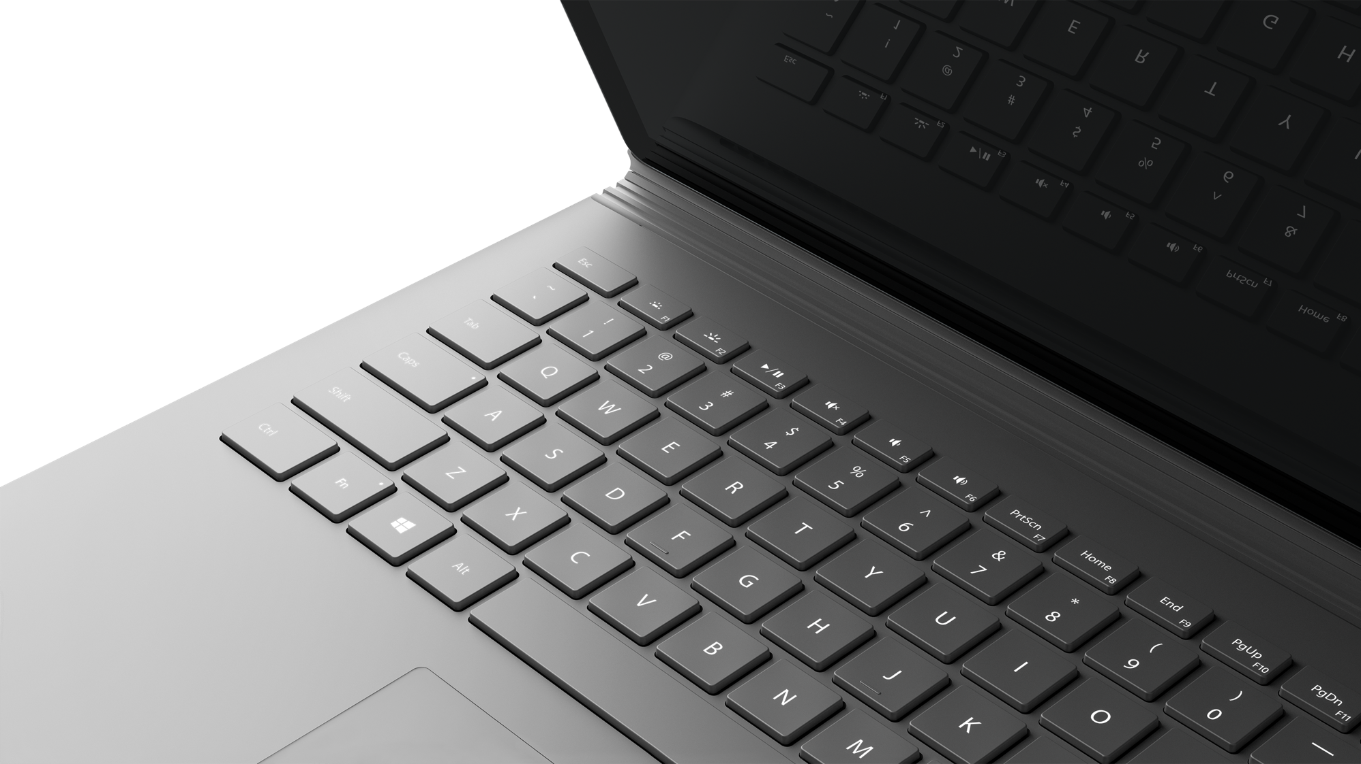
Next Steps

Slide 37
Questions?

