Slide 1
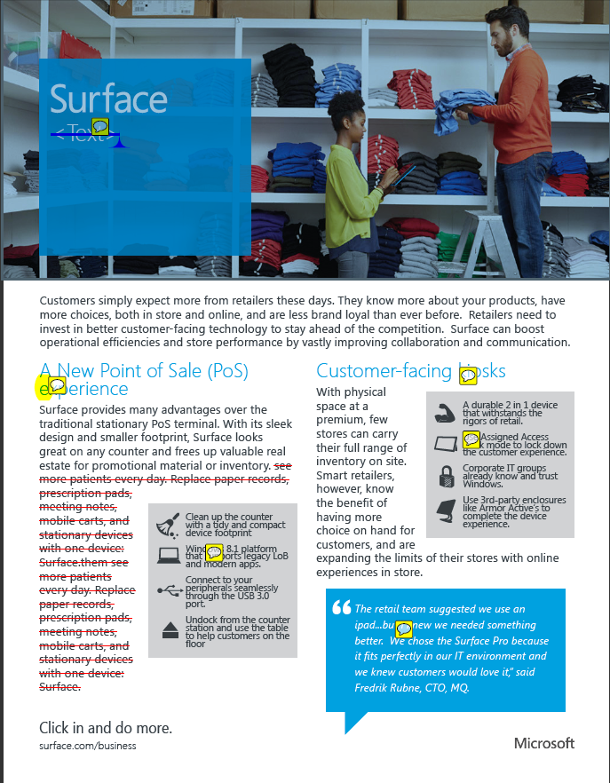
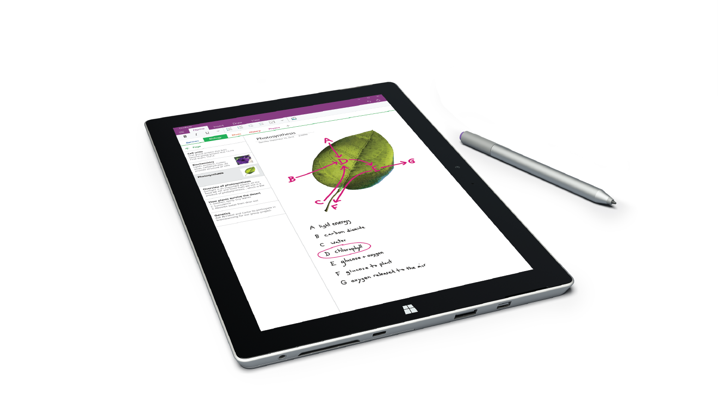
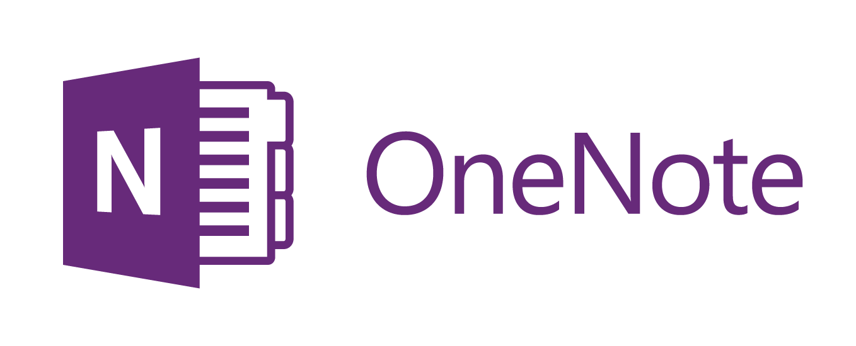
Partner logo placeholder
The most productive devices for Education
Surface brings all the best tools for teaching and learning together in one device. It has the full power of a laptop in a lightweight touchscreen tablet form. And, with best-in-class digital inking capabilities, Surface can replace pen and paper in your classroom.
Pen and paper. Evolved.
Any learner, any age
Ultra mobile
Surface provides a precise, on-screen digital pen input that enhances student learning through handwritten note taking. It allows students to more accurately express their ideas and gives them the freedom to solve complex problems and equations.
Cater to any learning style or any age with one device. Create personalized learning experiences for each student through all forms of learning activities—reading, writing, presenting, recording, touching, and typing.
Surface supports student learning anytime, anywhere. At only 1.73 pounds and 11.5 inches, Surface Pro is lightweight and thinner than most books—making it easy to carry. Built-in Wi-Fi and 4G LTE¹ allows students to do their work on the bus, at home, and at school.
“Using a precise digital pen increases a student’s ability to produce ideas, solve problems, communicate and learn during note taking and knowledge creation.”
― Sharon Oviatt, PhD in Experimental Psychology and author of The Design of Future Educational Interfaces
OneNote Class Notebook–a framework for teaching and learning
Teachers using OneNote Class Notebooks can manage all their lesson plans and class content in one central location. They can create and deliver interactive lessons in the collaboration space, stay organized using the content library for handouts, and provide student feedback in each students’ private notebook.
To learn more about how Surface + OneNote can replace pen and paper in the classroom visit onenote.com/classnotebook.

Slide 2
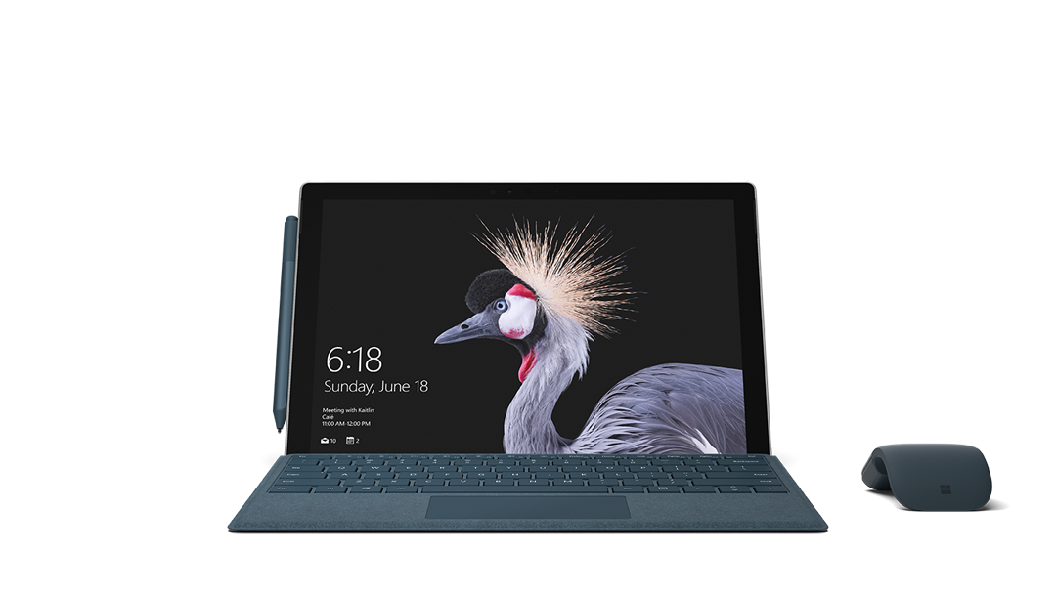
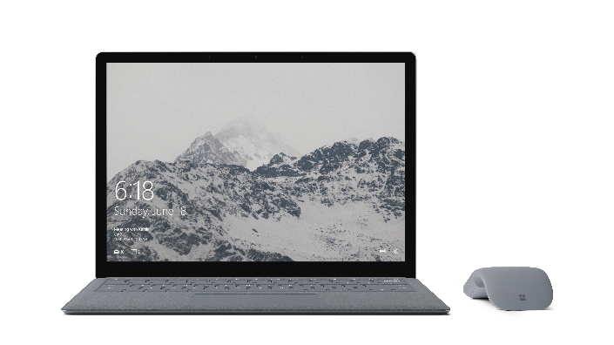
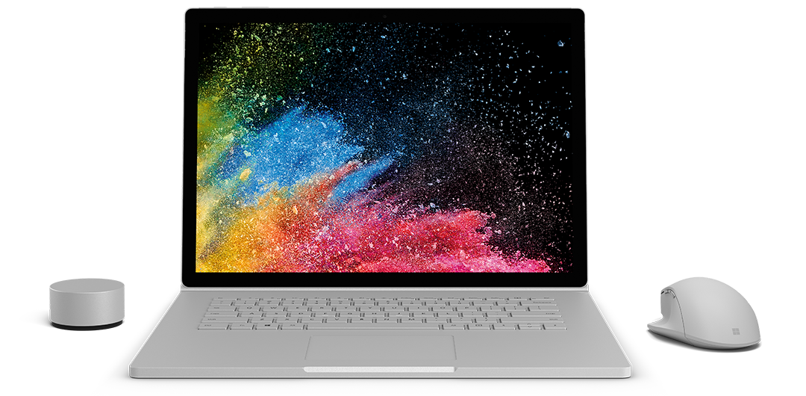
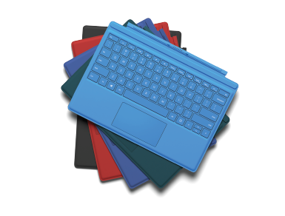
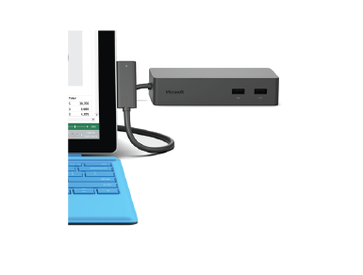
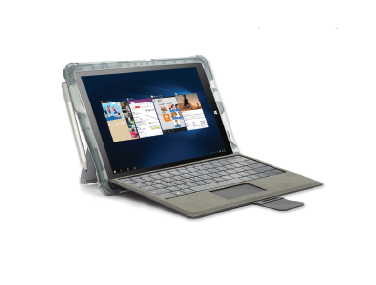
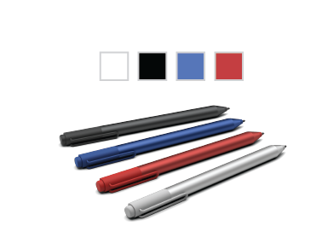
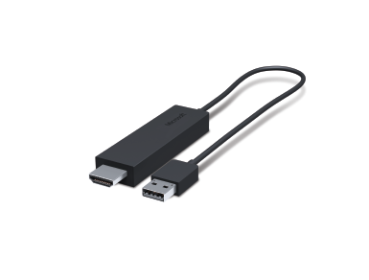
The most portable, and the most powerful
 | Surface Pro | Surface Book 2 | Surface Laptop
Dimensions | 11.5” x 7.9“ x 0.33” | Surface Book 2 13.5” i5: 12.3” x 9.14” x 0.51”-0.90” i7: 12.3” x 9.14” x 0.59”-0.90” Surface Book 2 15” 13.5” x 9.87” x 0.568-0.90” | 12.13” x 8.79” x .57”
Display | 12.3” PixelSense™ | 13.5” or 15” PixelSense™ | 13.5” PixelSense™
Weight | m3: 1.69 lbs (768 grams) i5: 1.70 lbs (770 grams) i5 with LTE Advanced³: 812 grams i7: 1.73 lbs (784 g) | Surface Book 2 13.5” i5: 3.38 lbs (1,534 grams) i7: 3.62 lbs (1,642 grams) Surface Book 2 15” i7: 4.20 lbs (1,905 grams) | I5: 2.76lbs (1,252 grams) I7: 2.83lbs (1,283 grams)
Resolution | 2736 x 1824; 10 point multi-touch | 3000 x 2000; 10 point multi-touch | 2256 x 1504; 10 point multi-touch
Kickstand | 3-position | Multi-position | None
Cameras | 5MP front-facing, 8.0MP rear-facing with autofocus; stereo microphone; stereo speakers with Dolby® sound | 5MP front-facing, 8.0MP rear-facing with autofocus; stereo microphone; stereo speakers with Dolby® sound | 720p HD front-facing; stereo microphone; omnisonic speakers with Dolby® sound
Processor | 7th Gen Intel® Core™ m3, i5, or i7 processor | 8th Gen Intel® Core™ quad-core i7 or 7th Gen dual-core i5 processor | 7th Gen Intel® Core™ i5, or i7
Storage and memory | 128GB storage, 4GB RAM 256GB storage, 4GB RAM 512GB storage, 8GB RAM 1TB storage, 16GB RAM | 13.5” 256GB storage, 8GB or 16GB RAM 512GB storage, 8GB RAM or 16GB RAM 1TB storage, 8GB or 16GB RAM 15” 256GB storage, 16GB RAM 512GB storage, 16GB RAM 1TB storage, 16GB RAM | 128GB storage, 4GB RAM 256GB storage, 4GB RAM 512GB storage, 8GB RAM 1TB storage, 16GB RAM
Get the most from Surface with these accessories
Type Cover
Click-in keyboard
with trackpad
doubles as a
protective cover.
Surface Dock
Easily transition
Surface Pro into a complete desktop workstation.
Rugged Case
Keep your Surface safe by adding a protective case.
Surface Pen
Write naturally,
draw, or annotate,
even on web pages.
Wireless Display Adapter
Present from anywhere in the classroom
Extended Services
• 1:1 tech support • Accident protection
• Quick replacement
Partner CTA Placeholder
¹ Check for market availability.

