Slide 1
Read Me
Start by understanding the value proposition for Microsoft Devices
as a catalyst for Digital Transformation (pitch deck).
Use this industry deck to convey the value of the portfolio to this specific audience. Key scenarios and customer stories are included.
For product deep dive decks, use the Microsoft Surface, Microsoft Book, Microsoft Studio, Microsoft Surface Pro 4, Microsoft Lumia, or Microsoft HoloLens decks.
For Microsoft sellers
Windows Education Decks
10 Ways Windows Wins in the Classroom
MSFT Devices Pitch Deck: visit Infopedia/Sales & Marketing/Devices (1st party) then click Portfolio.
Product decks: visit Infopedia/Sales & Marketing/Devices (1st party), then select the product of interest.
Industry apps & demos: Click here for the latest Surface apps and demos deck for Education.
For Partner sellers
Talk to your Microsoft PCMM or PSE for the latest readiness and marketing content. It lives on Drumbeat.

Slide 2
Let’s discuss your current challenges
Notes:
Pressures on your industry
Challenges your business is facing. Do they fall into these catagories:
1. empowering employees
2. engaging with customers
3. finding operational efficiencies
4. transforming your products or services
How does technology currently play a role?
How is technology holding you back?
What are the main user types/scenarios in your business?
What technology do they currently use?
What sort of improvements would you like to see? Are there metrics you’re trying to meet? (increased productivity, improved operations, improved sales close rates?)

Slide 3
Microsoft Devices for Higher Education
Name
Title
*Software shown is sold separately.
*Surface Type Cover sold separately.

Slide 4

Key challenges facing
Higher Education
Stagnant or declining learning outcomes
A need for more collaboration
Workload pressures
Restrictive classroom technology
Notes:
Stagnant or declining learning outcomes – despite a tremendous growth in 1:1, only a handful of schools have seen a significant improvement in student learning outcomes and many have seen a decline do the poor management or lack of training on how to use tech in the class.
A need for more collaboration- meet the demands of an increasingly global and team orientated workforce and college curricula. As the world economy continues to become more globalized.Schools are feeling increased pressure to incorporation group work and collaborative projects.
Workload pressures.
76% of teachers report workload as the most important factor leading them to consider leaving the profession. (http://whyteach.lkmco.org/)
45% of teachers stated that duplication added to the burden of their workload (http://www.advanced-learning.co.uk/wp-content/uploads/2016/02/Can-technology-genuinely-reduce-teacher-workload.pdf)
53% of teachers report that the frequency and detail required in marking, as well as the duplication of work involved, is burdensome – contributing to unnecessary and unproductive workloads. (https://www.gov.uk/government/uploads/system/uploads/attachment_data/file/401406/RR445_-_Workload_Challenge_-_Analysis_of_teacher_consultation_responses_FINAL.pdf)
1 in 6 teachers in the UK are spending more than 11 hours a week on marking and assessments. (http://edtechnology.co.uk/Article/teachers-spend-whole-day-on-marking)
Restrictive classroom technology.Restrictive classroom technology – 1 in 5 students WW has been diagnosed as special needs or has a learning disability . Accessibility has been a huge priority for department of educations but unfortunately, classroom technology hasn’t been able to adapt quick enough. Many students need to have different inputs and modalities to learn better, such as dyslexic students or a student who is visually impaired.

Slide 5










Top 10 ways Windows wins at Universities
The platform you never outgrow
Compatibility
king
Thinking
in ink
Collaborative
learning on all devices
Designed for all learning styles
Best in class assistive technology
Windows
is for doing
Deploy and manage your way
Safest Windows
ever
Get more for free than ever before
Notes:
The good news is that Windows 10 is tailored to enable a new 21st century world of learning.
Blended learning models such as a “Flipped Classroom” are becoming a reality. The web and improved networking allow access to data and content from many locations. And where we can’t connect, Windows still provides content offline to continue learning from anywhere.
Windows is designed for all learning styles including thinking in ink, touchscreen, video and audio.
Project based learning curricula stress development of skills such as collaboration, critical thinking, and creativity – and tools like OneNote, Word, and PowerPoint enable these core skills necessary for students to be successful in today’s competitive workforce.
Microsoft’s commitment to education has led us to provide purchasing mechanisms to better enable schools and students to have affordable, advanced technology. Our newest and best offering for academic institutions will be made available through academic volume licensing and bulk purchasing. The Windows 10 Education student use benefit provides students with all of the functionality of the Enterprise edition at aggressive discount levels while allowing in-place upgrades from Windows 10 Home or Pro. Windows 10 Education builds on Windows 10 Enterprise adding enterprise-grade features to address the advanced security and comprehensive device control & management needs of today’s educational institutions. It’s built to simplify deployment in the education space, providing a direct path for many devices to upgrade from Windows 10 Home or Windows 10 Pro to Windows 10 Education, without the need to wipe and reload the OS. Microsoft Desktop Optimization Pack (MDOP) is included as a standard component of the Education offering to help administrators manage their IT environments. For education institutions licensing Windows 10 organization-wide for faculty and staff, students can receive an upgrade to Windows 10 at no additional cost. Office 365¹ and Microsoft Intune¹ also have student use benefits that function in the same way as the Windows 10 Education student use benefit. ¹

Slide 6
Windows 10: the most secure Windows ever
PROTECT, DETECT, and RESPOND
Secure your identities
Protect enterprise data
Enhance threat resistance
Secure your devices
and connections
Detect, investigate, and respond to breaches
Pre-breach
Post-breach
Surface management mode
Notes:
Key points to mention:
Higher education tends to have more sensitive information than in K12, as it contains financial records, academic transcripts and employment information.
Cyber threats are increasing for higher education, with several breaches occurring over the past 3 years. For example Michigan State University database was attacked, containing 400,000 current and former students information. Social security numbers, Student ID numbers and dates of birth were all vulnerable. Big business is therefore not the only place hackers are going for data. Source: http://www.forbes.com/sites/leemathews/2016/11/19/michigan-state-university-hacked-student-data-stolen/#9be2f811f1bb , http://www.eduventures.com/2015/03/how-safe-is-your-student-data-data-privacy-implications-for-higher-education/
From a student and faculty researcher perspective: they need to ensure research data is completely secure, it holds intellectual property that forms the foundation of what the education institution is run from. To ensure this data remains secure, the best devices and OS must be utilized.
Points to mention are:
In a world of cyber threats, Windows 10 is the most secure Windows ever.
Empower students and teachers with enhanced remote access for anytime, anywhere learning
Windows 10 will help your school protect against modern cyber-attacks, deliver experiences your students will love and enable continuous innovation with a platform that keeps your school up to date with the latest technology.
Security features:
Azure Active Directory - One identity for Windows Store, Devices, and Office 365
Device Guard and Windows Defender– Help block malware
BitLocker and Enterprise Data Protection - Help keep data more secure
Use AppLocker with the Windows Store to block unwanted & inappropriate apps
Windows Hello* - Biometric security system to prevent unauthorized log-ins
*Windows Hello requires specialized hardware, including fingerprint reader, illuminated IR sensor or other biometric sensors.

Slide 7
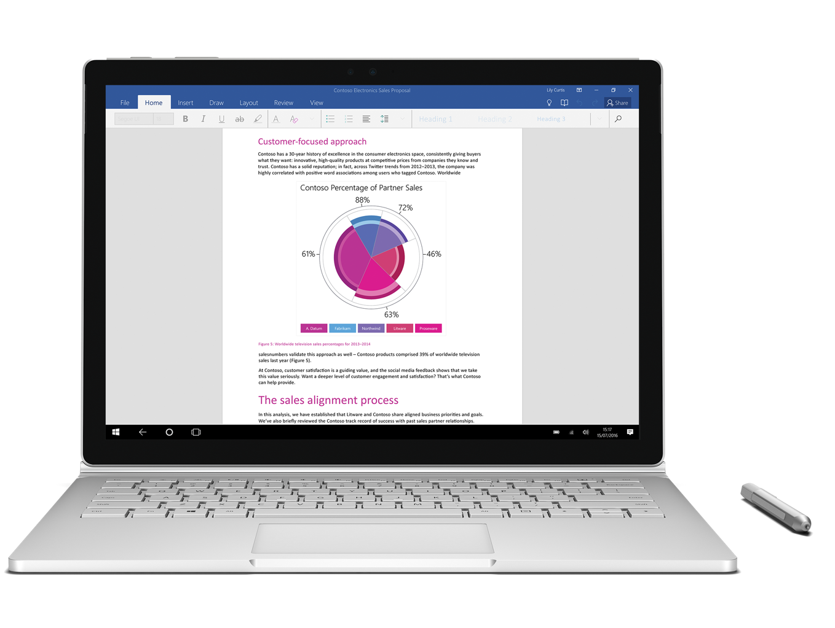
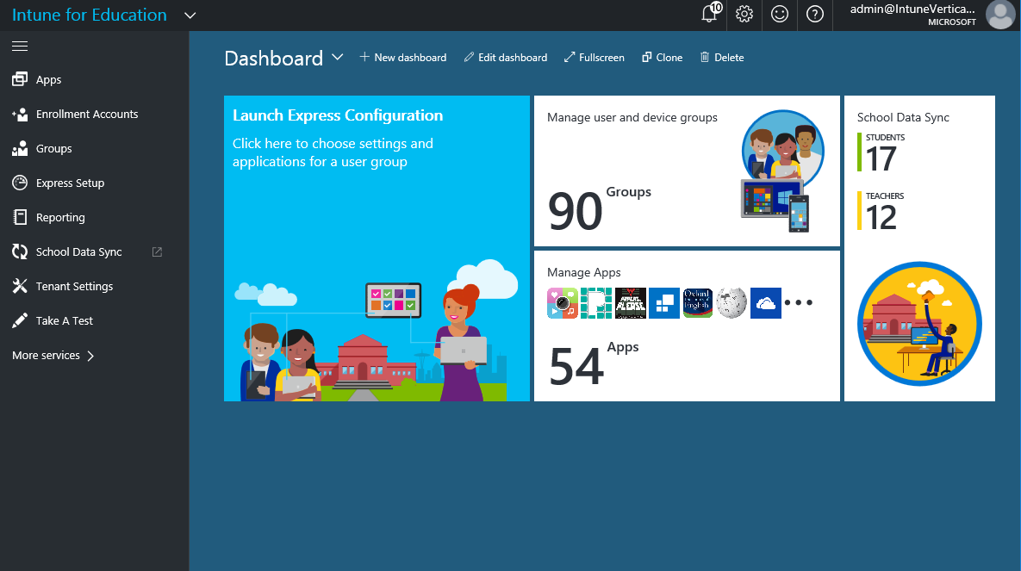
Intune for Education Helps Address School IT Needs
A simpler way for schools to deploy and manage apps and Windows 10 devices
  Simple setup
  Express Setup and USB setup key
  Easy app deployment
  Deploy apps without touching devices
  Easier shared device management
  Apps and settings follow users
  Easy to buy
  Per-device or through volume licensing
  Designed for education
  Easy to use for common school scenarios
Notes:
Intune for Education delivers easy setup and control of devices in the classroom.
Lets start with one area where we have got consistent feedback from our customers and partners – how about an easier way to setup and control devices?
In response we’ve created Intune for Education – we’re taking a rock-solid product built on top of our commercial Intune offering and making it easier for schools
Simple Setup- Intune for Education has an express setup experience to get up and running quickly. Plus, with the new Windows 10 creators update, it is easier than ever to set up a new device, including very light touch setup using a USB key to configure new devices
Easy App deployment: Education apps and appropriate settings applied to each enrolled device by default so IT can deploy and manage apps without touching the devices
For Shared Devices: Managed devices can be shared. Settings/apps follow users to any shared device.
Easy to buy: Purchase per-device ($30/device lifetime) or through Volume Licensing

Slide 8
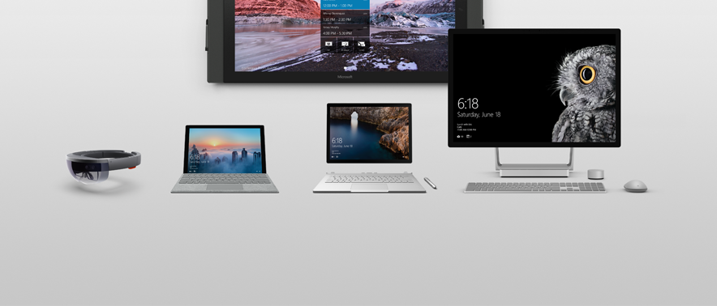
A portfolio designed around people
Natural
interactions
Versatile
form factors
Meticulously
crafted
Connected experiences
Notes:
We’re in the devices business to not just evolve and improve, but to revolutionize the way we work – the way we create, the way we innovate. To re-define and establish new categories of devices. To empower every business on the planet to achieve more.

Slide 9
Demo

Slide 10
Surface in Higher Education
Modern Teaching
Engineering, design and athletics
Empowering college students
Notes:
Note to speaker
This is an intro slide that details two scenarios where Surface can make the most impact in a Higher Education teaching environment.

Slide 11
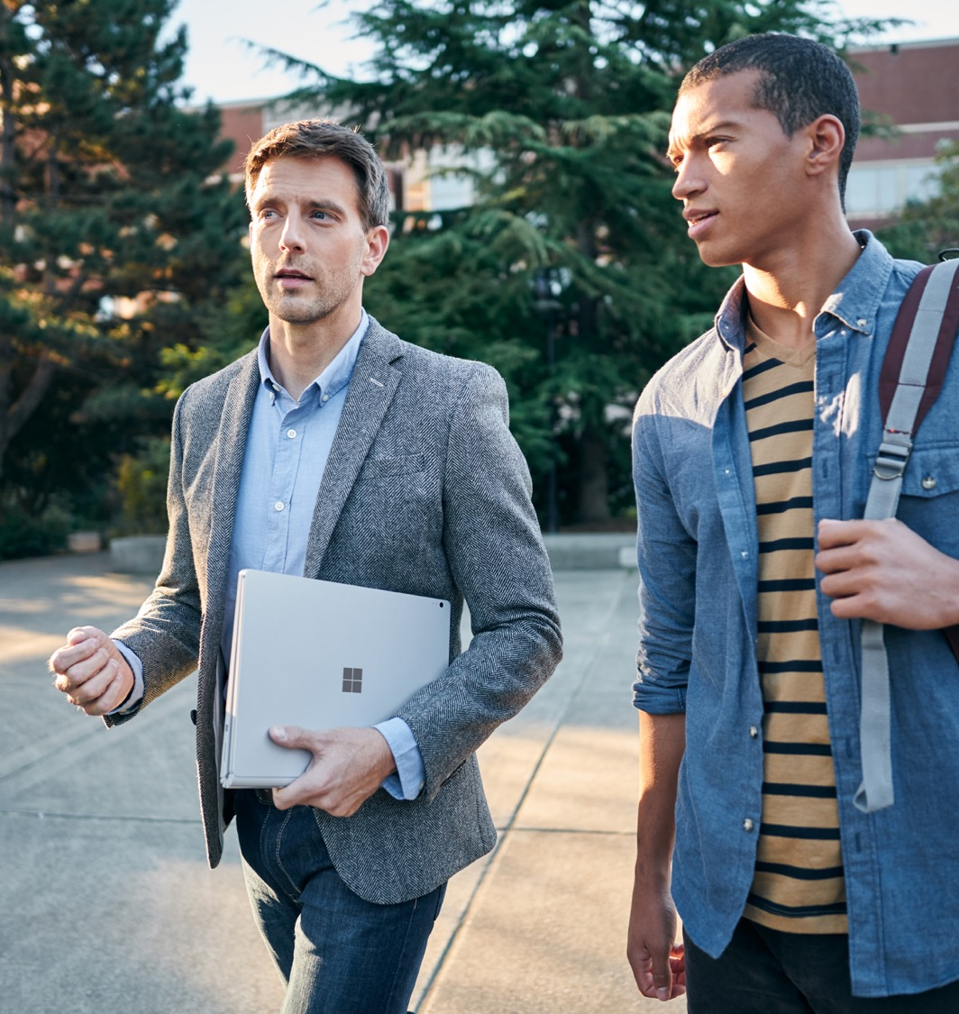
Modern teaching
Typical challenges:
Increasing workload pressures on teachers
Higher expectations of personalized learning
Investments in authentic learning.
Moving between classrooms, and offices
with clunky equipment and multiple devices.
Notes:
Bullet point 1: HED teachers are performing a variety of roles within the day, moving from lecturing, teaching small groups, to producing their own research: they need a device that is as flexible as they are.
Bullet point 2: Often they must use outdated legacy equipment, or are confined to a desktop for large data sets and software packages. They need mobility and speed to be the most productive.
Bullet point 3: to collaborate with students in any environment offers the possibility to improve learning outcomes. Lecture whiteboards, seminar projectors and personal devices cannot deliver the collaboration potential of surface products. This must all be done securely as student data and research participants must be protected at all times.
Note to speaker
Here we introduce the mobility and flexibility of the Surface devices compared with the more static whiteboard or laptop alternatives.
Bullet point 1:
The big 3 activities that have traditionally been part of the learning process are :
Reading – using textbooks, printouts or storybooks
Presenting/Lecturing – using a Chalkboard, Whiteboard, overhead or Smartboard
And Writing – using notebooks/paper
Other activities include:
Watching/Listening – using audio visual equipment to play videos or recordings
Individual Study – using worksheets, practice workbooks, researching problems, playing games to reinforce a concept, etc.
Assessment – using testing materials like blue books, paper quizzes, test sheets
Collaboration – sharing tools for group/project work
Increasingly, devices are being brought into the classroom to support many of these tasks
Bullet point 2: Some devices are better able to support different activities than others.
Tablets, like the iPad, are great for individual consumption-based activities
Chromebooks allow you to extend coverage to assessment and give more access to collaboration tools to support group work
But the 2 big activities of teacher presentation and writing are still not supported by these types of devices. You can do a certain level of presentation with a laptop, but the teacher being behind their desk typing or showing slides is not the same as standing in front of the class whiteboarding out a concept.
Surface is a hybrid (or 2-in-1 type device) which gives you the greatest flexibility for supporting all classroom activities
Bullet point 3: The Workload Challenge survey, conducted by the Department for Education, showed that 53% of sample respondents thought that, whilst marking pupils’ work is necessary and productive, the excessive nature, depth and frequency of marking was burdensome. (https://www.gov.uk/government/uploads/system/uploads/attachment_data/file/511256/Eliminating-unnecessary-workload-around-marking.pdf)
Bullet point 2
Sources to inform talk track and content update.
http://digitalpromise.org/2015/11/16/identifying-the-top-four-challenges-in-k-12-education/
https://www.gov.uk/government/uploads/system/uploads/attachment_data/file/511256/Eliminating-unnecessary-workload-around-marking.pdf
http://www.advanced-learning.co.uk/wp-content/uploads/2016/02/Can-technology-genuinely-reduce-teacher-workload.pdf

Slide 12
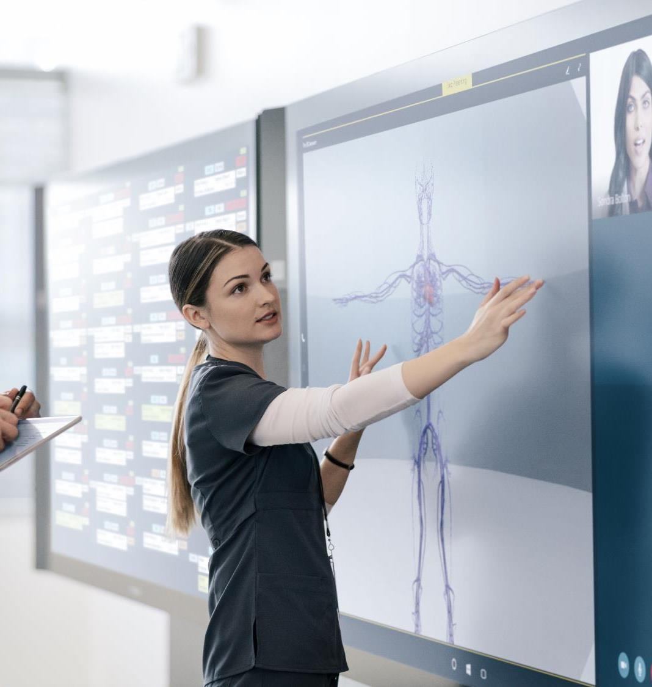
Modern teaching
How we solve the problem:
Thin, light and versatile devices with a multi-position, built-in kickstand, and digital inking.
Present lessons on the big screen and highlight important features with Surface Hub and Surface Pen. A powerful team collaboration device, it’s designed to advance the way students and teachers work together naturally.
Travel beyond the classroom using integrated video conferencing on Surface Hub’s large touch screens to access specialists and remote experts.
*Software shown is sold separately.
Notes:
Here we discuss specific benefits of the Surface Pro 4, Surface Pen and Surface hub.

Slide 13

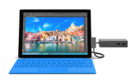



Surface for modern teaching
BENEFITS
Walk among your students
Move wirelessly around the classroom with Surface Pro 4 and Surface Book. Each are thin, light and can be used to control projectors, Surface Hub or other screens
Transition from laptop with keyboard and mouse or quickly convert to tablet mode
Surface devices all move to meet various angles: standing at counter height, at a desk, in the field or on your lap
Surface Studio with it’s 28” brilliant screen and frictionless hinge moves down to drafting mode for design work, writing and collaboration with students
Stay organized and engaged
Surface was designed for touch, highly responsive pen, type, mouse, trackpacd and voice
With multiple input options from touch to pen to keyboard and trackpad to mouse, it’s easier to go paperless. Annotate, grade papers, input class plans all on one device
Surface with Windows 10 and a choice of Intel® Core processors run even the most demanding software and apps
Expand the classroom
Connect with guest speakers, students and others around the world on Surface Hub
with HD cameras, screen and microphones
Sign in quickly with a smile using Windows Hello
Rear-facing camera provides close up views of demos, labs or work
Engage with students in the classroom and those dialing in remotely with Surface Hub’s dual pen and touch capabilities. Share whiteboards, annotations and anything else you want to present
Education 10% discount available in some markets. Please check with your local reseller for more details. Complete for Education Warranty helps conserve resources with claims sharing
KEY ACCESSORIES
Microsoft Complete for EDU
1:1 tech support
Accident protection
Quick replacement
Microsoft Wireless Display
Enables note taking, annotating changes or questions on Edge, PowerPoint, PDF and capturing customer signatures
Surface Dock
From portable to productive: Connect to dual monitors, speakers, a full-size keyboard and more
Surface Type Cover
Optimized for fluid typing with well spaced mechanical keys, enlarged glass trackpads and ergonomic sculpting
Surface Pen
Enables note taking, annotating changes or questions on Edge, PowerPoint, PDF and capturing customer signatures
*Accessories sold separately. Surface Pen sold separately from Surface Pro 4 Core M models.
Notes:
Surface Type Cover Technical Specifications:
11.60” x 8.50” x 0.19”
(295 mm x 216 mm x 4.65 mm)
0.68 lbs (310 g)
Available in onyx (with Fingerprint ID)
Mechanical keys that are spread out for
precision typing
Layout: QWERTY, full row of function keys (F1–F12)
Dedicated buttons for Windows shortcuts, media controls, and screen brightness
Right-click button
Magnetic attachment
Accelerometer
Surface Dock Technical Specifications:
5.12” x 2.36” x 1.18”
(130 mm x 60 mm x 30 mm)
1.2 1lbs. (550 g)
2 Mini Display Ports
1 Gigabit Ethernet port
4 USB 3.0 ports
1 Audio out port
Surface Connect cable
External power supply
Surface Pen Technical Specifications:
5.67” x 0.37” x 0.40”
(144 mm x 9.5 mm x 1 0.20 mm)
0.04 lbs (20 g)
Available in black, gold, blue, and silver
Compatibility: Surface 3, Surface Pro 3, Surface Pro 4, and Surface Book
Connector Type: Bluetooth 4.0LE
Buttons: Right-click and eraser
Battery: 1 AAAA
3rd party Chip and Pin Solutions
Verifone e355. Operates across multiple generations of smart devices or in standalone mode.
Bluetooth EMV by AnywhereCommerce. Nomand Device. Takes secure payments virtually anywhere, anytime.
Bluetooth EMV by AnywhereCommerce. Walker Device. Transforms smartphones, tablets and PCs into mPOS solutions.
Bluetooth EMV by Bluebird Pidion. EP300 Series. Enables payment in full with credit cards of all types.

Slide 14
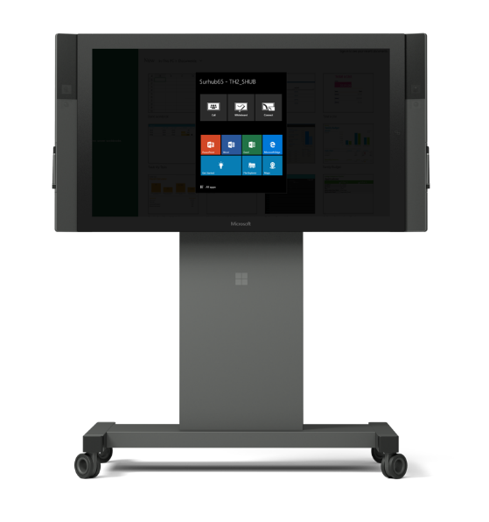
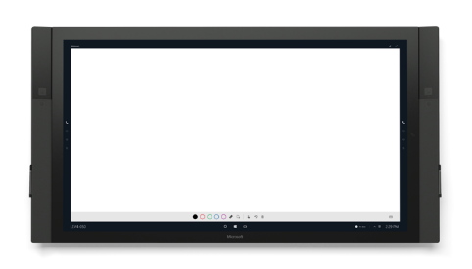
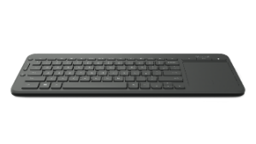
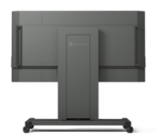
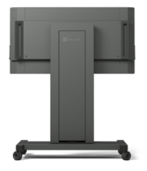
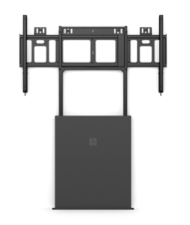

Surface Hub for modern teaching
BENEFITS
Engaging curriculum
  Keep students fully engaged with rich audio/visual/touch experiences by moving seamlessly between applications, web browsers and connected devices
  One-Touch Start. An intuitive Windows 10 home screen is ready to launch audio, video and the OneNote Whiteboard with just one touch
  Engage users simultaneously and naturally on the super-responsive 120 Hz screen with up to 100 touch points and three Surface Pen ink streams
  Increase group productivity by taking advantage of split-screen applications that encourage participation and teamwork
  Distance learning
  Collaborate not just across campus but across the planet. Connect via wired, wireless, personal and remote devices. Then present the screen to ensure everyone is working on content together
  Start meetings with one touch using Skype for Business and engage every participant with dual HD cameras and a four-element microphone array
  Empower productive teamwork via the Office suite of familiar applications
  Save content in the cloud or email it instantly to the team from the OneNote Whiteboard. Touch "I'm Done," to delete the session and restart the device
  Research
  Replace paper and chalkboard by working collaboratively via touch and Pen, allowing everyone to
  quickly sketch thoughts and mark up ideas simultaneously
  Keep sessions fluid, productive and easy to share using native applications and a seamless web experience
  Maintain research safely in the cloud or on personal devices. For security, there is no local storage. When users hit “I’m Done” the device resets for the next group
Surface Hub Keyboard
Connect via Bluetooth for quick typing and trackpad. Shortcuts include Skype for Business and quick connection to projector and whiteboard
KEY ACCESSORIES
Wall or Floor
Support Mounts
Fixed and stable placement
Rolling Stand
Easily move between spaces
*Accessories sold separately.
Notes:
SLIDE TO SHOW SURFACE HUB FEATURES FOR STORE OPS
One-touch meeting start. On average, it take thirteen minutes to start a meeting. With our communal design, with one-touch your meeting will start. Audio, video, and Whiteboard are automatically launched at the start of your meeting. No more “can you see me, can you hear me?”, participants can get to work right away.
Scheduled meetings are supported via Exchange, which is a turn-key solution, there is no change or special process required to use Surface Hub. However not all meeting are planned. By simply touch the Whiteboard icon or picking up the pen, teams can begin collaborating, one can add in remote participants by simply calling people via Skype for Business.
Runs Windows 10 for enterprise-grade security. Any Windows 10 app can be used on Surface Hub. Universal apps run natively without any authentication required. Desktops apps can be accessed from your personal devices via wired or wireless ingest. HTML 5 apps can be run via the Microsoft Edge platform.
Inking. The hardware within Surface Hub supports an unmatched large screen inking experience. The inking experience is fluid and natural, the ink feels as if it were coming out of the pen itself. The experience is possible due to the projected capacitive technology with Surface Hub, which is the same technology we experience in our mobile devices. The hardware within the pen is the customized to ensure ease of use and premium integration within the ink experience
Engaging everyone. The hardware design of Surface Hub ensures that remote participants are engaged just as if they were in the room. Wide angles cameras are installed to ensure the remote participants can see everyone in the room. The dual HD cameras are place at eye-level, for a more personal experience. A four element microphone array is optimized for voice and eliminates background noise.
Share content. Content is no longer just presented, it is also created. Your content is designed to be taken with you to any device. Within the OneNote Whiteboard, with one tap you can send your whiteboard to any device and continue to work on ideas after your session is over.
Project content. No meeting is without adding content to enrich the conversation. Personal computers can be projected into the hub wirelessly via miracast or wired via a display out port. Surface Hub supports cross platform devices such as Win7, Win8.1, Win10, iOS, OSx, and Android. Windows devices had the additional features of inkback and touch back, where one can operate their computer directly from the Surface Hub.
Common applications
O365
Power BI
Accessories:
Mounting Brackets
Rolling brackets

Slide 15


“We can have experts based in biomedical sciences in Bristol and we can disseminate their expertise to 8 different sights.”
John Henderson
Pediatric Respiratory Medicine
“We work with ideas that are so complicated, you just can’t get those ideas across in a basic email.
Having visual representations of things where you have immediate feedback with your collaborators is critical.”
Erin O’Callaghan
Senior Research Associate
Fascinated by the collaboration capabilities and applications enabled for medical teaching purposes, the University of Bristol in the UK has purchased 30 Surface Hub units to help their students and faculty gain more flexibility in learning and teaching.
The University plans to continue purchasing 20 more Surface hub units for more global teaching and learning experiences. They seeks to share knowledge and best practices between medical schools around the world and plan to use the Surface Hubs as a platform to drive empowered communication.
In addition, both the School of Medicine and the School of Engineering have expressed their intent to purchase Hololens as a means to enhance their respective learning experiences with augmented reality.
Surface Hub will be one of the key drivers of switching the University of Bristol back on Office 365 from Google Apps for Education.
PLAY VIDEO

Slide 16

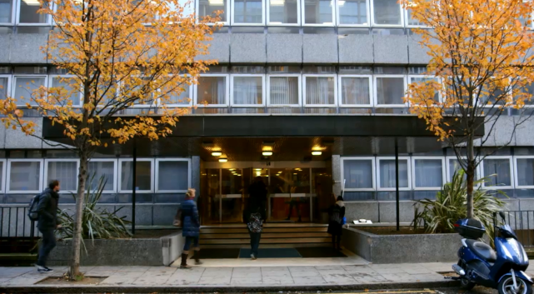
“The Surface will give our students a distinct advantage in the workplace and in the competition for jobs.”
Dr. Daniel Khan, Principal
Situation
St. Patrick’s College needed to equip a diverse student body with 21st Century technology skills. Needed student device integration with existing IT investments, and needed a technology tool to assist in academic excellence
Solution
Surface tablets running Windows 8.1 and Microsoft Office handed out to second-year students who met the college’s criteria for academic achievement. Microsoft Office 365 to store and share documents online, IT Academy for Microsoft Office online training courses.
Benefits
Digital literacy and technology skills for students and their families. Easy deployment and automated data syncing. Anytime access to learning resources.
PLAY VIDEO
Notes:
10,000 Surface RT tablets purchased, 500 initially rolled out to St. Patrick’s 2nd year students.
http://www.st-patricks.ac.uk/
http://www.microsoft.com/casestudies/Microsoft-Surface-with-Windows-RT/St-Patrick-s-College/British-College-Gives-Students-a-Competitive-Professional-Edge-with-Tablet-Solution/710000003816

Slide 17

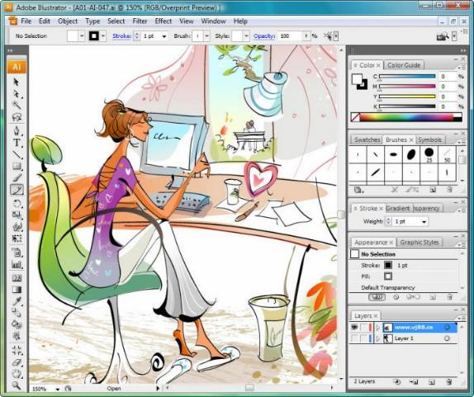


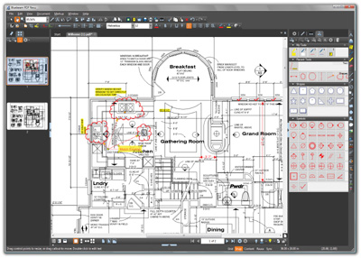
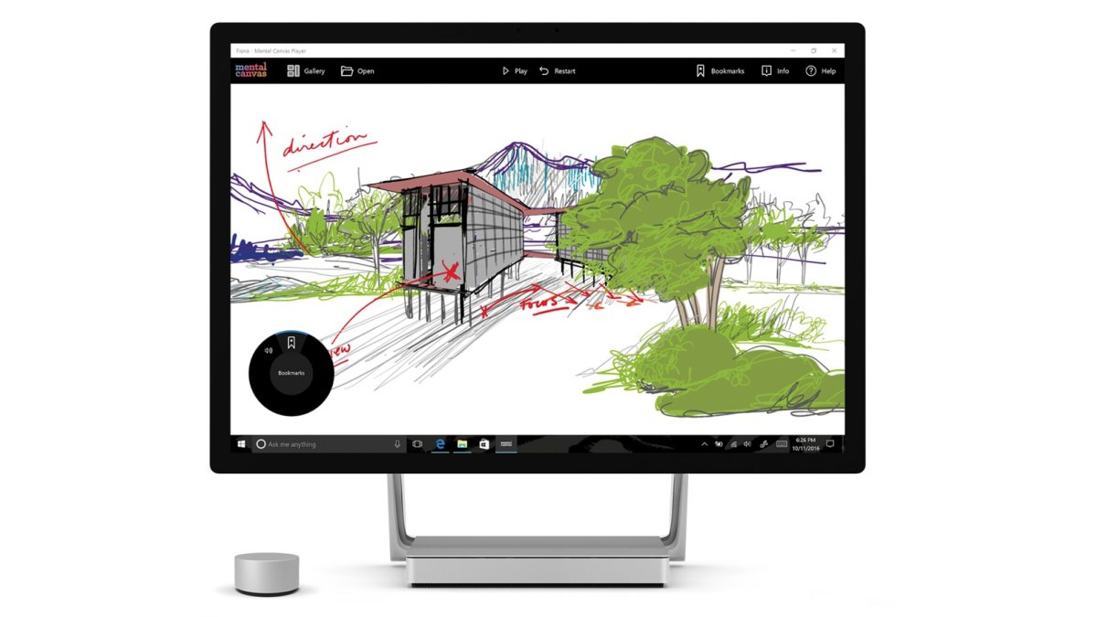
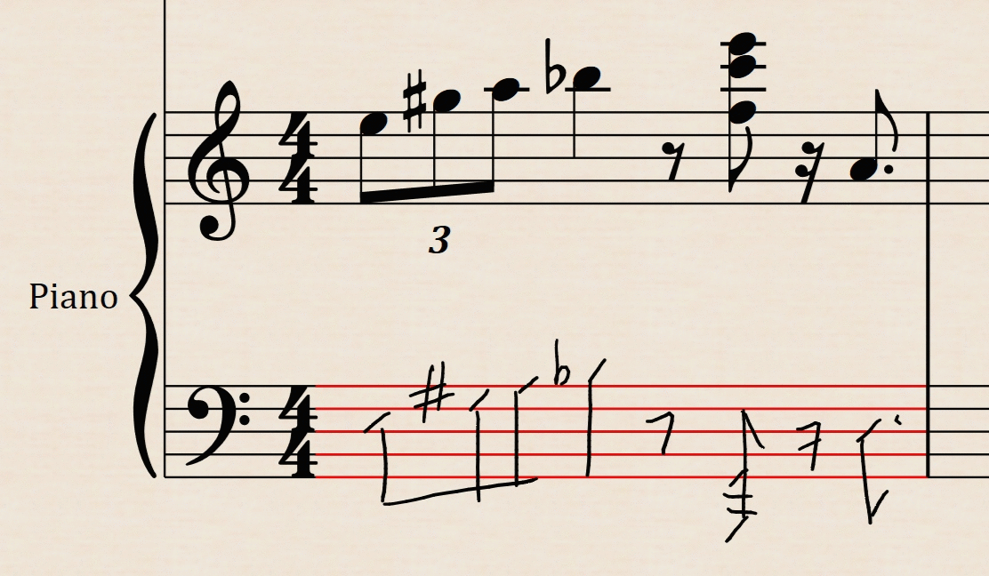
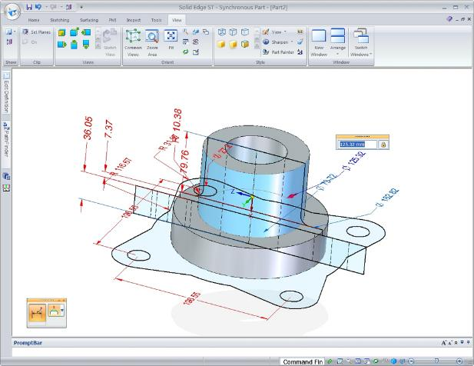



Surface working with
STEAM partners
PLAY VIDEO
Notes:
Click the “play video” button to view video of ISV partners in STEAM (science/technology/engineering/arts/math) developing software for Surface Studio.

Slide 18
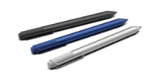
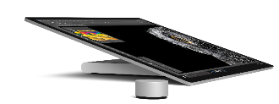
Surface for modern teaching: Engineering and Design
BENEFITS
Unique engagement with designs and projects
  Powerful Intel Core processors and dGPUs run CAD (e.g. Solidedge), animation software and more
  Discover unique Surface Pen and Dial capabilities for even better, natural design work
  Touch, design and annotate with brilliant touch screens
  Ports such as USB, SD card reader and miniDisplay easily connect you to peripherals and extend memory
  Move Surface to adapt to the way students work.
  Surface Book disconnects from the base to be used as a sketch pad or can be reconnected in canvas mode
  Surface Studio glides down to studio mode – creating the same feeling of working with pen and paper at a drafting table
KEY ACCESSORIES
Surface Pen
Enables note taking, annotating changes or questions on Edge, PowerPoint, PDF and capturing customer signatures
Surface Dial
Interact with technology and create in the most natural, immersive way. Store, customize, access, navigate, and reimagine physical tools in the digital world – from concept to creation
*Accessories sold separately.

Slide 19
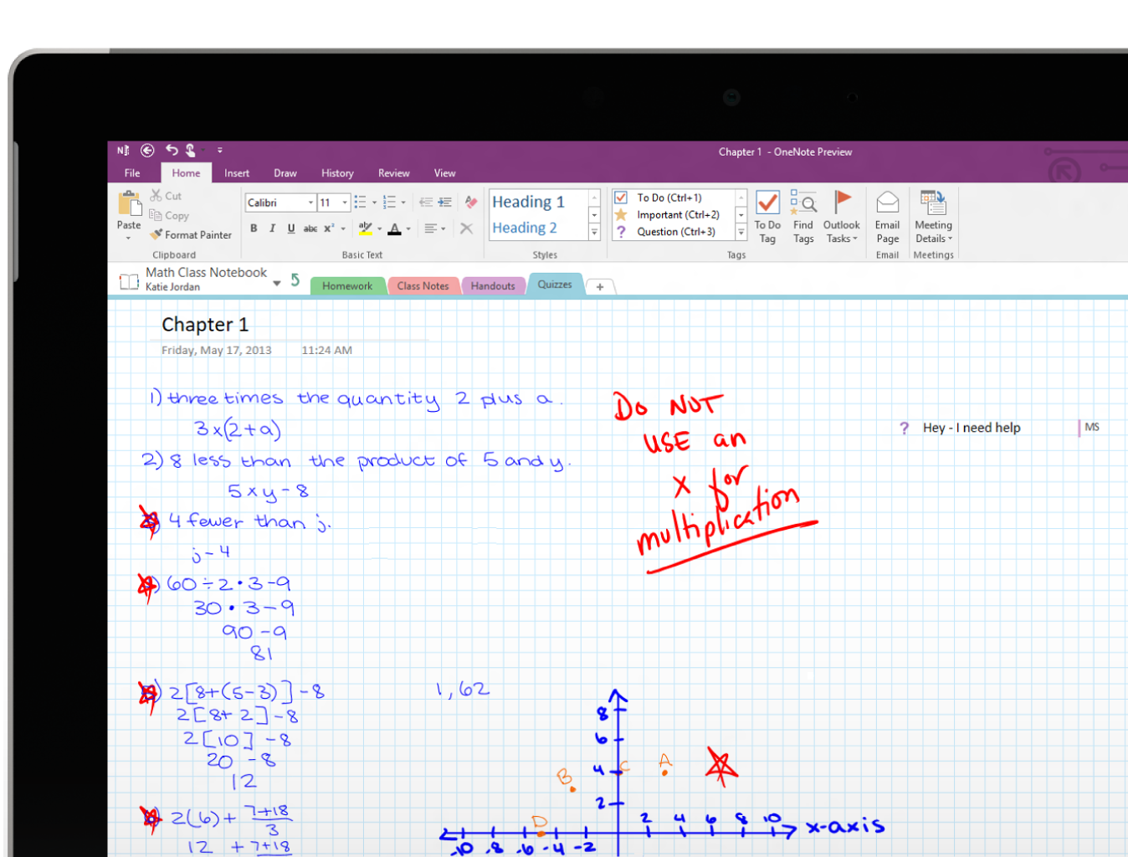
OneNote for modern teaching
Teachers using OneNote Class Notebooks can manage all their lesson plans and class content in one central location.
They can create and deliver interactive lessons in the collaboration space, stay organized using the content library for handouts, and provide student feedback in each students’ private notebook.
To learn more about how Surface + OneNote can replace pen and paper in the classroom visit onenote.com/classnotebook.
PLAY VIDEO

Slide 20

Notes:
London’s Royal Academy of Music. This is the perfect story of collaboration!

Slide 21

UW Formula Motorsports
The University of Washington’s Formula Motorsports team is a student led group of engineers working every year to build a Formula 1 style race car from scratch. They then compete with the car they’ve built against other schools across the world. This program is all about inspiring and empowering the next generation of engineers, makers, and scientists. Surface Book is their laptop of choice.
PLAY VIDEO

Slide 22
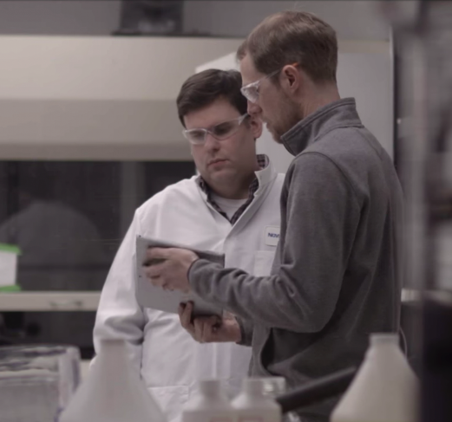
“The Surface Pro 4 is really important to me because it’s the only way I can take the CAD software onsite to clients.”
Ryan Spoering, PhD
Founder, Lab Machinist Solutions
LAB MACHINEST SOLUTIONS, LLC
Lab Machinist Solutions (LMS) works with clients in the sciences to build customized apparatus and research tools from customized prototypes. Clients come to LMS for innovative tools and their unique perspective. This requires a specific mix of
creativity and hard science.
Surface’s mix of flexible tools and creativity enable founder Ryan Spoering to create and design anywhere – from his workshop at home to consulting with his clients on-site. And because Surface runs tools from CAD to Solid Edge, he can take big ideas and make them concrete.
Because the Surface device has the ability to use any input, Spoering can
use it as a pad of paper to write and draw freely. This level of interaction
spurs creativity without constraints, allowing him to contribute in
meaningful ways to new science.
PLAY VIDEO

Slide 23


“Microsoft Surface helps us stay on the same page — connected,”
Warren Keller, Eagles head coach, whose players review videos and draw plays on the device to learn and perfect formations.
California School For the Deaf Football
In Fremont, California, the Eagles high school football team crushed most of its opponents last year for a stellar 10-1 record. They did it with hard work, teamwork, lightning-fast strikes and strong communication.
Based at the California School for the Deaf, a bilingual school, the Eagles dominate other teams with their speed and collaboration. They also use a Surface Pro 4 to prepare game strategies and develop new plays in real time.
For Eagles quarterback Jax Pedersen, football is a way of showing the world what he and his teammates can accomplish through passion and dedication.
“Most hearing teams think we can’t play until we’re on the field, and then afterwards, they have a lot of respect for us,” he says. “We don’t give up. We always pursue. We always play through our pain and we’ll support each other.”
The Eagles are featured in a new Microsoft video and national ad campaign that highlight their teamwork, technology and success.
PLAY VIDEO

Slide 24

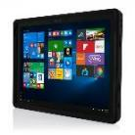
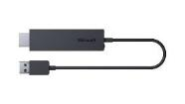
Surface for modern teaching: Athletics
BENEFITS
Walk among your students
Move from the field to the classroom or the locker room with Surface Pro 4 and Surface Book. Each are thin, light and can be used to control projectors, Surface Hub or other screens
Transition from full laptop with keyboard and mouse or quickly convert to tablet mode
Surface devices all move to meet various angles: standing at counter height, at a desk, in the field or on your lap
Practice Time
Surface was designed for touch, highly responsive pen, type, mouse, trackpad and voice
Fire up Surface to review today’s performance gos and run playbook apps
Use the USB, SD card, or miniDisplay ports to take practice or game footage into Adobe and other creative software suites (e.g. XOS Digital) for full video editing
On the Road
State-of-the-art features keep everyone connected and data secure
Be productive while you travel by plane, bus or car
Review game notes and footage on the road, work on class assignments from
the hotel, or relax with a pre-game movie
“
The best thing about Surface is that I can take it anywhere. I can balance work and play.”
- Drew Brees, NFL Quarterback
KEY ACCESSORIES
Surface Type Cover
Optimal key spacing allows fast and fluid typing while an enlarged glass trackpad offers precision control
Incipio Capture® Case
The ideal choice for rugged defense, featuring a convenient 360° rotating handle and adjustable strap
Microsoft Wireless
Display Adapter
Work untethered while projecting content on a big screen
*Accessories sold separately. Surface Pen sold separately from Surface Pro 4 Core M models.

Slide 25

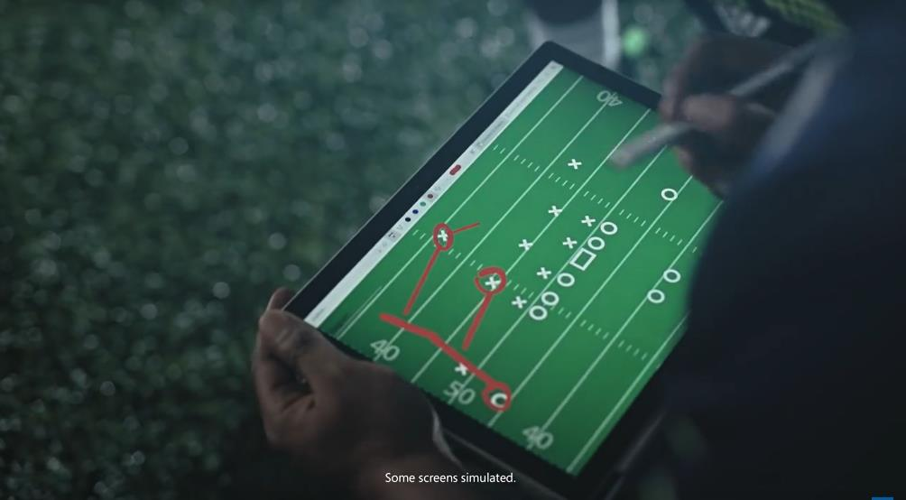
Microsoft Surface is the Official Tablet of the NFL and used by NFL coaches and players on the sidelines, in locker rooms, in practice facilities, and at home after the game.
Drew Brees, Clay Matthews III, Todd Gurley and other NFL stars use the Surface to perform at the highest levels.
Surface Pro is truly built for the fans.
PLAY VIDEO

Slide 26
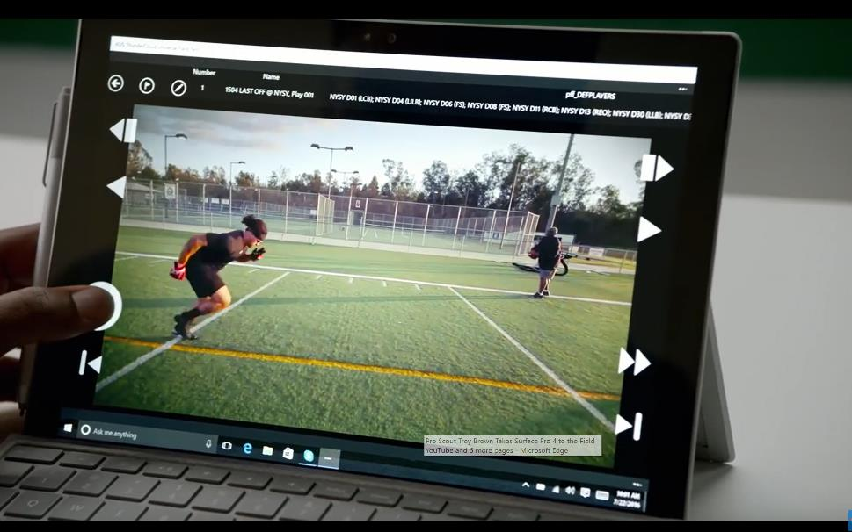
Trey Brown Director of Scouting
Pro Scout Trey Brown knows talent when he sees it.
From the field to the weight room to his hotel room, Trey's office is wherever he needs it to be.
PLAY VIDEO

Slide 27
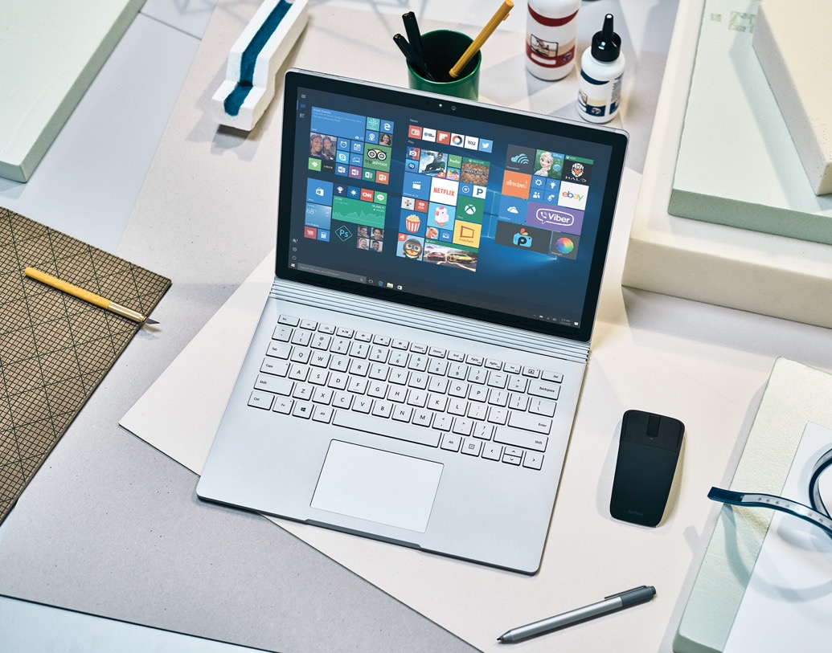
Empowering college students
Typical challenges:
Making and filing notes, research and projects together in one place, securely.
Running industry grade software seamlessly
Collaborating with peers for project work and with lecturers for remote learning
*Software shown is sold separately.
Notes:
Bullet point 1: Keeping track of all courses, research and notes can be tricky, if this wasn’t enough, it all needs to be done securely as research participant data is often vulnerable on student devices.
Bullet point 2: engineers need to be free to work remotely, to build and run CAD software where they please. Artists should be able to run adobe suites on a tablet seamlessly, without being restricted to a workstation. Whatever the specialism, students should be free to learn where it suits them, so software needs to be as mobile as they are.
Bullet point 3: being able to collaborate with peers is essential to students, who increasingly expect to work across different mediums, from anywhere. It is essential for students with disabilities to access learning opportunities, as remote learners do too. Technology shouldn’t be the factor restricting this from happening.

Slide 28
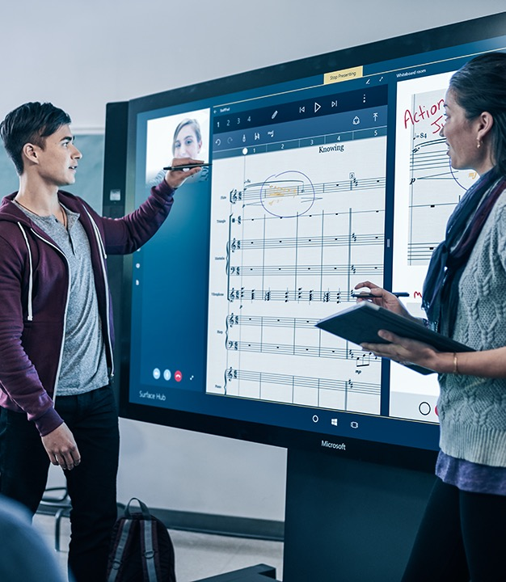
Empowering college students
How we solve the problem:
With Surface Hub, students can collaborate, create and brainstorm together to bring ideas to life on the big screen. And, with beautiful HD graphics, teachers can provide an interactive, engaging experience whenever there’s a video or project to share.
Students can annotate, save, and share projects as collaborate across geographies. Utilizing the cloud means students work is always backed up, always secure.
The power of surface means students can work freely, across geographies, running all the industry grade software they need to achieve the best learning outcomes.
*Software shown is sold separately.

Slide 29
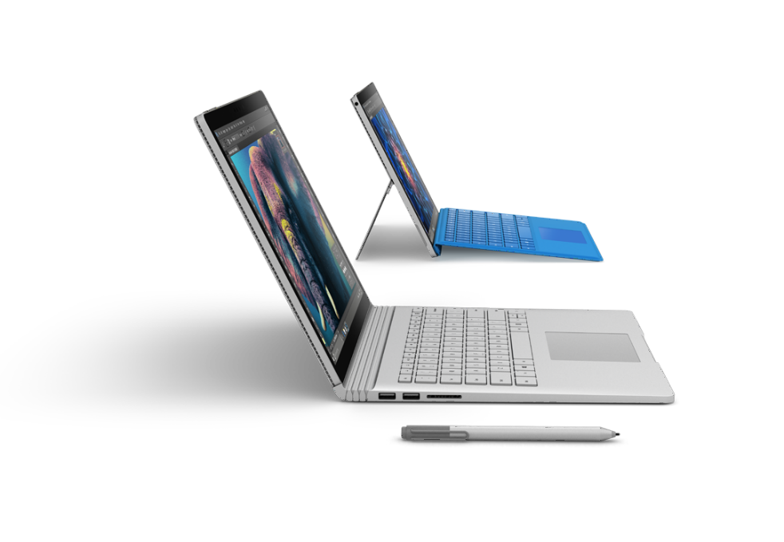
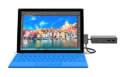

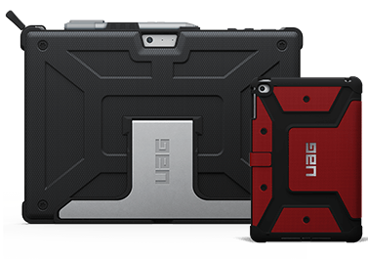


Surface Benefits: empowering college students
BENEFITS
Keeping up with today’s mobile student
Surface Pro 4 and Surface Book are thin, light and can be used as a full laptop with keyboard and mouse or quickly convert to tablet mode; making it easy to work individually or collaboratively
Multiple ports (USB, SD card, miniDisplay) provide easy connection to printers, monitors and memory sticks
The USB port in the Surface power cord comes in handy for charging phones and other devices
Surface devices all move to meet various angles: standing at counter height, at a desk or on your lap
Surface runs Windows 10 Home, Pro and Enterprise, so you can still work without an internet connection
Students learn and work differently
Surface was designed for multiple inputs to meet student’s needs: touch, pen for note taking and drawing, keyboards with trackpads and mice
Digital inking with the highly responsive pen allows for spontaneous creativity and brainstorming
Run all familiar Windows software plus apps
Go paperless. Annotate, grade papers, input class plans all on one device
Rear facing camera makes it easy to record lecture, demos or key parts of a presentation
Security is top of mind
Windows Hello cameras in Surface allow for easy but secure student login with a smile.
Set up device sharing with multiple user login if desired
Windows Defender provides built-in anti-virus protection while Device Guard provides access
controls so only trusted apps run on your school’s devices
Education 10% discount available in some markets. Please check with your local reseller for more details
KEY ACCESSORIES
Microsoft Complete for EDU
1:1 tech support
Accident protection
Quick replacement
Microsoft Wireless Display
Work untethered while projecting content on a big screen
Surface Dock
From portable to productive: Connect
to dual monitors, speakers, a full-size keyboard and more
Surface Pro 4
Type Cover
Optimized for fluid typing with well spaced mechanical keys and enlarged glass trackpad
Durable cases
Designed to allow versatility
Surface Pen
Enables note taking, annotating changes or questions on Edge, PowerPoint, PDF and capturing signatures
*Accessories sold separately. Surface Pen sold separately from Surface Pro 4 Core M models.
Notes:
Surface Type Cover Technical Specifications:
11.60” x 8.50” x 0.19”
(295 mm x 216 mm x 4.65 mm)
0.68 lbs (310 g)
Available in onyx (with Fingerprint ID)
Mechanical keys that are spread out for
precision typing
Layout: QWERTY, full row of function keys (F1–F12)
Dedicated buttons for Windows shortcuts, media controls, and screen brightness
Right-click button
Magnetic attachment
Accelerometer
Surface Dock Technical Specifications:
5.12” x 2.36” x 1.18”
(130 mm x 60 mm x 30 mm)
1.2 1lbs. (550 g)
2 Mini Display Ports
1 Gigabit Ethernet port
4 USB 3.0 ports
1 Audio out port
Surface Connect cable
External power supply
Surface Pen Technical Specifications:
5.67” x 0.37” x 0.40”
(144 mm x 9.5 mm x 1 0.20 mm)
0.04 lbs (20 g)
Available in black, gold, blue, and silver
Compatibility: Surface 3, Surface Pro 3, Surface Pro 4, and Surface Book
Connector Type: Bluetooth 4.0LE
Buttons: Right-click and eraser
Battery: 1 AAAA
3rd party Chip and Pin Solutions
Verifone e355. Operates across multiple generations of smart devices or in standalone mode.
Bluetooth EMV by AnywhereCommerce. Nomand Device. Takes secure payments virtually anywhere, anytime.
Bluetooth EMV by AnywhereCommerce. Walker Device. Transforms smartphones, tablets and PCs into mPOS solutions.
Bluetooth EMV by Bluebird Pidion. EP300 Series. Enables payment in full with credit cards of all types.

Slide 30
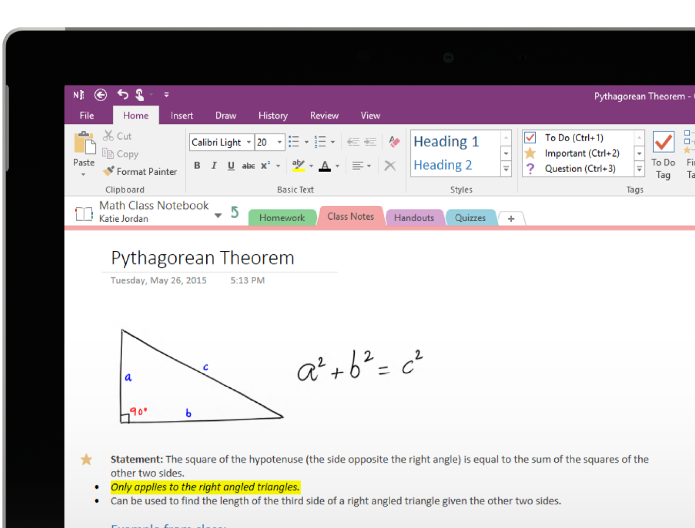
OneNote: empowering students
Snap images of the whiteboard and import and annotate on them
Work with friends and share notes, make edits in real time
Sketch or write by hand for note taking, science and math problems
Easily track homework assignments
Import images from the web or other files and annotate over them
Create To Do lists
Record audio
Work from any device, anywhere so you never lose your work

Slide 31
Writing in Education
Research shows the benefits of using Digital ink in the classroom:
Substantial time savings
for educators
4 out of 5
said it saved them time when preparing and administering assessments.
3 out of 4
are not frustrated by technical issues
60%
say it reduces time spent posting resources online
Less technology ‘friction’ for students and teachers
68%
say that using a touch-based device with a stylus increases the quality of communications with increased levels of student engagement
90%
believe stylus and touch allow them to improve the quality of preparing materials and curriculum for instructions and activities.
Efficiencies in
daily activities
67%
said their stylus-based device helped save them time when preparing materials and curriculum for instruction.
88%
say it allows them
to increase the quality
of the instruction to the entire class.
*OneNote and Microsoft O365 sold separately.
Notes:
SLIDE TO SHOW WINDOWS-COMPATIBLE POS OPTIONS
Sleek – this looks like cool modern retail
Easily managed by IT with existing management tools
Remote lockdown if lost or stolen
Improve customer satisfaction
A secured credit card reader enables purchases anywhere in the store.
Sales associates can also “line-bust” to reduce wait times or meet customers on the sales floor to ring up purchases
Boost conversion and basket size
With shorter lines, sales associates can also use the device for assisted selling, inventory management, or productivity tasks.
Mobile devices allow employees to go hands-free on
the sales floor and offsite, helping to drive sales
without barriers.

Slide 32

Melissa DeCapua
Nursing student
Melissa uses her Surface Pro to read, study, take notes, and collaborate with fellow students and her professors.
She also uses her Surface outside of classwork to draw, paint and do amateur photography. Surface is her tablet, laptop, desktop... everything!
PLAY VIDEO

Slide 33
Surface delivers proven results
$615 saved in device purchase costs as employees can be provisioned with a single Surface Pro.
90
60
%
%
Agree or strongly agree they get more done away from their desk
Agree or strongly agree they are more satisfied with their ability to get things done
Forrester Research, Microsoft Surface Pro 3 Delivers Reduced Device Costs And Improved Revenue, June 2015. Statistics based on using a Surface Pro 3 device.
Notes:
The results – in terms of efficiency, productivity and cost-savings – speak for themselves.

Slide 34
Surface Hub total economic impact
1: Summary of benefits
Through 5 customer interviews and data aggregation, Forrester concluded that Microsoft Surface Hub has the following financial impact.
2: Breakdown of benefits
The TEI study quantified specific costs, benefits, and metrics that matter to customers.
$1.5
ROI
138
$1
%
9
Months payback
Installation and ongoing costs
Millions 3-year analysis
Device costs
$0.5
Sales improvement enabled by Surface Hub client meetings
Meeting productivity
$0
Meeting productivity
$1.4m
Benefits
$620k
Costs
This document is an abridged version of a case study commissioned by Microsoft titled:
The Total Economic Impact of Microsoft Surface Hub. February, 2016.
Notes:
Don’t just take our word for it.
A Forrester Total Economic Impact study has studied the financial benefits on organizations.

Slide 35
Surface Hub total economic impact
3: Voice of the customer
4: Surface Hub by the numbers
“We had a client meeting to propose a project. Instead of using the whiteboard, we used the Surface Hub, and it was incredibly successful.“
Director of Design and Construction,
Architecture Firm
1,065,697
$
in year 3
Annual benefit after full ramp up of Surface Hub devices
15-23
25
$
Minutes saved on pre and post meeting tasks
In printing costs saved per meeting
“Emailing the OneNote files after a
meeting saved time on every meeting
that uses the Surface Hub.“
COO,
US law firm
20
%
Increase in sales from client meetings leveraging Surface Hub
This document is an abridged version of a case study commissioned by Microsoft titled:
The Total Economic Impact of Microsoft Surface Hub. February, 2016.
Notes:
Don’t just take our word for it.
A Forrester Total Economic Impact study has studied the financial benefits on organizations.

Slide 36



Complete for EDU Plan
Complete
for Education
Complete
for Enterprise
 | Standard | Extended Hardware Service |  | Complete for Business
Plan Essentials
Warranty coverage | Included | With purchase |  | With purchase |  | With purchase of any EDU-qualified device | With purchase of 250+ devices
Plan duration | 1 or 2 years, varies by country | 3 or 4 years, depending on purchase type |  | 3 or 4 years, depending on purchase type |  | 3 years | 3 years
Activation | Upon device deployment | Within 45 days of purchase |  | Within 45 days of purchase |  | At time of device purchase | At time of device purchase
Replacement timeline (business days) | 5-8 (varies by country) | 3-5 (varies by country) |  | 3-5 (varies by country) |  | 3-5 (varies by country) | 1-5 (varies by country)
Coverage
Manufacturer’s defects, including battery
Accidental damage, including cracked screens, spills, power surges, etc. |  |  |  |  |  | 100% of devices purchased | 200% of devices purchased
Onboarding
Claims Sharing setup
Deployment materials
Surface Experience Training |  |  |  |  |  | For teachers | For end-users
Device Replacement
Prepaid return shipments
Advanced exchange (varies by country)
Account-level claims sharing
1% non-bootable claims
Pricing (USD) | 1 year | + 2 years | + 3 years | + 2 years | + 3 years | + 2 years | + 2 years
Surface Pro 4 | $0 | $99 | $149 | $249 | $399 | $299 / $225 in bundle | $299
Surface Book | $0 | $199 | $249 | $349 | $499 | $399 / $359 in bundle | $399
Notes:
Full details on Complete for EDU plan: https://microsoft.sharepoint.com/sites/infopedia/pages/layouts/kcdoc.aspx?k=G02KC-1-7326

Slide 37




A warranty you’ll use
Accidental Damage
Protect your device from the unexpected. No matter the accident, we’ve got your back.
With advanced exchange, you’ll receive replacement devices before shipping back the defective units.
Claims Sharing
Receive one AD claim per device, grouped together and shared across your institution.
Available claims equals 100% of total devices; managed at an account level rather than a device level.
Surface Training
Learn the features and benefits of Surface through live online or on-site training.
Content is customizable and schedules are flexible so you can train the right groups at the right time.
Onboarding Desk
Take advantage of up-and-running support from a team of dedicated Microsoft contacts.
The Onboarding Desk will assist with device registration, Smart Start resources, and training coordination.
Surface Dock
From ultraportable to ultraproductive: Connect to dual monitors, speakers, a full-size keyboard, and more.
Notes:
Full details of the Complete Warranty for Education can be found at https://www.microsoft.com/surface/en-us/business/completeforbusiness

Slide 38
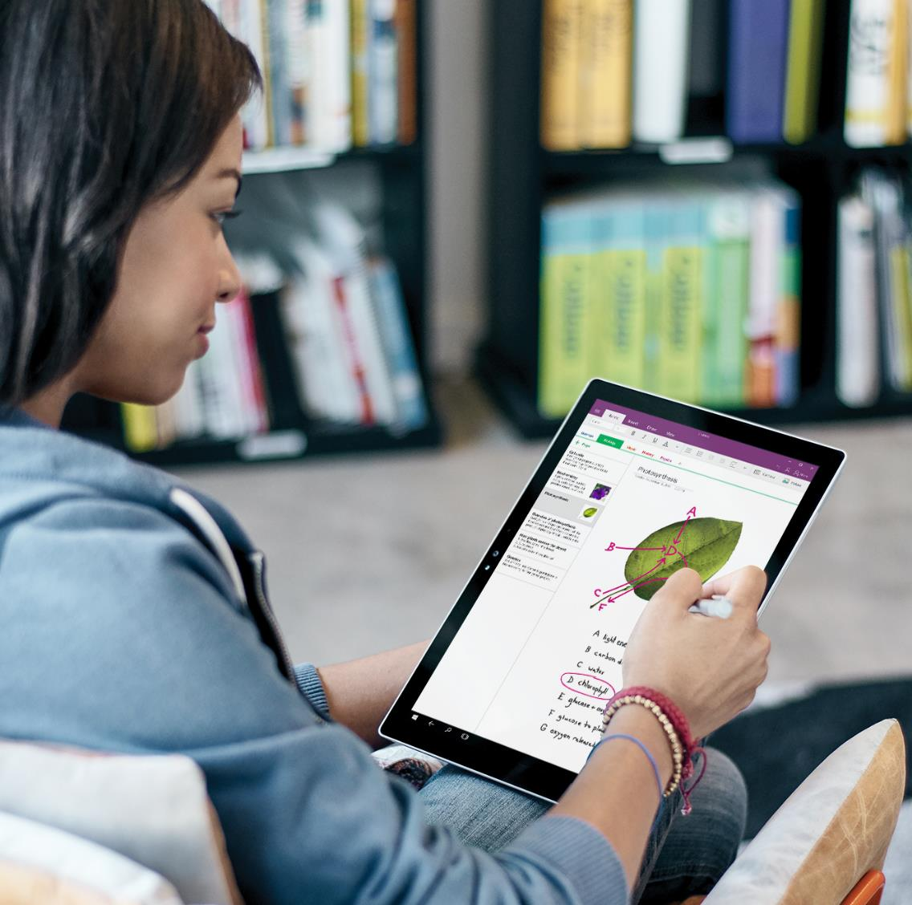
In Summary, Surface…
Maintains student engagement
Empowers them through creativity and collaboration
Flexes to different learning styles
Allows students and teachers to Think in Ink
Reduces educator workload

Slide 39
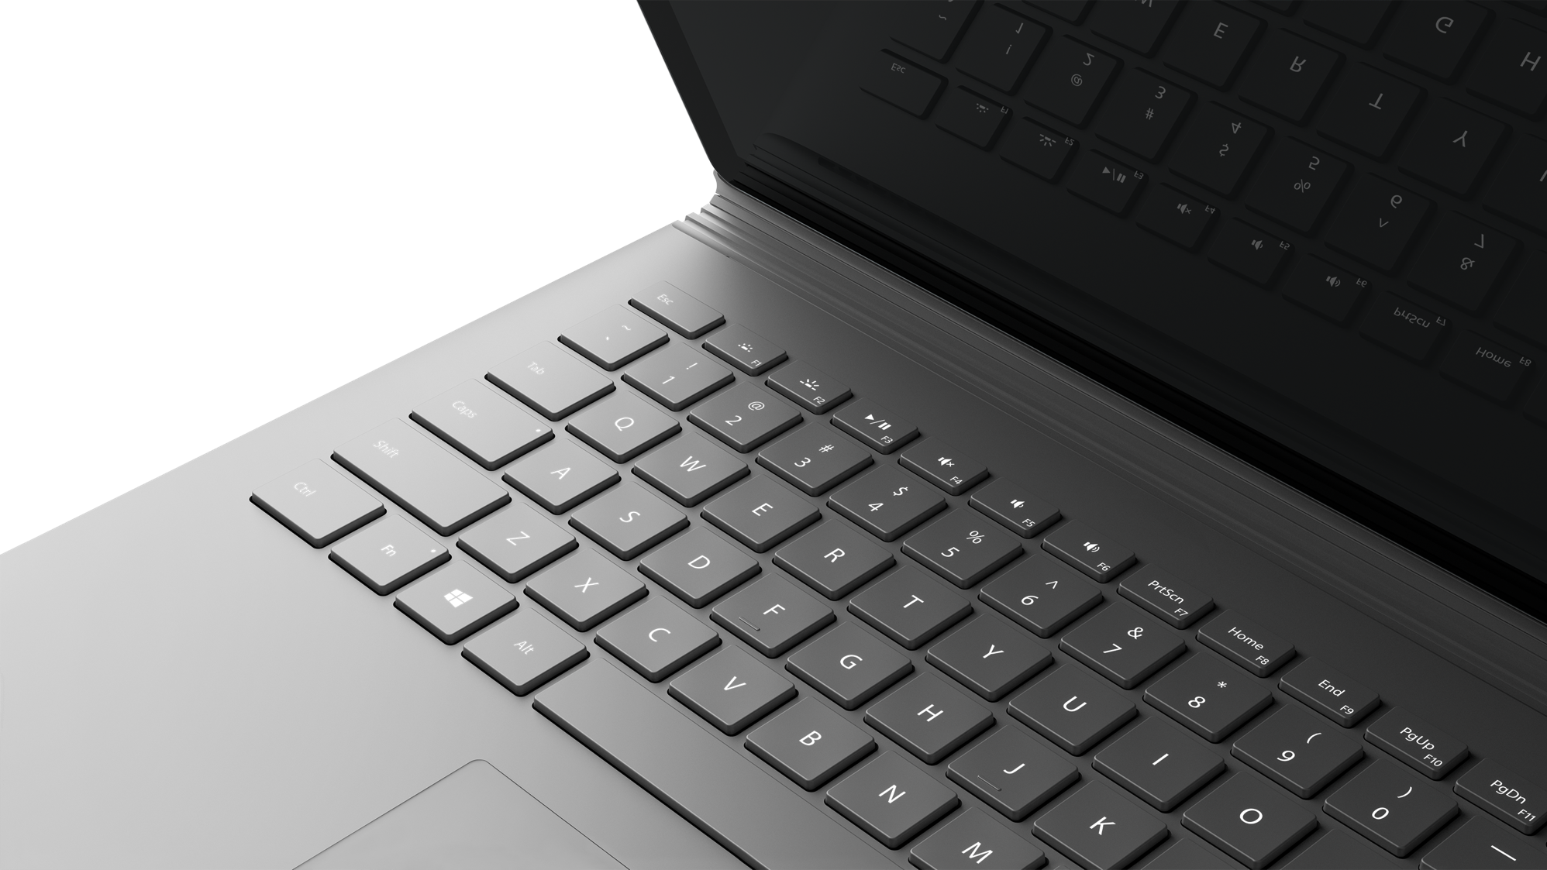
Next Steps

